Slide 1
THE TEXAS CASA
VOLUNTEER TRAINING SESSION 1

Slide 2
Chapter 1: The CASA/GAL Volunteer Role
Pre-Work Recap, Chapter Overview and Competencies
The Volunteer Role
The Child Welfare System
Working a Case
Chapter Wrap-Up: Review and Evaluation
Chapter 2: Pre-Work

Slide 3
Chapter 1:
Pre-Work Summary
Read pages 8-46, the CASA Role through the end of the Bleux Case File, and complete the following:
Complete the Developing Competencies for CASA/GAL Volunteers Assessment.
Write down any questions you have about the Child Welfare History material.
Review the Bleux Case File, and write a brief case summary.

Slide 4
Chapter 1: Chapter Overview and Competencies
Competency Category | Knowledge, Skills and Attributes Development in Chapter 1
CASA/GAL Role | Knows how to define the CASA/GAL volunteer role
 | Understands the function of a CASA/GAL report to the court
 | Understands the knowledge, skills and attributes necessary to succeed as a CASA/GAL volunteer
Foundation of Knowledge | Understands the nature and scope of the roles of others (e.g., caseworkers, attorneys, therapists, etc.)
 | Understands the nature and scope of the child welfare system
 | Knows the importance of the federal laws that impact their advocacy
 | Understands a child’s journey through the child welfare system

Slide 5
Chapter 1:
The CASA/GAL Volunteer Role
Beginning our CASA journey
1B

Slide 6
Chapter 1: The CASA/GAL Volunteer Role
Pre-Work Recap, Chapter Overview and Competencies
The Volunteer Role
The Child Welfare System
Working a Case
Chapter Wrap-Up: Review and Evaluation
Chapter 2: Pre-Work

Slide 7
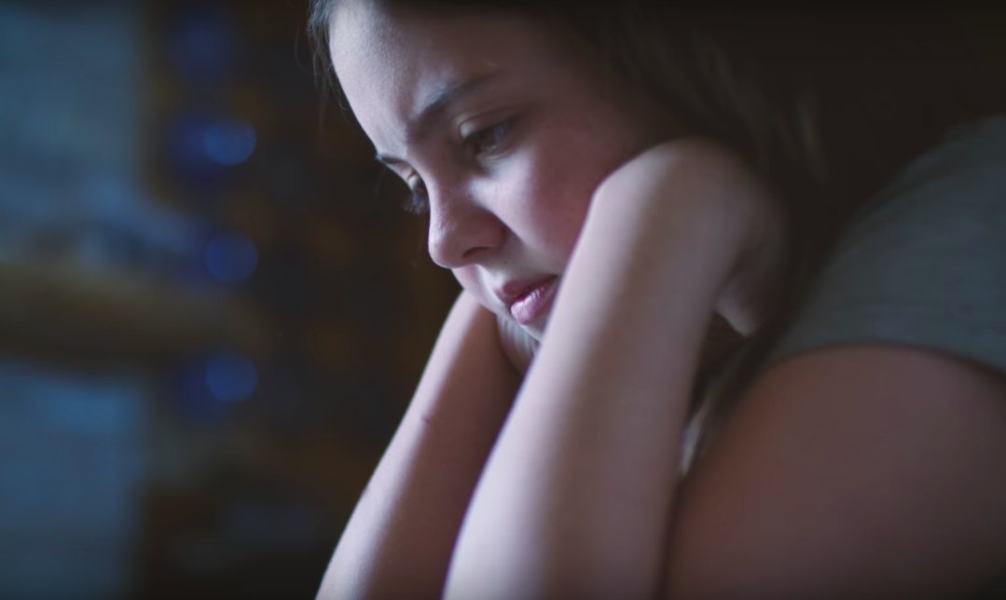
Chapter 1: The CASA/GAL Volunteer Role
Video: Emily’s Dragon

Slide 8
Chapter 1: The National CASA Association
The mission of the National Court Appointed Special Advocate Association, together with its state and local member programs, supports and promotes court-appointed volunteer advocacy so every abused or neglected child in the United States can be safe, have a permanent home and the opportunity to thrive.

Slide 9
Chapter 1: [Your Program’s] Mission
Mission
[Your program’s logo]

Slide 10
Chapter 1: Key Components of the Volunteer Role
Information Gathering
Facilitation
Advocacy
Monitoring

Slide 11
Chapter 1: Impact of CASA/GAL
What do you remember about the Bleux case?

Slide 12
Chapter 1: Impact of CASA/GAL
Bleux Case Investigation Notes
May 19 - Deshawn Bleux, a 2-month-old child who appeared to show symptoms of shaken baby syndrome, is admitted to the hospital. Father took child to the hospital when he could not be woken for his regular 10 p.m. feeding.
May 21 - Child remains in the hospital with an injury more severe than previously thought.

Slide 13
Chapter 1: Impact of CASA/GAL
Bleux Case Investigation Notes
May 23 - Deshawn to be released from the hospital and placed in foster care. Father, Miles Bleux, denies shaking the child.
May 24 - Mother refused to say anything other than she was not home at the time of the incident.

Slide 14
Chapter 1
Break

Slide 15
Chapter 1: Competencies for Volunteer Advocates
1C
Sound Judgment
Foundations of Knowledge
Communication
CASA/GAL Role
Cultural Competence
Initiative
Self-Care

Slide 16
Chapter 1: Competencies for Volunteer Advocates
What is the dilemma?
What are potential consequences?
What is a solution?

Slide 17
Chapter 1: The CASA/GAL Volunteer Role
Pre-Work Recap, Chapter Overview and Competencies
The Volunteer Role
The Child Welfare System
Working a Case
Chapter Wrap-Up: Review and Evaluation
Chapter 2: Pre-Work

Slide 18
Chapter 1: Key Laws
1974
1978
1980
1997
1999
Child Abuse Prevention & Treatment Act
Indian Child Welfare Act
Adoption Assistance and Child Welfare Act
Adoption and Safe Families Act
Foster Care Independence Act

Slide 19
Chapter 1: Introduction to the Child Welfare System
Child Protective Services Process Flowchart

Slide 20
Chapter 1: Who Participates in a Case?
The child
CASA volunteer
CASA supervisor
Attorney for the child
Parents/caretakers
named in the petition
Attorney for the parent/caretaker
DFPS caseworker
Attorney representing DFPS
Judge
Indian child’s tribe (only in ICWA cases)

Slide 21
Chapter 1: The CASA/GAL Volunteer Role
Pre-Work Recap, Chapter Overview and Competencies
The Volunteer Role
The Child Welfare System
Working a Case
Chapter Wrap-Up: Review and Evaluation
Chapter 2: Pre-Work

Slide 22
Chapter 1: Introduction to Reporting in Court
Most essential aspect of your work
How you present information you have gathered
Visible documentation of your involvement in the case
Used by judges to make informed decisions

Slide 23
Chapter 1
Expectations
1B

Slide 24
Chapter 1: Review
In this chapter, you learned about:
How CASA makes a difference.
The CASA volunteer role.
Skills required for the role.
Child welfare laws.
How the child welfare system and court system work together.
The importance of court reports.

Slide 25
Chapter 1: Evaluation
Please fill out the Session 1 Volunteer Training Evaluation and give to the facilitator.

Slide 26
Chapter 2: Pre-Work
Read pages 66-98, “How Children Grow and Develop” through “The Importance of Family Engagement,” and complete the following:
Read the Bleux Case Court Report provided by your facilitator.
Review your program’s policies provided by your facilitator.

