Slide 1
THE TEXAS CASA
VOLUNTEER TRAINING SESSION 2

Slide 2
Chapter 2: The Well-Being of a Child
Pre-Work Recap, Chapter Overview and Competencies
Children’s Needs and Development
Child Abuse and Neglect
Working a Case
Chapter Wrap-Up: Review and Evaluation
Chapter 3: Pre-Work

Slide 3
Chapter 2: Pre-Work
Read pages 66-98, “How Children Grow and Develop” through “The Importance of Family Engagement,” and complete the following:
Read the Bleux Case Court Report provided by your facilitator.
Review your program’s policies provided by your facilitator.

Slide 4
Chapter 2:
Chapter Competencies
Competency Category | Knowledge, Skills and Attributes Development in Chapter 2
Foundations of Knowledge | Understands age-appropriate behavior and development for children
 | Understands a child’s basic needs
 | Understands why the MSL standard is in the best interest of children
 | Understands the cycle of attachment
 | Understands what constitutes abuse and neglect
 | Understands risk factors for child abuse and neglect
 | Understands the benefits and steps to using a strength-based approach
Sound Judgment | Knows how to evaluate what is in the child’s best interest
Communication | Understands the elements of a court report

Slide 5
Chapter 2: The Well-Being of a Child
Pre-Work Recap, Chapter Overview and Competencies
Children’s Needs and Development
Child Abuse and Neglect
Working a Case
Chapter Wrap-Up: Review and Evaluation
Chapter 3: Pre-Work

Slide 6
Chapter 2: Children’s Needs and Development
Children’s Needs
1B

Slide 7
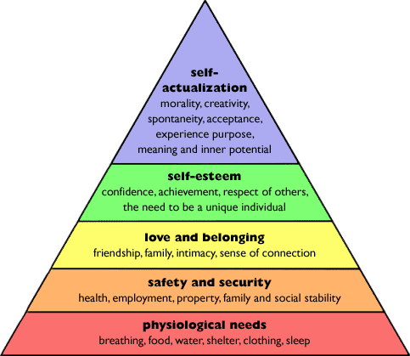
Chapter 2:
Maslow’s Five Categories of Needs

Slide 8
Edward Deci’s Psychological Needs
Chapter 2:
Autonomy
People’s need to perceive that they have choices
Relatedness
People’s need to feel connected to others
Competence
The need to meet everyday challenges with success and growth

Slide 9
Chapter 2: Children’s Needs and Development
Attachment
1B

Slide 10
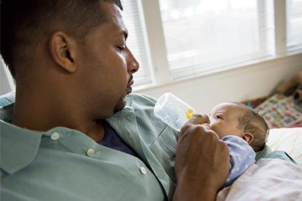
Chapter 2:
The Attachment Cycle
Need
Signals
Discomfort
Security
Trust
Attachment
Signals
Comfort
Satisfaction
of Need

Slide 11
Chapter 2: Children’s Needs and Development
Minimum Sufficient Level (MSL) of Care

Slide 12
Chapter 2:
Minimum Sufficient Level (MSL) of Care
Removing a child from their home is traumatic.
Children should be removed only when parents cannot provide the minimum sufﬁcient level of care.

Slide 13
Chapter 2:
Minimum Sufficient Level (MSL) of Care
Factors to consider:
Physical, emotional and developmental needs are met.
Parent’s behavior complies with accepted child-rearing practices.
Parent’s behavior falls within reasonable limits of the community.

Slide 14
Chapter 2: Children’s Needs and Development
The “Best Interest Principle”
1B

Slide 15
Chapter 2:
The “Best Interest” Principle
The CASA/GAL volunteer is guided by the “best interest” principle when advocating for a child:
Know the child well.
Make fact-based recommendations.
Inform the court of the child’s wishes, but advocate for best interest.

Slide 16
Chapter 2:
A Child’s Needs and the Volunteer’s Role
As a volunteer advocate:
The child’s needs are paramount.
Focus on healthy growth and development.
Consider a child’s age, stage of development and attachment figures.
Your role is to identify and advocate for the child’s unmet needs.

Slide 17
Chapter 2:
The “Best Interest” Principle
Questions to ask yourself
Is the child safe?
Is the child’s unique culture being respected?
What are the special needs of this child?
Is the child’s sense of time being honored?
Is the child receiving the emotional nurturance necessary for healthy brain development?
Can this child speak on their own behalf?
Should the child be present in court?

Slide 18
Chapter 2: The Well-Being of a Child
Pre-Work Recap, Chapter Overview and Competencies
Children’s Needs and Development
Child Abuse and Neglect
Working a Case
Chapter Wrap-Up: Review and Evaluation
Chapter 3: Pre-Work

Slide 19
Chapter 2:
Child Abuse and Neglect
CASA/GAL volunteer can’t determine child abuse or neglect; the court will decide.
CASA/GAL volunteers should recognize signs of abuse and neglect, and advocate for a safe home for a child.
Factors not related to abuse but related to trauma or stress indicate that a child is need of help and support.
Child abuse can be physical, sexual, emotional or neglect.
Physical
Sexual
Emotional
Neglect

Slide 20
Chapter 2:
Risk Factors - Child Abuse and Neglect
Child-related factors
Parent/caretaker-related factors
Social situational factors
Family factors
Triggering situations

Slide 21
Chapter 2:
Family Strengths and Weaknesses
-
Taking a Look at Your Own Family
1B

Slide 22
Chapter 2:
Family Strengths and Weaknesses
Your ability to identify strengths in families depends on which lens you use in your advocacy work:
-
If you see through a deficit lens, you focus on family problems.
+
If you see through a resources lens, you focus on identifying family strengths.

Slide 23
Chapter 2: Family Strengths and Weaknesses
Bleux Case: Meeting the Parents

Slide 24
Chapter 2:
Family Strengths and Weaknesses
The Importance of Family Engagement

Slide 25
Chapter 2: The Well-Being of a Child
Pre-Work Recap, Chapter Overview and Competencies
Children’s Needs and Development
Child Abuse and Neglect
Working a Case
Chapter Wrap-Up: Review and Evaluation
Chapter 3: Pre-Work

Slide 26
Chapter 2: Working a Case
Asking the Right Questions and
Planning Your Next Steps
1B

Slide 27
Chapter 2: Children’s Needs and Development
Key Elements of the CASA/GAL
Volunteer Court Report
1B

Slide 28
Chapter 2:
Key Elements of the Court Report
Child(ren)/Situation
Permanency Plan
Summary of Contacts
Case Summary
Areas of Concern
Recommendations

Slide 29
Chapter 2: The Well-Being of a Child
Pre-Work Recap, Chapter Overview and Competencies
Children’s Needs and Development
Child Abuse and Neglect
Working a Case
Chapter Wrap-Up: Review and Evaluation
Chapter 3: Pre-Work

Slide 30
Chapter 2:
Review: The Well-Being of the Child
In this chapter, you learned about:
Age-appropriate behavior for children.
Children’s basic needs and MSL.
The cycle of attachment and signs of disrupted attachment.
Child abuse and neglect risk factors.
Using a strengths-based approach.
Evaluating what’s in a child’s best interest.
Initial steps to take when working a case.
Key elements of court reports.

Slide 31
Chapter 2: Evaluation
Please fill out the Chapter 2 Volunteer Training Evaluation and give to the facilitator.

Slide 32
Chapter 3:
Pre-Work
Read pages 126-141, Understanding Child Trauma through Initial Case Notes for the Black-Smith Case, and complete the following:
Watch Shane’s Digital Story video
Watch First Impressions: Exposure to Violence and a Child’s Developing Brain video
Watch CASA GAL Sample Interview: 4-Year-Old Child Part 1 video
Complete the assignment Prep for Interviewing a Child

