Slide 1
THE TEXAS CASA
VOLUNTEER TRAINING SESSION 3

Slide 2
Chapter 3: Trauma, Resilience and Communication Skills
Pre-Work Recap, Chapter Overview and Competencies
Trauma and Resilience
Skill Building: Communication and Interviewing
Working a Case
Chapter Wrap-Up: Review and Evaluation
Chapter 4: Pre-Work

Slide 3
Chapter 3: Pre-Work
Read pages 126-141, Understanding Child Trauma through Initial Case Notes for the Black-Smith Case, and complete the following:
Watch “Shane’s Digital Story” video.
Watch “First Impressions: Exposure to Violence and a Child’s Developing Brain” video.
Watch “CASA GAL Sample Interview: 4-Year-Old Child Part 1” video.
Complete the assignment Prep for Interviewing a Child.

Slide 4
Chapter 3: Chapter Overview and Competencies
Competency Category | Knowledge, Skills and Attributes Development in Chapter 3
Foundation of Knowledge | Understands the nature and scope of trauma, and how it affects children
 | Understands possible reactions of children to separation and loss
 | Understands the importance of resilience in overcoming trauma in children
Sound Judgement | Understands making appropriate fact based recommendations to the court
Communication | Knows how to utilize basic communication and interviewing skills
 | Knows strategies for interviewing children

Slide 5
Chapter 3: Trauma, Resilience and Communication Skills
Pre-Work Recap, Chapter Overview and Competencies
Trauma and Resilience
Skill Building: Communication and Interviewing
Working a Case
Chapter Wrap-Up: Review and Evaluation
Chapter 4: Pre-Work

Slide 6
Chapter 3: Preparing to Talk about Trauma
“There was a child went forth every day;
And the first object he look’d upon, that object he became;
And that object became part of him for the day,
Or for many years, or stretching cycles of years.”
- Walt Whitman

Slide 7
Chapter 3: The Feelings Thermometer
Very uncomfortable
Extremely stressed and anxious
Need to get out of here now
VERY HOT
Moderately uncomfortable
Stressed and anxious
Distracted and edgy
HOT
Mildly uncomfortable
Slightly stressed and anxious
Losing my focus
WARM
Comfortable
Not stressed or anxious
Focused and engaged
JUST RIGHT
A little bored
Losing my focus
COOL
Totally bored
Not focused or engaged
Planning my escape
ICE COLD

Slide 8
Chapter 3: Child Trauma
When a child witnesses or experiences an event that poses a threat (real or perceived) to the life or well-being of them or someone close to them:
The event causes feelings of fear, helplessness or horror.
The child is unable to cope with the intense feelings.

Slide 9
Chapter 3: Types of Trauma
Acute
Chronic
Complex
Historical

Slide 10
Chapter 3: Child Trauma
Review Shane’s Story
1B

Slide 11
Chapter 3: Types of Trauma
Treat children as individuals, not victims.
Consider the child’s past experiences.
You may request a trauma screening for the child.
Parents may have unresolved trauma histories.
Parents also may undergo a trauma screening.

Slide 12
Chapter 3: Long Term Effects of Childhood Trauma
Video: Adverse Childhood Experiences
Read the Adverse Childhood Experiences (ACE) Calculator

Slide 13
Chapter 3: Long-Term Effects of Childhood Trauma
Think about the Black-Smith case from your Pre-Work:
What long-term effects might trauma have on Francis’ health and well-being?
Once Tammy’s case closes, will her trauma affect her health and well-being? Why or why not?

Slide 14
Chapter 3: The Separation Experience
Children experience trauma if removed from the home.
Each new placement increases damage to their emotional and psychological health.
When removed from homes, they feel isolated and detached.
For safety, sometimes they must be moved.

Slide 15
Chapter 3: The Separation Experience
The Separation Experience
1B

Slide 16
Chapter 3: Resilience
Resilience – Part 1
1B

Slide 17
Chapter 3: Resilience
Resilience is very individual.
Some children are naturally more resilient than others.
Resilience can be built and enhanced through practice.

Slide 18
Chapter 3: The Seven C’s of Resilience
Competence
Confidence
Connection
Character
Contribution
Coping
Control

Slide 19
Chapter 3: Trauma, Resilience, and Communication Skills
Pre-Work Recap, Chapter Overview and Competencies
Trauma and Resilience
Skill Building: Communication and Interviewing
Working a Case
Chapter Wrap-Up: Review and Evaluation
Chapter 4: Pre-Work

Slide 20
Chapter 3: The Basic Elements of Communication
The Basic Elements of Communication
1B

Slide 21
Chapter 3: Basics of Communication
Effective communication is critical to your ability to advocate for children and requires:
Self-awareness
Sensitivity
Skills

Slide 22
Chapter 3: Basics of Communication (Cont’d.)
Three components of communication:
Verbal component - refers to the actual words spoken
Nonverbal component - refers to gestures, tone of voice, and other unspoken means of conveying a message
Feelings component - refers to the feelings experienced as a result of the communication

Slide 23
Chapter 3: Types of Questions
Open-Ended Questions
Encourage others to engage in a dialogue with you.
Cannot be answered with a simple yes, no or one-word answer.
Close-Ended Questions
Are useful when you are trying to obtain factual information.
Can be answered with a simple yes or no, or with a single word or short phrase

Slide 24
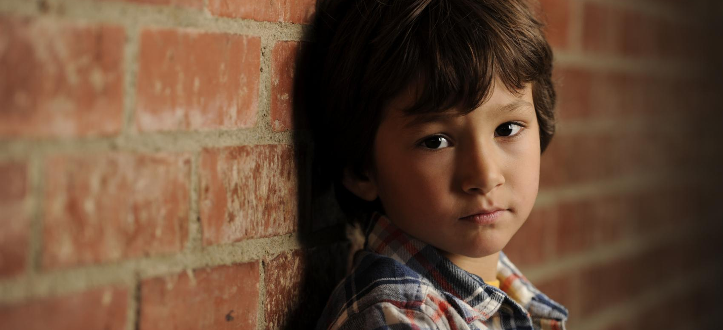
Chapter 3: Turn into an Open-Ended Question for a Child
Do you want to live with your mother or your father?

Slide 25
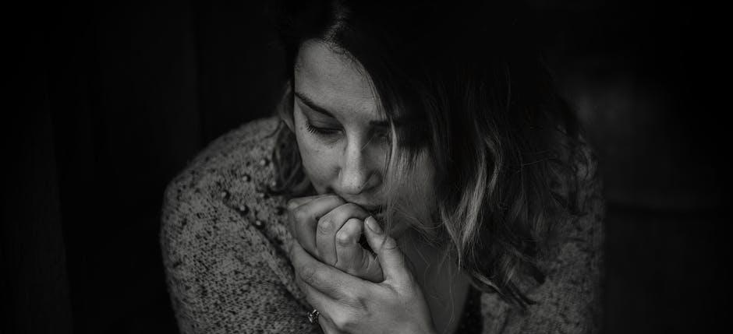
Chapter 3: Turn into an Open-Ended Question for a Parent
You seem unhappy lately. Are you?

Slide 26
Chapter 3: Turn into an Open-Ended Question for a Parent
Do you understand the difference between a CASA/GAL volunteer and a caseworker?

Slide 27
Chapter 3: The CASA/GAL Volunteer Interview
“Interviewing Skills: Talking with a 4-year-old
(Part 2)”

Slide 28
Chapter 3: Working a Case
Pre-Work Recap, Chapter Overview and Competencies
Trauma and Resilience
Skill Building: Communication and Interviewing
Working a Case
Chapter Wrap-Up: Review and Evaluation
Chapter 4: Pre-Work

Slide 29
Chapter 3: The Black-Smith Case
What do you remember about the Black-Smith case?

Slide 30
Chapter 3: The Black-Smith Case
Black-Smith Case
Sept 15: Six-year-old Tammy made a call to 911 due to domestic violence in the home. Police found two children on the scene (Tammy, age 6; Grace, 4 months) and removed the children from the home due to parents being too inebriated to provide a safe home for their children
Sept 22: Tammy and Grace were moved from the emergency foster care placement and placed with licensed foster parents Linda and Dave Gilbert.

Slide 31
Chapter 3: The Black-Smith Case
Sept 25: Due to where the new foster home is located, Tammy moved to a new school. Linda reported this change has been very difficult for Tammy
Sept 29: Following an initial hearing, parents were ordered to receive drug/alcohol screenings, attend any recommended substance abuse treatment programs and provide random urinalysis.
Nov 29: Parents stipulated to adjudication, thereby acknowledging the issues are substance abuse, physical abuse and domestic violence services.

Slide 32
Chapter 3: The Black-Smith Case
Runner
Questioner
Scribe
Moderator

Slide 33
Chapter 3: The Black-Smith Case
It’s time to work the case!

Slide 34
Chapter 3: Effective Recommendations
Recommendations are the result of your work on a case.
When you make written recommendations, you are asking the court to make an order.
The judge will decide whether or not to order the recommendations.
Recommendations should be written clearly and concisely.

Slide 35
Chapter 3: Effective Recommendations (Cont’d.)
Consider the following when your write your recommendations:
Custody and placement of child
Counseling
Parental visitation
Sibling visitations
Random drug screening
Substance abuse assessments
7. Diagnostic assessment
8. Services for parents
9. Educational needs
10. Community resources
11. Any other need the children
or parents may have

Slide 36
Chapter 3: Effective Recommendations (Cont’d.)
Recommendations should:
Cover all the child’s needs.
Not set parents up for failure.
Be supported in the Case Summary.
Include outcome measures.

Slide 37
Chapter 3: Trauma, Resilience, and Communication Skills
Pre-Work Recap, Chapter Overview and Competencies
Trauma and Resilience
Skill Building: Communication and Interviewing
Working a Case
Chapter Wrap-Up: Review and Evaluation
Chapter 4: Pre-Work

Slide 38
Chapter 3: Review: Trauma, Resilience, Communication Skills
In this chapter, you learned about:
Trauma and its effects.
Separation and loss.
The role of resilience.
Communication and interviewing skills.
Open- versus close-ended questions.
Interviewing a child.
Writing effective recommendations.

Slide 39
Chapter 3: Evaluation
Please fill out the Chapter 3 Volunteer Training Evaluation and give to the facilitator.

Slide 40
Chapter 4: Pre-Work
Read pages 152-171, Mental Illness in Families through Initial Case Notes for the Greene Case, and complete the following:
Complete the Examining Poverty vs. Neglect Scenarios Activity.
Play the online game “Spent” to learn more about the challenges of poverty.

