Slide 1
THE TEXAS CASA
VOLUNTEER TRAINING SESSION 4

Slide 2
Chapter 4: Mental Health, Poverty and Confidentiality
Pre-Work Recap, Chapter Overview and Competencies
Mental Health
Poverty
Skill Building: Professional Communication
Working a Case
Chapter Wrap-Up: Review and Evaluation
Chapter 5: Pre-Work

Slide 3
Chapter 4: Pre-Work Recap
Read pages 152-171, Mental Illness in Families through Initial Case Notes for the Greene Case, and complete the following:
Complete the Examining Poverty vs. Neglect Scenarios Activity.
Play the online game “Spent” to learn more about the challenges of poverty.

Slide 4
Chapter 4: Chapter Overview and Competencies
Competency Category | Knowledge, Skills and Attributes Development in Chapter 4
CASA/GAL Role | Understands how to obtain relevant confidential information
Foundation of Knowledge | Understands how mental illness affects families
 | Understands strategies to advocate for children and adolescents with mental health disorders
 | Understands how poverty can impact families and children
Sound Judgment | Understands the confidentiality requirements of being a CASA/GAL volunteer

Slide 5
Chapter 4: Mental Health, Poverty and Confidentiality
Pre-Work Recap, Chapter Overview and Competencies
Mental Health
Poverty
Skill Building: Professional Communication
Working a Case
Chapter Wrap-Up: Review and Evaluation
Chapter 5: Pre-Work

Slide 6
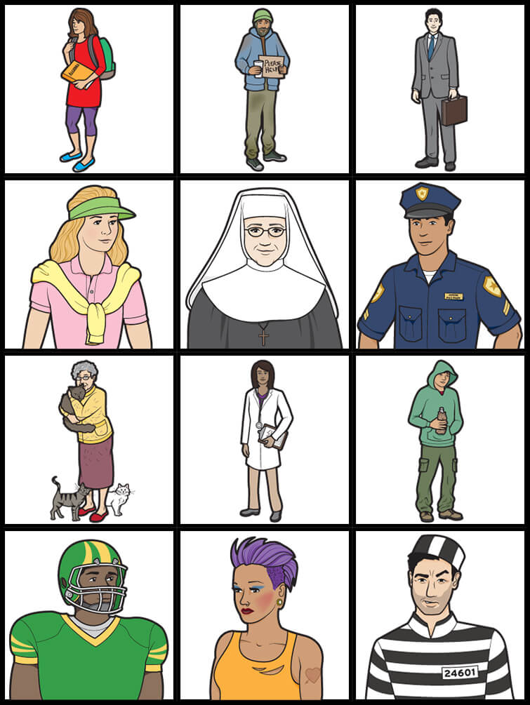
Chapter 4: Mental Illness
Which of the people below might be living with a mental illness?

Slide 7
Chapter 4: Mental Illness in Families
A mental illness is a condition that impacts a person’s thinking, feeling or mood, and may affect their ability to relate to others and function on a daily basis. Each person will have different experiences, even people with the same diagnosis.
The National Alliance on Mental Illness

Slide 8
Chapter 4: Causes of Mental Illness
Multiple causes, such as genetics, biology, environment & life stressors
Not caused by personal weakness or a character defect
Affects the whole person

Slide 9
Chapter 4: Impact on Children
Children of a parent with mental illness may experience:

Slide 10
Chapter 4: Impact on Children
Children of a parent with mental illness may experience:
Inappropriate levels of responsibility.
Self-blame.
Anger, anxiety or guilt.
Embarrassment, shame or isolation.
School-related problems, drug use and poor social relationships.
Mood disorders, alcoholism and personality disorders.

Slide 11
Chapter 4: Mental Illness in Families
As a CASA/GAL volunteer:
It is not your task to diagnose mental illness.
Focus less on a parent’s diagnosis and more on their ability to meet MSL.
Be aware of indicators that may point to the need for professional assessment.

Slide 12
Chapter 4: Mental Illness in Families
Some possible indicators of mental health issues:
Social withdrawal
Hopelessness
Disruptive thoughts
Expression of feeling disproportionate to the circumstances
Behavior changes

Slide 13
Chapter 4: Understanding Mental Illness
The Greene Case
1B

Slide 14
Chapter 4: Mental Health for Children in Care
Without adequate understanding of mental health, medications can harm children.
When emotional trauma is the cause, both therapy and medication may be considered.
Medications can be part of a successful intervention and treatment plan to treat mental illness.

Slide 15
Chapter 4: Multimodal Approach to Mental Health
Medication treatment or psychopharmacology
Behavioral or talk therapy
Trauma-informed therapy
Play therapy
Family therapy
Alternative therapies

Slide 16
Chapter 4: Medications and Mental Health
Questions advocates should ask a prescribing doctor

Slide 17
Chapter 4: Mental Health, Poverty and Confidentiality
Pre-Work Recap, Chapter Overview and Competencies
Mental Health
Poverty
Skill Building: Professional Communication
Working a Case
Chapter Wrap-Up: Review and Evaluation
Chapter 5: Pre-Work

Slide 18
Chapter 4: Poverty
The majority of children you will encounter as a CASA/GAL volunteer will be living at or below the poverty level.
Developing a better understanding of the realities of poverty will assist you in being a better advocate.

Slide 19
Chapter 4: Poverty Questions
What is the minimum wage?
What are the current poverty guidelines for a family of four?
What percent of people of color fall within the poverty guidelines?
What percent of the white population falls within the poverty guidelines?

Slide 20
Chapter 4: Higher Rate of Poverty in the System
Why are children who are impoverished more likely to be in the system?
Poverty causes great stress in families.
Families who turn to community resources for help are more likely to be reported due to mandatory reporting laws.
Poverty itself is a major risk factor of abuse.

Slide 21
Chapter 4: Higher Rate of Poverty in the System
Discuss:
What effect might living in poverty have on access to health care, education and day care?
What effect does current poverty have on future poverty?
Are the experiences of families of color who are impoverished different from those of white families who are impoverished? Are race and income level interconnected?

Slide 22
Chapter 4: Risk Factors of Poverty
Children who are impoverished face a greater risk of impaired brain development due to exposure to a number of other risk factors including but not limited to:
Inadequate nutrition
Parental substance abuse
Maternal depression
Exposure to unsafe environments
Low-quality day care

Slide 23
Chapter 4: Poverty vs. Neglect
Are the following safety issues?
A family does not have a refrigerator.
A family lives in a rental unit with holes in the floor.
A family lives in a car.
A family does not have a regular pediatrician.
A family does not have electricity.
A family does not have money to buy the mother’s antidepressant medication.
A family does not have a crib for their infant.
A family has one parent who uses drugs.

Slide 24
Chapter 4: Poverty vs. Neglect
What keeps a family from asking for help?
Culture
Language or literacy barriers
Immigration issues
Child’s age
Thinking a problem is only temporary
Pride
Embarrassment or shame

Slide 25
Chapter 4: Mental Health, Poverty and Professional Communication
Pre-Work Recap, Chapter Overview and Competencies
Mental Health
Poverty
Skill Building: Professional Communication
Working a Case
Chapter Wrap-Up: Review and Evaluation
Chapter 5: Pre-Work

Slide 26
Chapter 4: Obtaining Confidential Case Records
As a court-appointed advocate, you have access to the child’s records.
To obtain the parents’ records, you need a release of information signed by the parent.
Follow your program’s direction on how best to access Child Protective Services documents, school records and other information.

Slide 27
Chapter 4: Confidentiality Flowchart
Is it in the child’s best interest to share this information?
NO
Do not share the information. Contact CASA program staff.
NO
YES
Resist sharing the information. Is the person legally entitled to it?
Is it my information to share?
YES
Contact CASA program staff.
NO
Direct the person asking to the original source.
YES
Is the person legally entitled to the information?
NO
YES
Tell the person that he or she will need to obtain a court order.
Share the information.

Slide 28
Chapter 4: Timely, Effective Communication
The family court system functions on strict timelines to place a child in a safe, permanent home.
Successful completion of a case plan is at times difficult for parents, especially with drug and mental health issues.
As a CASA/GAL volunteer, you have to speak with various people on a case, with different mandates and rules.
As a CASA/GAL volunteer, you should be a facilitator of communication between involved parties and workers.
Open, respectful communication among all involved is critical to serving the child’s best interests.

Slide 29
Chapter 4: Effective Communication
Effective Communication with
Professionals on a Case
1B

Slide 30
Chapter 4: Mental Health, Poverty and Professional Communication
Pre-Work Recap, Chapter Overview and Competencies
Mental Health
Poverty
Skill Building: Professional Communication
Working a Case
Chapter Wrap-Up: Review and Evaluation
Chapter 5: Pre-Work

Slide 31
Chapter 4: The Greene Case
The Greene Case
The Greene Case

Slide 32
Chapter 4: The Greene Case
Two weeks ago: A call was made to the CPS hotline by Parkside Elementary stating that Marky Greene often comes to school with poor hygiene. Much of his clothing is not his size, and he has his third case of head lice in three months.
This CPS social worker (SW) interviewed child’s parents, Judy and Roy Greene. The family is Caucasian, and the parents are in their late twenties. Per medical records, the mother has been diagnosed with bipolar disorder. The Greene family moved here from a few states away, and have no extended family living nearby.

Slide 33
Chapter 4: The Greene Case
SW found conditions in the home deplorable but not dangerous. CPS decided to ﬁle a petition for neglect but to allow the child to remain at home for the time being.
Adjudication and disposition hearings were held the same day. Both parents attended. It was determined that the child’s placement will continue in their home until three-month review hearing. Parents were ordered to cooperate with CPS treatment plan. Judge admonished them to work hard and pointed out that Marky was still under court’s jurisdiction. He ordered CPS to not hesitate to take physical custody, should conditions in the home or family deteriorate.

Slide 34
Chapter 4: The Greene Case
Runner
Questioner
Scribe
Moderator

Slide 35
Chapter 4: The Greene Case
It’s time to work the case!

Slide 36
Chapter 4: Working a Case
Taking Case Notes
1B

Slide 37
Chapter 4: Mental Health, Poverty and Professional Communication
Pre-Work Recap, Chapter Overview and Competencies
Mental Health
Poverty
Skill Building: Professional Communication
Chapter Wrap-Up: Review and Evaluation
Chapter 5: Pre-Work
Working a Case

Slide 38
Chapter 4: Mental Health, Poverty and Professional Communication
In this chapter, you learned about:
Effects of mental illness.
Medication risks for children.
Poverty as a risk factor for abuse or neglect.
Poverty versus neglect.
Obtaining confidential information.
Professional effective communication.
Taking good case notes.

Slide 39
Chapter 4: Evaluation
Please fill out the Chapter 4 Volunteer Training Evaluation and give to the facilitator.

Slide 40
Chapter 5: Pre-Work
Read pages 176–191, “What is Substance Abuse?” through “Initial Case Notes for the Bass Case.”

