Slide 1
THE TEXAS CASA
VOLUNTEER TRAINING SESSION 5

Slide 2
Chapter 5: Substance Abuse, Diversity and Disproportionality
Pre-Work Recap, Chapter Overview and Competencies
Substance Abuse
Skill Building: Cultural Competence
Working a Case
Chapter Wrap-Up: Review and Evaluation
Chapter 6: Pre-Work

Slide 3
Chapter 5: Pre-Work Recap
Read pages 176-191, What is Substance Abuse? through Initial Case Notes for the Bass Case.

Slide 4
Chapter 5: Competencies
Competency Category | Knowledge, Skills and Attributes Development in Chapter 5
Foundation of Knowledge | Understands the ways substance abuse can affect children and families
 | Knows the importance of being aware of resources in the community that assist with substance abuse
Cultural Competency | Knows strategies and steps to increase cultural competency skills and demonstrate culturally competent child advocacy
 | Understands the root causes of disproportionate representation of children of color in the child welfare system and the disparate outcomes children of color experience
Communication | Understands the importance of speaking and writing clearly and concisely

Slide 5
Chapter 5: Substance Abuse and Cultural Competence
Pre-Work Recap, Chapter Overview and Competencies
Substance Abuse
Skill Building: Cultural Competence
Working a Case
Chapter Wrap-Up: Review and Evaluation
Chapter 6: Pre-Work

Slide 6
Chapter 5: Substance Abuse
Understanding Substance Abuse

Slide 7
Chapter 5: Substance Abuse and Cultural Competence
Substance Abuse and Parenting

Slide 8
Chapter 5: Effects of Substance Abuse on Parenting
Video: Saving Kids
What are the challenges of advocating for a family with parental substance abuse?

Slide 9
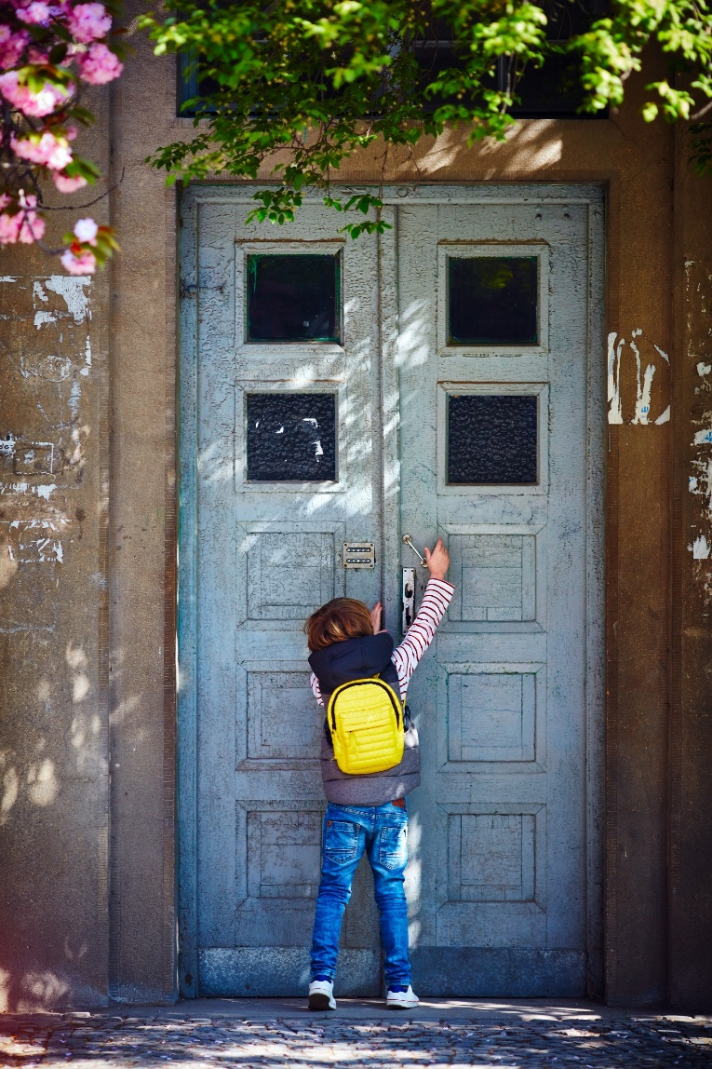
Chapter 5: Can the Child Return Home?
Key points to consider:
The parent’s ability to function in a caregiving role
The child’s health, development and age
Parental history of substance abuse and treatment
Safety of the home
Family supports
Available treatment resources
Treatment prognosis and/or length of sobriety

Slide 10
Chapter 5: Finding a Balance – Shannon’s Story
Shannon was removed from her mother Caterina’s custody for drunken driving, when 1 year old.
Shannon was placed in foster care with Natalia and Marie for 16 months.
Caterina successfully completed treatment for alcohol abuse.
Natalia and Marie supported her, helped to furnish an apartment and facilitated church visits.

Slide 11
Chapter 5: Finding a Balance – Shannon’s Story
Shannon was returned to her mother when 28 months old.
After a little more than a year, Caterina relapsed and was transported to the emergency room.
Shannon was placed back with Natalia and Marie.
Caterina completed her treatment successfully again.
Should Shannon return to Caterina, or should Caterina’s parental rights be terminated so that Natalia and Marie can adopt the child?

Slide 12
Chapter 5: Substance Abuse, Diversity and Disproportionality
Pre-Work Recap, Chapter Overview and Competencies
Substance Abuse
Skill Building: Cultural Competence
Working a Case
Chapter Wrap-Up: Review and Evaluation
Chapter 6: Pre-Work

Slide 13
Chapter 5: What Is Culture?
Culture is a learned pattern of customs, beliefs and behaviors, socially acquired and socially transmitted through symbols and widely shared meanings.
Through culture, people and groups define themselves, conform to society's shared values, and contribute to society.

Slide 14
Chapter 5: Diversity and Cultural Competence
Diversity means differences or variety in people’s identities or experiences, such as ethnicity, race, national origin, language, gender, gender identity, religion, ability, sexual orientation and socioeconomic class.
Cultural competence means the ability to work effectively with people from a broad range of backgrounds, experiences and viewpoints.

Slide 15
Chapter 5: Culture Is Like an Iceberg

Slide 16
Chapter 5: Skill Building: Cultural Competence
The Value of Diversity

Slide 17
Chapter 5: Disproportionality
Disproportionality is the overrepresentation or underrepresentation of various groups in different social, political or economic institutions.

Slide 18
Chapter 5: Disproportionality in Child Welfare
There are no proven differences among races in the likelihood that a parent will abuse or neglect a child.
There is a great difference among races in the likelihood that a child will be removed from home.
African American, American Indian and Native Alaskan children, and children of two or more races are overrepresented in the system nationwide.
Latino children are overrepresented in the Texas child welfare system.

Slide 19
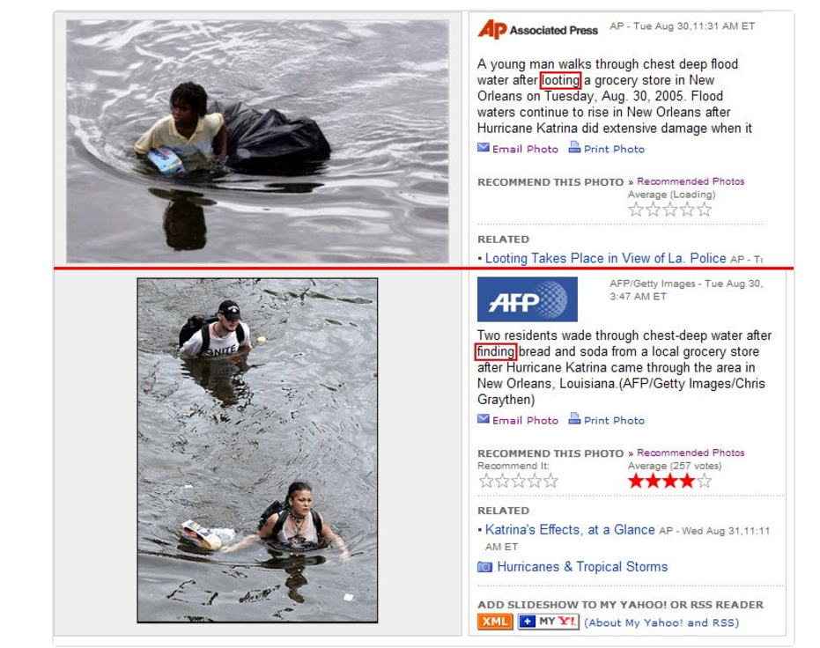
Chapter 5: Disproportionality and Disparate Outcomes
A young man walks through chest-deep flood water after looting a grocery store in New Orleans…
Two residents wade through chest-deep water after finding bread and soda from a local grocery store after Hurricane Katrina…

Slide 20
Chapter 5: Substance Abuse, Diversity and Disproportionality
Pre-Work Recap, Chapter Overview and Competencies
Substance Abuse
Skill Building: Cultural Competence
Working a Case
Chapter Wrap-Up: Review and Evaluation
Chapter 6: Pre-Work

Slide 21
Chapter 5: The Bass Case
What do you remember about the Bass case?

Slide 22
Chapter 5: The Bass Case
Three weeks ago, Lavender Bass, age 6, came into care following a complaint.
The CPS investigator located the mother and child behind the bar where mother is employed.
Mother, Susan Mailer, was passed out drunk and sleeping in her car.
Lavender was sitting in the shade of a nearby tree waiting for her mom to wake up and take her home.
The police were called and the mother arrested for public drunkenness.

Slide 23
Chapter 5: The Bass Case
Lavender was placed in foster care with Bonnie Matthews.
Susan Mailer’s criminal record reflected a tendency toward violence.
She has been in a couple of physical fights in the bar where she’s employed.
She has also been arrested for dealing marijuana and was once found using inhalants.

Slide 24
Chapter 5: The Bass Case
It’s time to work the case!

Slide 25
Chapter 5: Working a Case
Writing Effective Court Reports
1B

Slide 26
Chapter 5: Writing Effective Court Reports
Consider the sample Case Summaries in your Volunteer Manual:
Which statements are based on opinions?
Which statements are based on facts?
What’s missing from each example?
What could be improved in each example?
Example #1: John Bass
Example #2: Lavender Bass
Example #3: Susan Mailer

Slide 27
Chapter 5: Substance Abuse, Diversity and Disproportionality
Pre-Work Recap, Chapter Overview and Competencies
Substance Abuse
Skill Building: Cultural Competence
Working a Case
Chapter Wrap-Up: Review and Evaluation
Chapter 6: Pre-Work

Slide 28
Chapter 5: Substance Abuse, Diversity and Disproportionality
In this chapter, you learned about:
The cause and effect of substance abuse.
Substance abuse resources.
How culture affects your work.
How cultural competence benefits children and families.
Causes of disproportionality.
Writing effective court reports.

Slide 29
Chapter 5: Evaluation
Please fill out the Chapter 5 Volunteer Training Evaluation and give it to the facilitator.

Slide 30
Chapter 6: Pre-Work
Read pages 200-217, Understanding Domestic Violence through Initial Case Notes for the Amarillo Case, and complete the following:
Write down any questions you have after reading the Understanding Domestic Violence section.
Complete the Sorting People Online Activity.
Complete the Exploring Culture and Perceptions Activity.
Complete the Culturally Competent Child Advocacy Activity.

