Slide 1
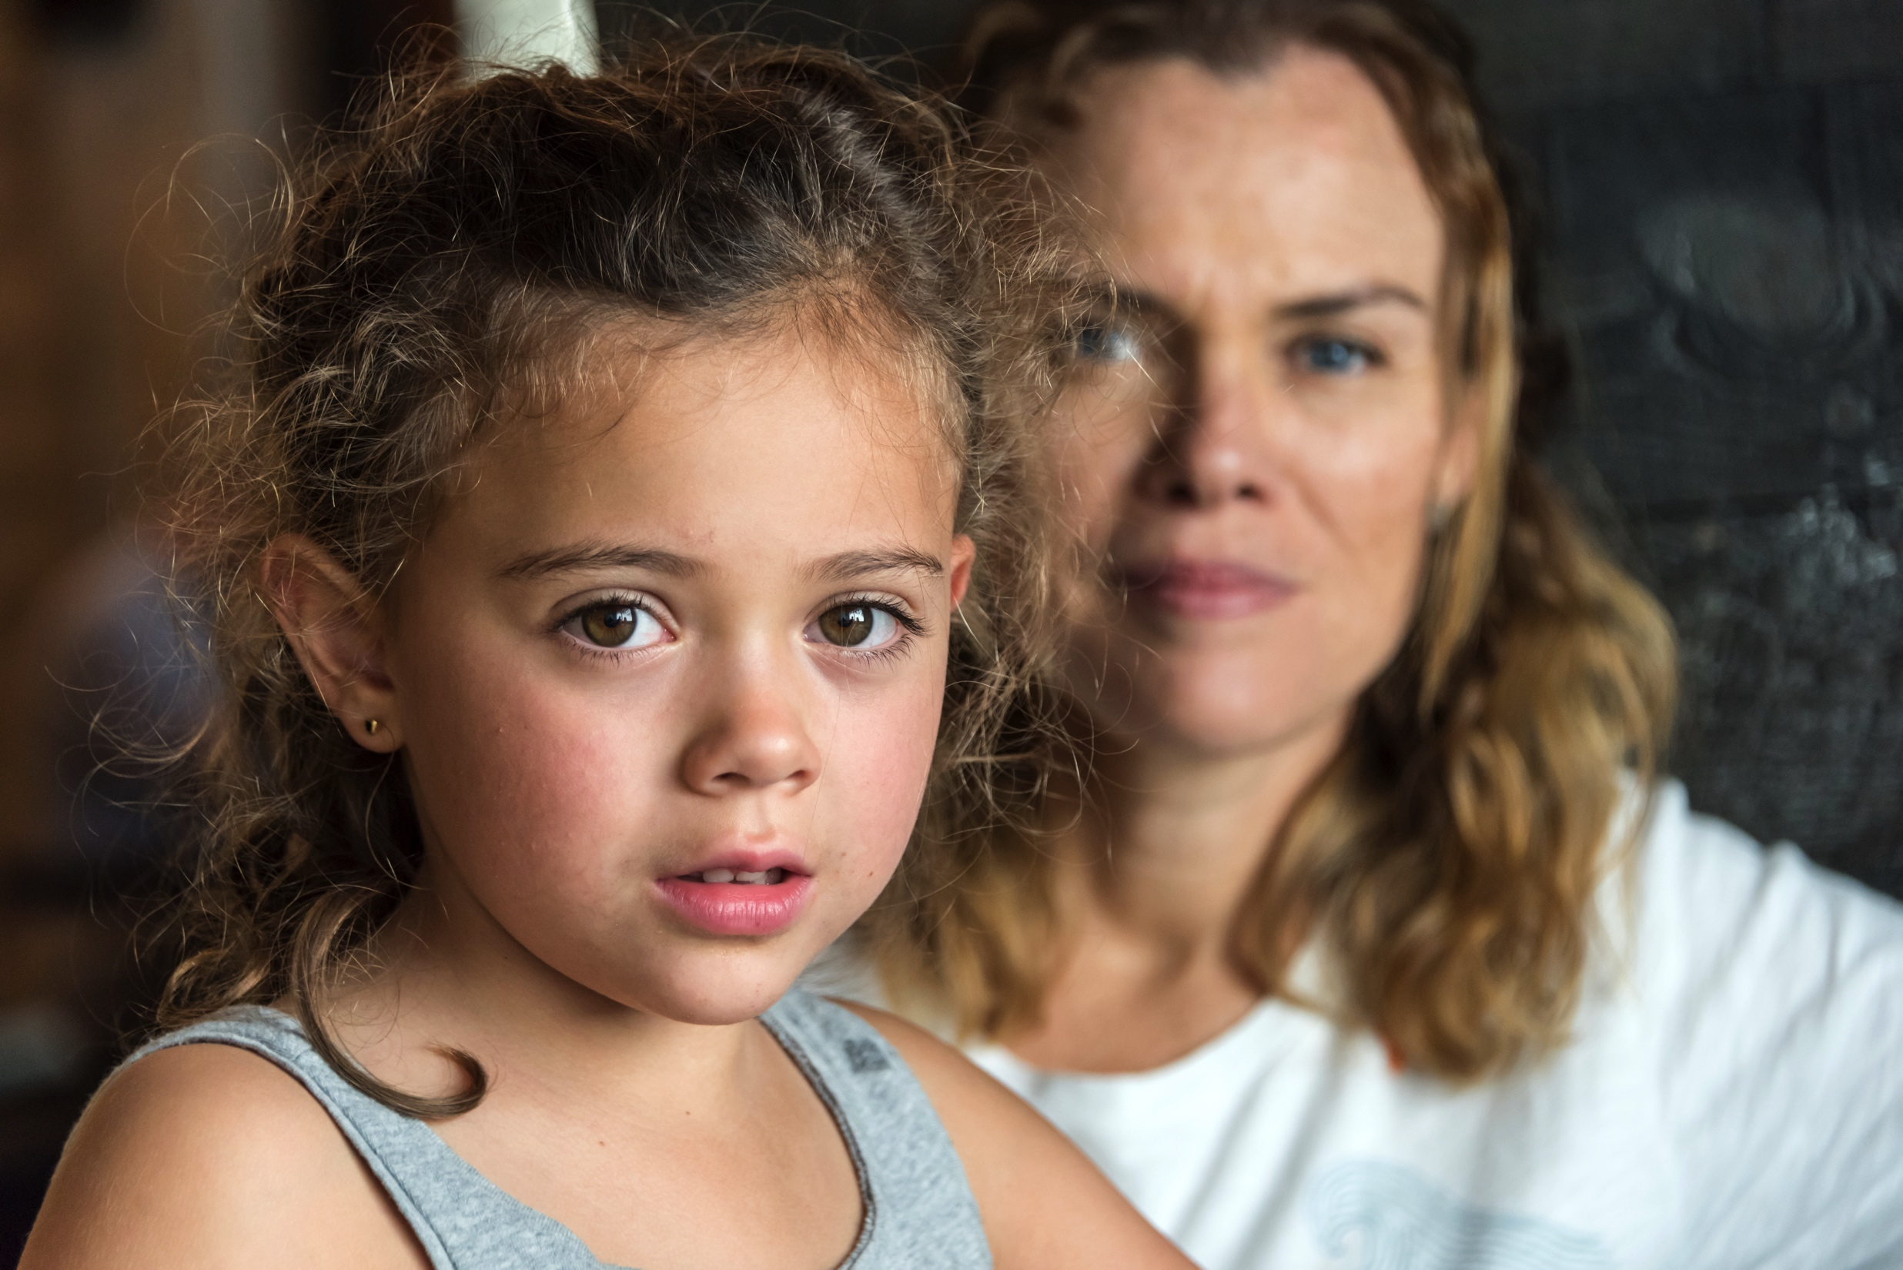

THE TEXAS CASA
VOLUNTEER TRAINING SESSION 6

Slide 2
Chapter 6:
Domestic Violence, Bias and Cultural Competence
Pre-Work Recap, Chapter Overview and Competencies
Domestic Violence
Skill Building: Cultural Competence
Working a Case
Chapter Wrap-Up: Review and Evaluation
Chapter 7: Pre-Work

Slide 3
Chapter 6:
Pre-Work Recap
Read pages 200-217, Understanding Domestic Violence through Initial Case Notes for the Amarillo Case, and complete the following:
Write down any questions you have after reading the Understanding Domestic Violence section.
Complete the Sorting People Online Activity.
Complete the Exploring Culture and Perceptions Activity.
Complete the Culturally Competent Child Advocacy Activity.

Slide 4
Chapter 6:
Competencies
Competency Category | Knowledge, Skills and Attributes Development in Chapter 6
Cultural Competency | Understands and demonstrates self-awareness to eliminate the influence of personal biases and values when working with diverse groups
 | Knows strategies and steps to take to increase cultural competency skills and demonstrate culturally competent child advocacy
 | Understands how to recognize and challenge own biases
Foundation of Knowledge | Understands how domestic violence affects children and families
 | Knows the importance of being aware of resources in the community that assist with substance abuse
Communication | Understands the importance of speaking and writing clearly and concisely
 | Knows how to utilize basic communication and interviewing skills

Slide 5
Chapter 6:
Domestic Violence and Cultural Competence
Pre-Work Recap, Chapter Overview and Competencies
Domestic Violence
Skill Building: Cultural Competence
Working a Case
Chapter Wrap-Up: Review and Evaluation
Chapter 7: Pre-Work

Slide 6
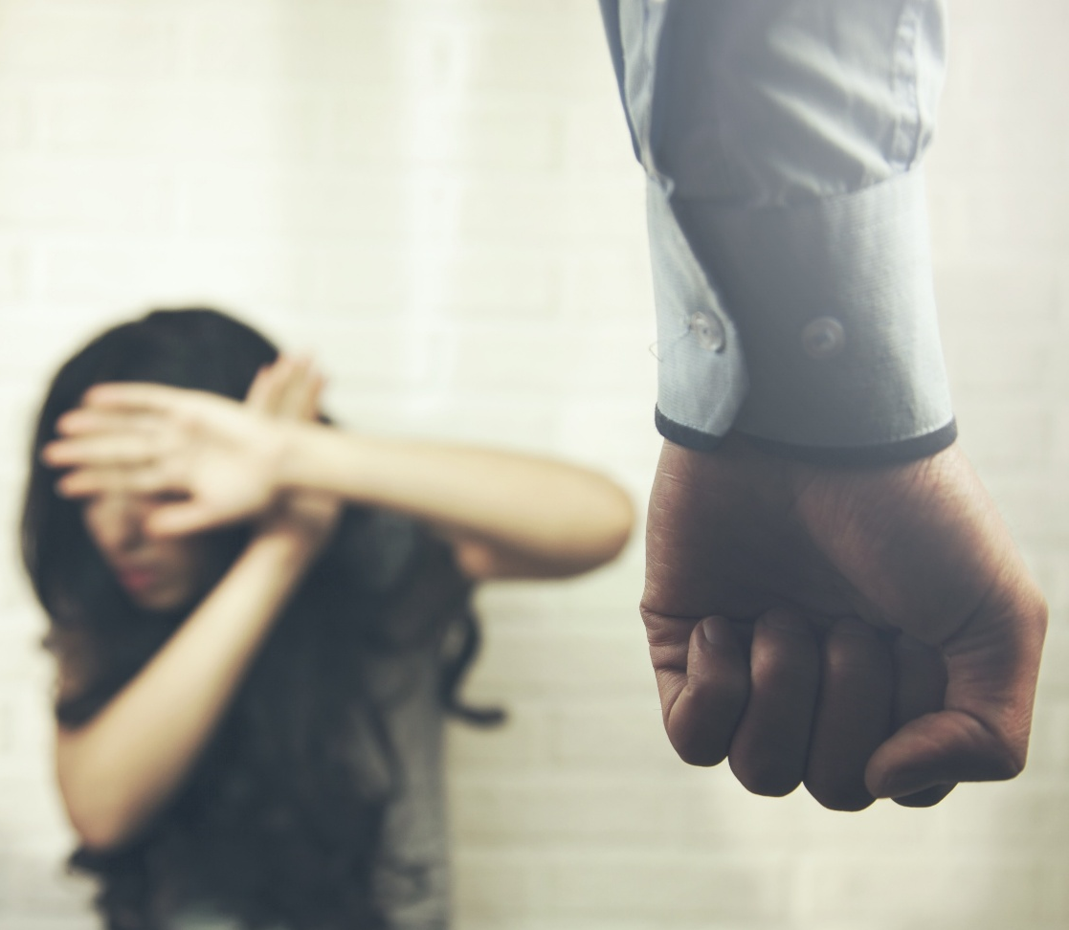
Chapter 6:
Domestic Violence
Domestic violence is physical violence, sexual violence, stalking and psychological aggression committed by a current or former intimate partner.
Center for Disease Control and Prevention
Notes:
Activity 6A Part 1

Slide 7
Chapter 6:
Domestic Violence Case
Video: Why We Stayed
Notes:
Activity 6A Part 1

Slide 8
Chapter 6:
Domestic Violence Case
  Discussing the “Why We Stayed” video:
  What was going through your mind while you watched the video?
  How do you think hearing these stories might influence your advocacy?
  Was there a “why I stayed” reason that surprised you or spoke to you?
  Which reasons were not covered?
Notes:
Activity 6A part 2?

Slide 9
Chapter 6:
Impact of Domestic Violence
Video: Lisa’s 911 Call
Notes:
Activity 6B, part 1

Slide 10
Chapter 6:
Impact of Domestic Violence
  Recapping “Lisa’s 911 Call”:
  What were your impressions of Lisa?
  What were your impressions of her mother?
  What were your impressions of her step-father?
Notes:
Activity 6A part 2?

Slide 11
Chapter 6:
Domestic Violence
As a CASA/GAL volunteer, you should:
  Be knowledgeable and concerned about domestic violence.
  Take into account the history and severity of family violence when making placement recommendations.
  Determine the best interest of the child.
  Seek resources for children from violent homes.
  Recommend help for parents.

Slide 12
Chapter 6:
Challenges
What Challenges You?
1B
Notes:
Activity 6C, Part 2 –

Slide 13
Chapter 6:
Domestic Violence and Cultural Competence
Pre-Work Recap, Chapter Overview and Competencies
Domestic Violence
Skill Building: Cultural Competence
Working a Case
Chapter Wrap-Up: Review and Evaluation
Chapter 7: Pre-Work

Slide 14

Chapter 6:
Culture and Perceptions
As a CASA/GAL volunteer:
  Understand the discomfort that families often feel disclosing specific personal information such as race, family form, ethnicity, gender identity, geographic identity, age, sexual orientation, religion or spirituality, language, disabilities, socioeconomic status and immigration status.
  Work to build rapport and help families feel comfortable sharing important information.

Slide 15
Chapter 6:
Skill Building: Cultural Competence
Culturally Competent Child Advocacy
1B
Notes:
Activity 6E

Slide 16
Chapter 6:
Stereotypes
Are rigid and inflexible.
Hold even when presented with evidence contrary to the stereotype.
Limit people’s potential, perpetuate myths and are gross generalizations about a particular group.
Stereotypes…
Notes:
Debrief slides for activity 6E

Slide 17
Chapter 6:
Cultural Competence
Cultural competence is an ongoing process of recognizing and overcoming biases by thinking flexibly and finding credible sources of information about those who are different from you.
Being aware of and respecting differences allows you to practice culturally competent child advocacy.
Notes:
Debrief slides for Activity 6e

Slide 18
Chapter 6:
Increasing Cultural Competence
To increase your cultural competence, you can use the resources in your community:
Local library
Museums
A university in your community
The internet
Community agencies
Communities of faith

Slide 19
Chapter 6:
Domestic Violence and Cultural Competence
Pre-Work Recap, Chapter Overview and Competencies
Domestic Violence
Skill Building: Cultural Competence
Working a Case
Chapter Wrap-Up: Review and Evaluation
Chapter 7: Pre-Work

Slide 20
Chapter 6:
The Amarillo Case
What do you remember about the Amarillo case?
Notes:
Activity 6G

Slide 21
Chapter 6:
The Amarillo Case
July 3 (three years ago):
Neighbor called police as a result of “loud shouting” in the home of Jose and Myrian Amarillo.
Police found the parents too inebriated to provide a safe home for children.
Mother had bruises and bleeding as a result of abuse from her husband.
The three children Maria,13; Joanna, 3; and Graciela, 1, were first placed together in emergency foster care and then in separate homes.
Notes:
Activity 6G

Slide 22
Chapter 6:
The Amarillo Case
September 17 (three years ago):
Parents were advised to attend a substance abuse treatment program.
Mr. Amarillo was ordered to attend domestic violence program. Mrs. Amarillo was ordered to attend domestic violence survivors program.
Joanna was placed in the same foster home placement as Graciela.
Maria remained in group home placement.

Slide 23
Chapter 6:
The Amarillo Case
May 3 (two years ago):
Joanna and Graciela Amarillo have been placed in a new foster setting.
Foster family was willing to serve as a placement for Maria Amarillo.
Maria Amarillo had many episodes of running away from the foster families in which she was placed.
Maria Amarillo has been placed into a transitional housing center for teenage girls.
The department has filed a petition to terminate parental rights as parents did not comply with court-ordered services.

Slide 24
Chapter 6:
The Amarillo Case
August 9 (two years ago): Parental rights were terminated.
September 26 (two years ago): Maria Amarillo was placed in the same foster home as her younger siblings.
What are your recommendations for this case as a CASA/GAL volunteer?
Services for the child
Services for the parent
Placement decisions

Slide 25




Chapter 6:
The Amarillo Case
Runner
Questioner
Scribe
Moderator

Slide 26

Chapter 6:
The Amarillo Case
It’s time to work the case!

Slide 27
Chapter 6:
Amarillo Case
Summarizing the Current Status of a Case
1B

Slide 28
Chapter 6:
Domestic Violence and Cultural Competence
Pre-Work Recap, Chapter Overview and Competencies
Domestic Violence
Skill Building: Cultural Competence
Working a Case
Chapter Wrap-Up: Review and Evaluation
Chapter 7: Pre-Work

Slide 29
Chapter 6:
Domestic Violence and Cultural Competence
In this chapter, you learned about:
  Domestic violence and how it affects children and families.
  Domestic violence resources.
  How your personal values and biases can affect your objectivity.
  How cultural competence can improve your advocacy.
  Steps to increase your cultural competency skills.
  Your culture’s effects on your values, attitudes and behaviors.
  How to write a case summary about a child.

Slide 30
Chapter 6:
Evaluation
Please fill out the Chapter 6 Volunteer Training Evaluation and give to the facilitator.

Slide 31
Chapter 7:
Pre-Work
Read pages 226-260, Statistics on Youth Aging Out of Foster Care through Initial Case Notes for the Brown Case, and complete the following:
Watch the “In Brief: How Resilience Is Built” video and think about relationships you had as a youth that helped you build resilience.
Listen to the “Childhood Reflections” audio clip.
Complete the Questions Based on K–12 Experiences activity.

