Slide 1


THE TEXAS CASA
VOLUNTEER TRAINING SESSION 7

Slide 2
Chapter 7:
Educational Advocacy, Older and LGBTQ Youth
Pre-Work Recap, Chapter Overview and Competencies
Permanence
Educational Advocacy
Advocating for Older Youth and LGBTQ Youth
Working a Case
Chapter Wrap-Up: Review and Evaluation
Chapter 8: Pre-Work

Slide 3
Chapter 7:
Pre-Work Recap
Read pages 226-260, Statistics on Youth Aging Out of Foster Care through Initial Case Notes for the Brown Case, and complete the following:
Watch the “In Brief: How Resilience is Built” video and think about relationships you had as a youth that helped you build resilience.
Listen to the Childhood Reflections audio clip.
Complete the Questions Based on K–12 Experiences activity.

Slide 4
Chapter 7:
Chapter Overview and Competencies
Competency Category | Knowledge, Skills and Attributes Development in Chapter 7
Foundation of Knowledge | Understands the factors that contribute to a child’s resilience
 | Understands the importance of resilience in overcoming trauma in children
 | Understands concurrent planning
 | Understand options for permanence for the child
 | Understands how CASA/GAL advocacy differs for young children and older youth
 | Knows strategies to address educational challenges
 | Understands the issues faced by LGBTQ youth in the child welfare system

Slide 5
Chapter 7:
Educational Advocacy, Older and LGBTQ Youth
Pre-Work Recap, Chapter Overview and Competencies
Permanence
Educational Advocacy
Advocating for Older Youth and LGBTQ Youth
Working a Case
Chapter Wrap-Up: Review and Evaluation
Chapter 8: Pre-Work

Slide 6
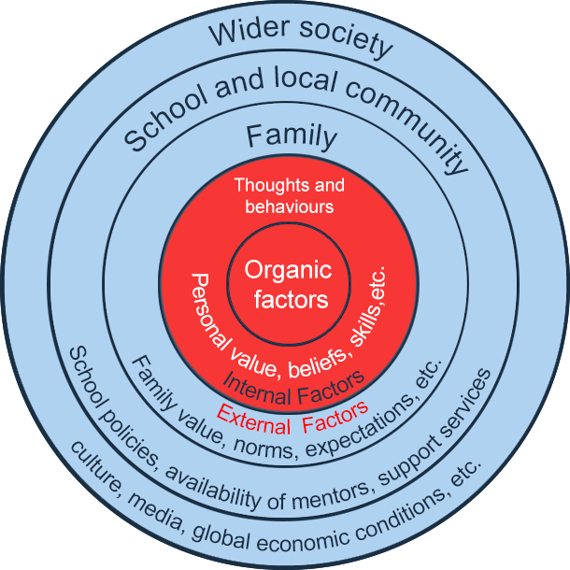
Chapter 7:
Factors Affecting Resilience
Influences
Influences

Slide 7
Chapter 7:
Factors Affecting Resilience
Video: Bailey’s Story

Slide 8
Chapter 7:
Permanence
  Children require a primary attachment figure: an adult who consistently meets their emotional and physical needs.
  This role is typically filled by a biological parent.
  Other caring adults who commit unconditionally to the child can also meet the child’s need for permanence.

Slide 9
Chapter 7:
Permanence
As a CASA/GAL volunteer:
  Advocate for a safe, permanent home as soon as possible, honoring the child’s culture and sense of time.
Possible permanent options include:
  Return to parent.
  Adoption (by a relative or nonrelative).
  Permanent Managing Conservatorship to a relative.

Slide 10
Chapter 7:
Permanence
What is Permanent Managing Conservatorship to a relative?
  It is an alternative to adoption for children or youth who have been placed with relatives.
  It can occur with or without termination of parental rights.
  The relative conservator will be legally granted decision-making powers for the child or youth.

Slide 11
Chapter 7:
Permanence
  Long-Term Foster Care
    Becomes the plan for older children or children labeled as difficult for whom there is no identified family.
    Is an impermanent solution: a new dialogue around how to make permanence a reality is needed.

Slide 12
Chapter 7:
Factors Affecting Resilience
Permanence – Baily’s Story

Slide 13
Chapter 7:
Concurrent Planning
  Concurrent planning involves working on two solutions simultaneously:
    Primary Plan
    Concurrent Plan
  Actively pursuing a backup plan moves a case more quickly through the system with better results.
  Concurrent planning should be family-centered, with parents involved in decision making from the start.

Slide 14
Chapter 7:
Educational Advocacy, Older and LGBTQ Youth
Pre-Work Recap, Chapter Overview and Competencies
Permanence
Educational Advocacy
Advocating for Older Youth and LGBTQ Youth
Working a Case
Chapter Wrap-Up: Review and Evaluation
Chapter 8: Pre-Work

Slide 15
Chapter 7:
Educational Advocacy Quick Assessment Form
Questions to consider:
How might this educational assessment form be helpful on a case with an older youth?
How might it be helpful in a case with a younger or even preschool-aged child?
How might it be helpful in preventing problems and intervening early so that students can be successful?

Slide 16
Chapter 7:
Educational Advocacy, Older and LGBTQ Youth
Pre-Work Recap, Chapter Overview and Competencies
Permanence
Educational Advocacy
Advocating for Older Youth and LGBTQ Youth
Working a Case
Chapter Wrap-Up: Review and Evaluation
Chapter 8: Pre-Work

Slide 17
Chapter 7:
Advocating for Older Youth
What would the outcome be for a teen who remained in foster care until aging out and did not receive help navigating through the following systems?
Education
Housing or Living Situation
Mental Health
Employment
Finances

Slide 18

Chapter 7:
Advocating for LGBTQ Youth
There is a disproportionate number of lesbian, gay, bisexual, transgender and queer* and questioning (LGBTQ) youth in foster care.

Slide 19
Chapter 7:
Factors Affecting Resilience
Randy’s Story

Slide 20
Chapter 7:
Educational Advocacy, Older and LGBTQ Youth
Pre-Work Recap, Chapter Overview and Competencies
Permanence
Educational Advocacy
Advocating for Older Youth and LGBTQ Youth
Working a Case
Chapter Wrap-Up: Review and Evaluation
Chapter 8: Pre-Work

Slide 21
Chapter 7:
The Brown Case
What do you remember about the Brown case?

Slide 22
Chapter 7:
The Brown Case
August 7 (last year): Urgent care center notified CPS of 14-year-old Jessica Brown, who had been treated for broken ribs. Jessica told CPS social worker (SW) that she had run away from home the night before after being beaten “for the last time” by her mother’s live-in boyfriend, Wayne Pender.
August 8 (last year): Child released from hospital and placed by CPS into emergency foster care.

Slide 23
Chapter 7:
The Brown Case
August 19 (last year): Jessica removed from foster home after she confided to her foster mother that she is lesbian, and the foster mother felt uncomfortable with Jessica sharing a room with her 13-year-old daughter. Jessica has been placed in Abigail Barton Home for Girls.
November 8 (last year): Abigail Barton Home for Girls notified SW that Jessica Brown did not return to the group home after school.

Slide 24
Chapter 7:
The Brown Case
December 21 (last year): SW received call from Jessica asking for assistance, as she had been living on the street since running away from the group home. She stated she had been harassed and bullied, hit, and was teased with names such as “Jessie the Lezzie” and “dyke” by other girls in the group home. SW located emergency foster care for Jessica.
December 29 (last year): Jessica was placed with paternal cousin, Candice Clark (age 30).

Slide 25




Chapter 7:
The Brown Case
Runner
Questioner
Scribe
Moderator

Slide 26

Chapter 7:
The Brown Case
It’s time to work the case!

Slide 27
Chapter 7:
The Brown Case
Writing a Case Summary: Parents
1B

Slide 28
Chapter 7:
Educational Advocacy, Older and LGBTQ Youth
Pre-Work Recap, Chapter Overview and Competencies
Permanence
Educational Advocacy
Advocating for Older Youth and LGBTQ Youth
Working a Case
Chapter Wrap-Up: Review and Evaluation
Chapter 8: Pre-Work

Slide 29
Chapter 7:
Domestic Violence and Cultural Competence
In this chapter, you learned about:
Permanency options and concurrent planning.
Educational challenges.
Issues faced by older youth.
Issues faced by LGBTQ youth.
Writing a Case Summary: Parents.

Slide 30
Chapter 7:
Evaluation
Please fill out the Chapter 7 Volunteer Training Evaluation and give to the facilitator.

Slide 31
Chapter 8:
Pre-Work
Read pages 266-292, Initial Notes for the Redd Case through CASA/GAL Volunteer Competencies Review Activity and complete the following:
Using the Redd Case Notes and your program’s court report template, complete the Writing Your Court Report activity per your facilitator’s instructions.
Complete the CASA/GAL Volunteer Competencies Review activity.

