Slide 1
Board Orientation and Continuing Board Training

Slide 2
The Roles and Services provided by National CASA, Texas CASA and your program
https://texascasa.org/resources/casa-roles-national-state-local/
*TAC 377.115 current local, statewide and national association services

Slide 3
The role of National CASA/GAL Association is to strategically establish, promote and support the formation, recruitment, training, development and activities of highly effective member programs.

Slide 4
Establish membership criteria, policies and practices for all affiliations with the National CASA/GAL Association i.e., local programs, state organizations, auxiliaries, individual memberships, strategic alliances and partnerships
Establish the core model for CASA/GAL advocacy
Promote, manage, conduct and encourage evidence-based research, scholarship, education, training and the distribution of information in, between and among volunteer CASA and GAL programs
Lead a child advocacy movement through public education and awareness regarding children and youth who have experienced abuse or neglect

Slide 5
Develop and disseminate materials to promote the CASA/GAL program and increase the public’s awareness resulting in increased volunteers, donors and other program supporters
Build and protect the National CASA brand
Establish CASA/GAL standards and ensure achievement through a quality assurance process
Develop and provide a national standardized curriculum that trains volunteer advocates and staff to deliver positive outcomes for children

Slide 6
BoardSource link
National CASA provides each local CASA program with one paid membership to Boardsource. Click on the link below for more information
https://boardsource.org/membership-registration/?ref=1132&pid=53086

Slide 7
The Role of Texas CASA

Slide 8
Provide support to local programs in areas of advocacy, governance, communications, administration, finance/risk and volunteer recruitment and retention
This Photo by Unknown Author is licensed under CC BY-SA

Slide 9
Oversight for Quality Assurance and Standards Compliance

Slide 10
Pass-thru Funding
VOCA
HHSC funds
Guide to Grants
This Photo by Unknown Author is licensed under CC BY-SA

Slide 11
Your Local Program
Mission Statement
Demographics of children served
Values and Vision statement

Slide 12
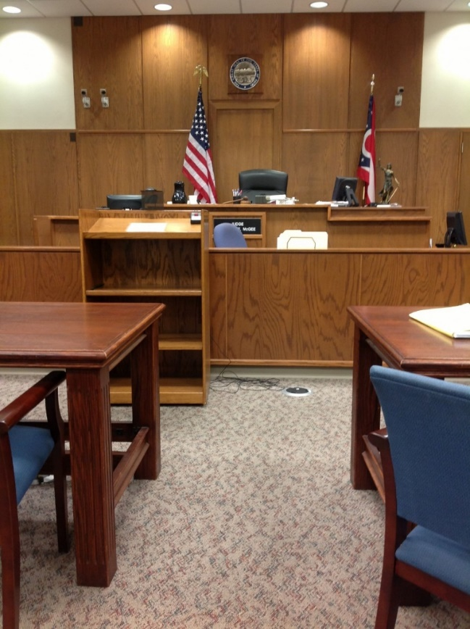
CASA’s role in the Child
Welfare System
GAL Role
Best Interest
https://texascasa.org/understanding-the-roles-in-a-cps-case/
*TAC 377.115 the operation of the court and the child welfare system

Slide 13
Roles and Responsibilities for CASA Boards
*TAC 377 program governance.

Slide 14
Ensure Effective Organizational Planning
Planning occurs at various levels depending on many circumstances such as the nonprofit’s size and organizational complexity, but most boards focus on creating a comprehensive plan that accounts for each of the following topics:
Mission statement and organizational purposes
Current programs and services
New programs and services
Supporter development and retention
Staffing (both current and projected)
Financial projections, including income and expenditures
Part of effective strategic planning is periodically assessing the organization’s progress toward achieving your previously set goals.

Slide 15
Provide Sufficient Resources

Slide 16
Make Sure the Organization Fulfills Legal Obligations
Tax-exempt organizations must adhere to several rules in order to maintain their status.
It’s up to board members to be aware of applicable federal, state, and local laws and ensure the nonprofit meets those requirements.

Slide 17
Provide Proper Financial Oversight
An important part of effective nonprofit management is ensuring revenue is properly managed. Because organizations are granted tax-exempt status by law to fulfill a public need, the board’s obligations extend beyond the organization’s stakeholders.
Your board members don’t need to be nonprofit accounting experts, but they should have a good sense of how much money is coming in and coming out of your organization. As part of providing sufficient oversight, the board should monitor all financial activities and ensure the organization’s program spending is appropriate.

Slide 18
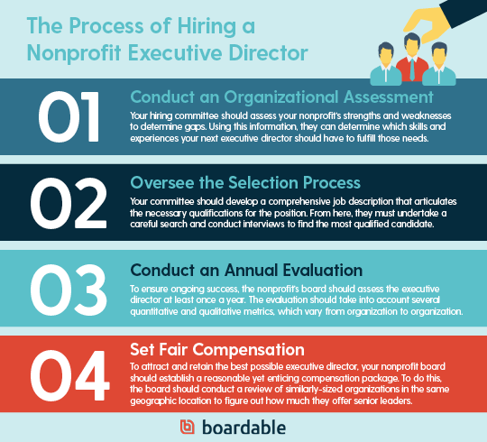
Select and Evaluate the Executive Director

Slide 19
Improve the Organization’s Public Standing
As part of their core duties, board members should publicly advocate for the organization to help maintain a positive standing within the community. For the most passionate board members, this responsibility comes naturally. When networking, they should aim to ignite that same enthusiasm for the cause in others, including their friends, families, and professional connections.

Slide 20
Policies and Procedures
Your policies and procedures determine what you can do, what you can’t do and what to do if something goes wrong. This information gives board, staff and volunteers a sense of structure around what is allowed and possible, and management a guide for what to do if things go wrong!
It is the board’s responsibility to get these policies in place, and vote on changing them if issues repeatedly come up. Reviews all required policies at least every three (3) years (or more often if required by law, rule, regulation, ordinance, executive order, court order or standards) to assess the need for updates. The date of the most recent review shall be noted on the corresponding document.

Slide 21
Recruit and Orient New Board Members
Because board members’ terms only last for a couple of years, they should always be on the lookout for successors. Recruiting board members who bring fresh skills, insight, diversity, networks and experiences to the table (while avoiding conflicts of interest!) is the ideal.
The Board Building Cycle
https://casacollege.myabsorb.com/#/online-courses/a5482269-fbb4-467b-a827-15c45a159fe2

Slide 22
Committees
Some common nonprofit committees include:
Executive committee (required)
Finance committee (required)
Governance committee
Fundraising committee
Marketing committee

Slide 23
Measuring Success
In order to assess how well your board of directors is fulfilling their nonprofit board responsibilities, it’s important to regularly look at how you’re doing. A standardized assessment can give you the data you need to keep making improvements!
Self-assessment
Peer-to-peer assessment
Assessment by executive director
Assessment by an external consultant

Slide 24
Avoid Overreach
Find the balance within the board to avoid overreach and provide oversight.
This Photo by Unknown Author is licensed under CC BY-NC-ND

Slide 25
Review Your Strategic Plan’s
Goals
Objectives
Persons Responsible
Timelines
Track and Review Annually
*TAC 377.115 the applicable goals, objectives, and methods of operation of the local volunteer advocate program

Slide 26
STANDARD 2 GUIDING PRINCIPLES
A. Integrates the following guiding principles into all aspects of CASA/GAL program practices, policies and procedures:
1. Recognize the importance of family preservation and/or reunification:
a. It is in a child’s best interests to remain with their family of origin when safely
possible.
b. The CASA/GAL program acknowledges that children experience trauma when
separated from their family of origin.
c. If a child is removed from their family of origin, it is in the child’s best interests
to be reunified with their family of origin as soon as safely possible.
d. If a child is removed from their family of origin, the child should be placed with a
relative whenever safely possible and in the child’s best interests.
e. Strengthening families, through recommendations for services, supports,
visitation and communications, is in the child’s best interests to achieve stability
and/or reunification.

Slide 27
f. The CASA/GAL program requires and demonstrates respect for the parents and
all parties associated with the case.
g. The CASA/GAL program ensures that information regarding the family’s
strengths is incorporated into reports to the court.
h. The CASA/GAL program ensures that information regarding the child’s wishes
is incorporated into reports to the court.
i. When a court determines a child cannot be safely reunified with their family
of origin consistent with legal mandates, another permanent placement is in a
child’s best interests.

Slide 28
Recognize the importance of diversity, equity and inclusion:
a. All children regardless of age, race, ethnicity, national origin (ancestry), color, religion (creed), gender, gender expression, sexual orientation, disability or physical challenge, or socioeconomic status should be safe, have a permanent home and an opportunity to thrive.
b. The CASA/GAL program acknowledges the existence of implicit bias and takes steps to minimize and/or eliminate implicit bias.
c. The CASA/GAL program demonstrates an understanding of disproportionality impacting children who are in the child protection system due to allegations of abuse or neglect.

Slide 29
FY23 Local Board of Directors (LBOD) training series
https://texascasa.org/resources/fy23-lbod-training/

Slide 30
STAY CONNECTED

Slide 31
QUESTIONS?

Slide 32
THANK YOU

