Slide 1
Quality Assurance Preparation Training
May 5th, 2023
Virtual
Notes:
10 minutes Deedra

Slide 2
Notes:
5 minutes Celeste

Slide 3
Poll Question:
Have you ever participated in a Texas CASA Quality Assurance Review?
Notes:
Add Poll question Celeste

Slide 4
Webinar Q & A
Please feel free to post any questions you may have in the
Q & A tab, and we will address them at the end of the presentation.

Slide 5
Training Objectives
Understand the QA process.
Successfully navigate a virtual QA Review.
What documents are required for IoC submission.
Why the Self-Audit checklist and TAC/TFC checklist is important.
How to utilize Advocacy File and Volunteer File Assessment forms.
Compiling complete and accurate background check lists.
Notes:
Review each and provide brief overview - LC

Slide 6
FY24 QA Schedule Sept. 1, 2023 – Aug. 31, 2024
Quarter 1 | Quarter 2 | Quarter 3
San Antonio-DD-Sept Kingsland - LC – Sept Edinburg - DD - Oct Victoria – DD - Oct Lufkin - LC - Oct Nacogdoches - LC - Oct Beaumont - DD - Nov Waxahachie -LC- Nov | Brownwood -DD- Dec Stephenville -LC- Dec Galveston - DD - Jan Midland - DD - Jan Liberty - LC - Jan Cleburne - LC – Jan Mason – DD - Feb Granbury - LC - Feb | Sulphur Springs-LC-Mar Ft. Worth - LC - Mar Orange - DD - Mar Decatur - DD - Mar Dalhart - LC - Apr Houston - DD - Apr Longview - LC - May Corpus - DD - May
Notes:
Your program was notified last week of the month of your QA review LC

Slide 7
Understand the QA Process
Notes:
Overview of QA process- Focus Advocacy and Risk LC

Slide 8
QA Review Timeline

Slide 9
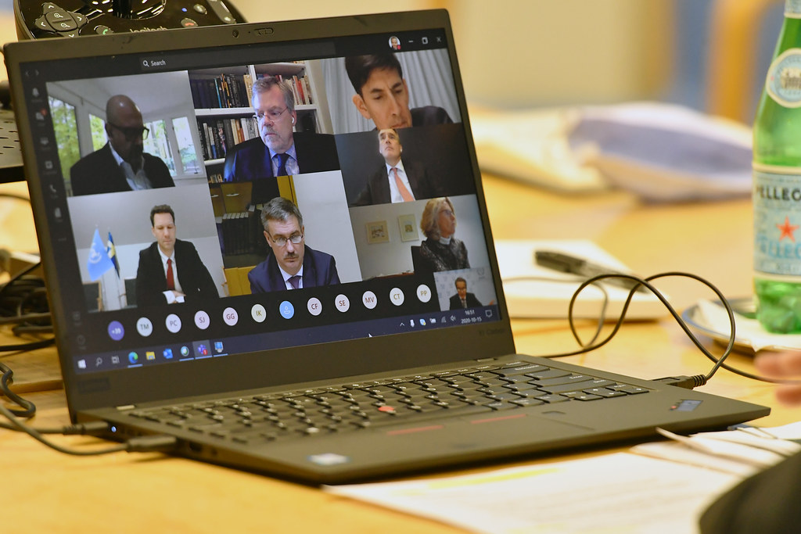
Successful Navigation of Virtual QA Review
This Photo by Unknown Author is licensed under CC BY
Notes:
ZOOM- 7 minutes?
Knowledge of screen sharing, digital documentation, (Digital not required), camera on, test mic, add confidentiality segment DD

Slide 10
Indicators of Compliance (IoC’s)
The following documents must be submitted no later than 20 days prior to the QA Review. Each policy only needs to be submitted once. For example, if the board job description is included in board policies and procedures, you will only need to submit the board policies and procedures one time.
Notes:
DD

Slide 11
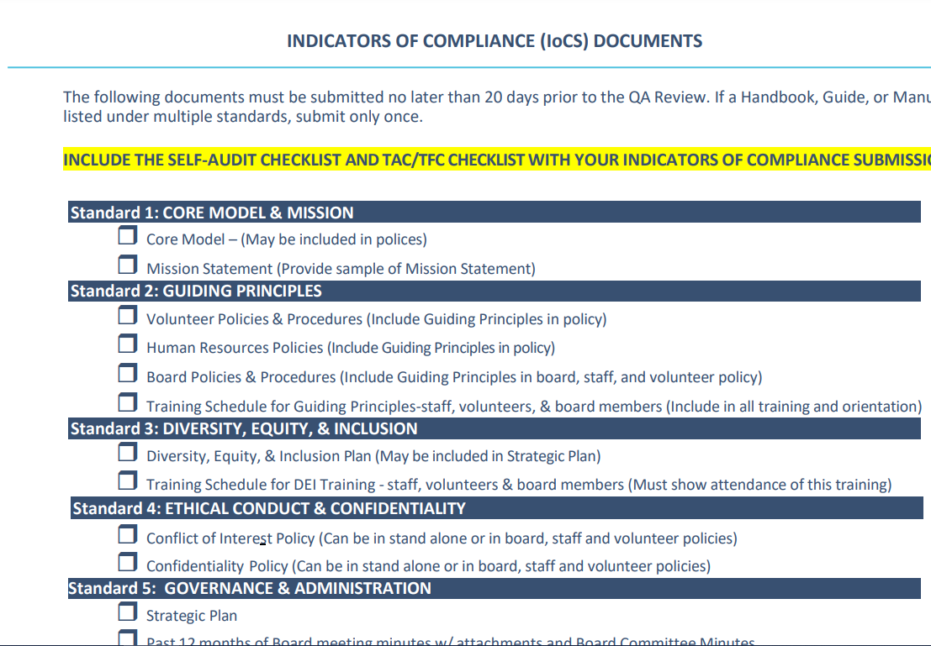
Indicators of Compliance (IoC)
Notes:
LC how to submit IOC’s, Confidentiality agreement, Active Children by supervisor and Caseload by Supervisor – all alphabetical report

Slide 12
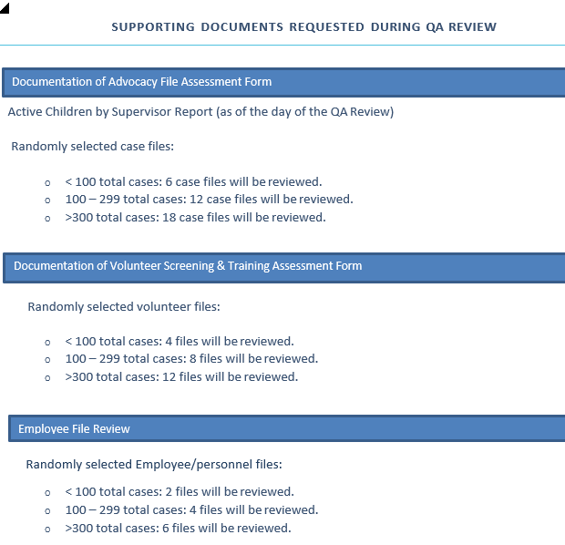
Additional Documents Requested during QA Review
Notes:
DD Random selection of files and how many cases we look at
Go through what we look at in employee file

Slide 13
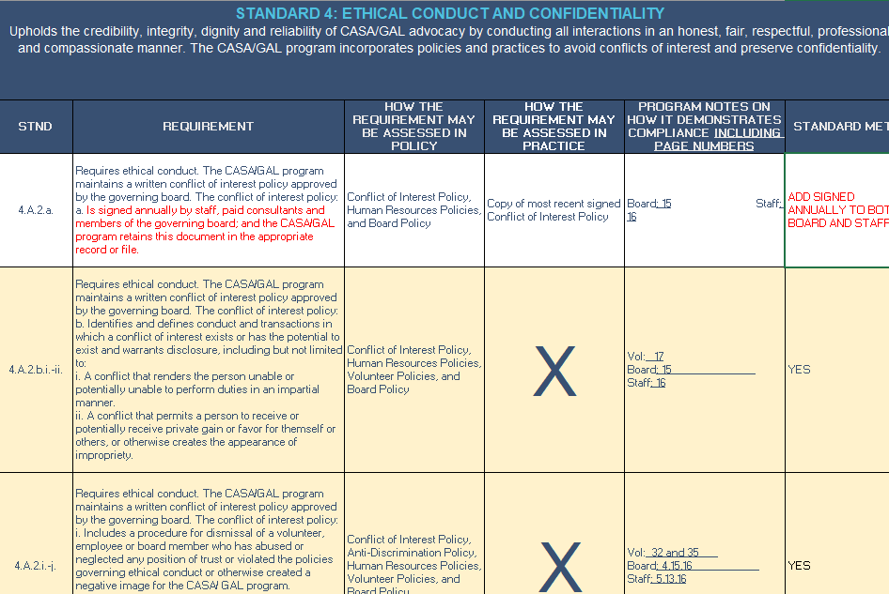
Self Audit Checklist
Notes:
LC we will fill in last column with either yes or no or onsite. If no, we will highlight in red the verbiage that is missing

Slide 14
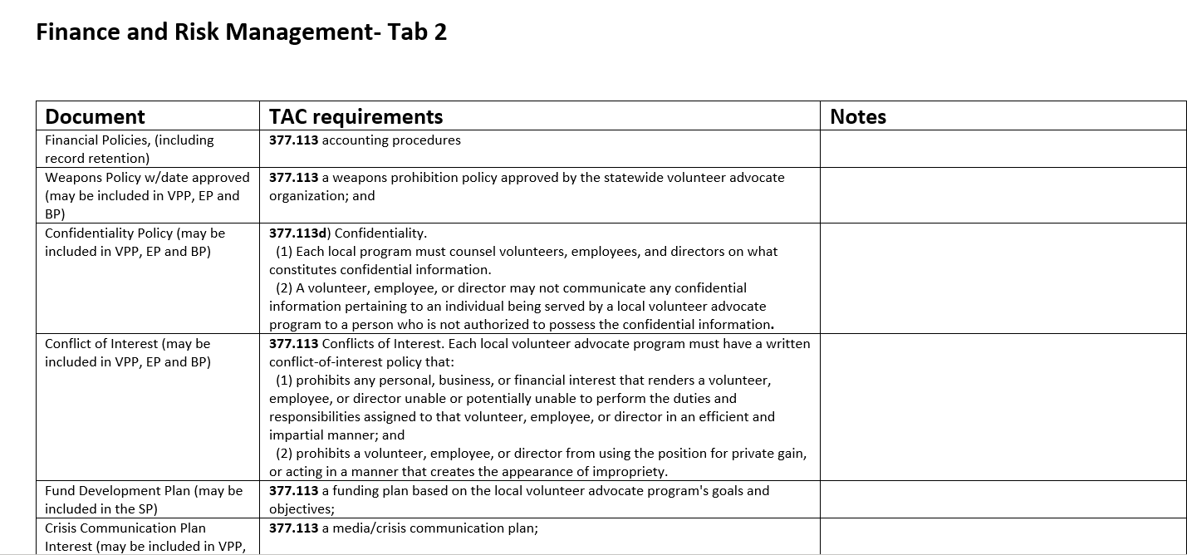
TAC/TFC Checklist
Notes:
DD

Slide 15
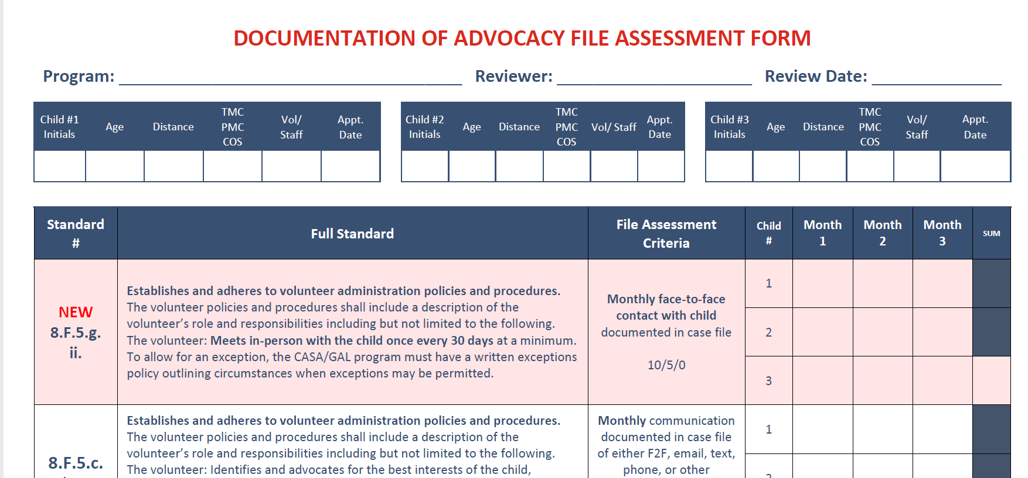
Notes:
30 minutes? DD

Slide 16
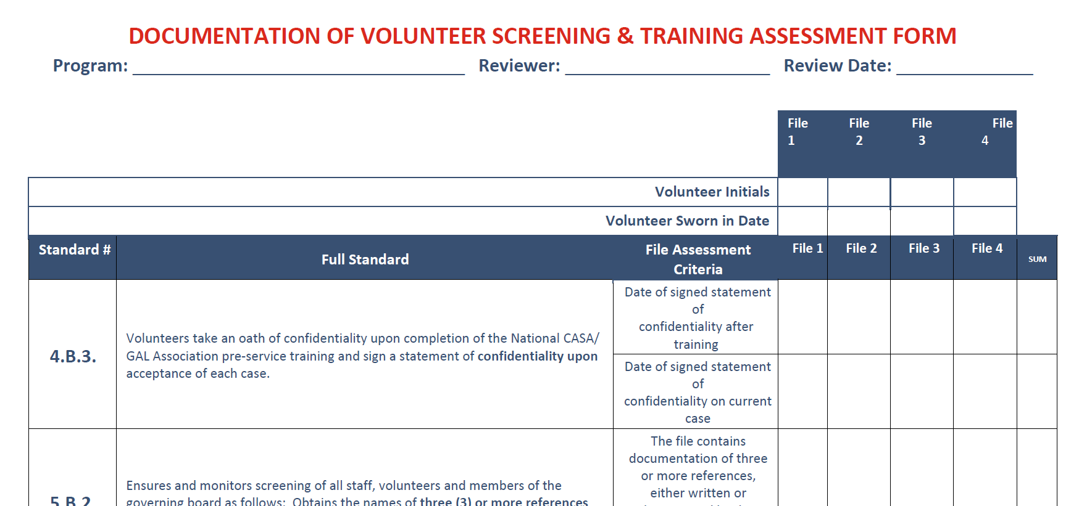
Notes:
20 Minutes? DD

Slide 17
Background Checks for
Board-Staff-Volunteers
1. Board Roster
2.Staff Roster
3.Assigned Volunteer by Supervisor report
1.DFPS (ABCS) Active Background Check History List
2.Fingerprint-Based Background Check-Offline
Applicant Management List
3.National Name Based Search
Notes:
7 minutes?- CP

Slide 18
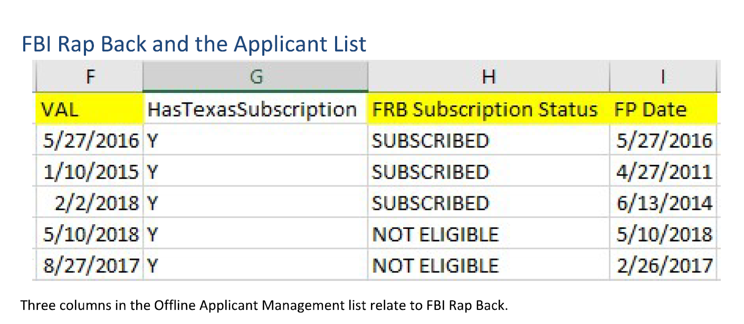
Offline Applicant Mgmt
DPS RapBack # 512-424-2746
512
(
Notes:
2 minutes- Celeste

Slide 19
Need Assistance?
Notes:
DD LC

Slide 20
Debbie Dugger
(936) 402-3565
ddugger@texascasa.org
Linda Coronado
(806) 346-3891
lcoronado@texascasa.org
Notes:
DD

