Slide 1
Infant and Toddler Volunteer Training
Carollynn Thesing, Infant-Toddler Team Leader
Renee Lukefahr, Advocacy Specialist

Slide 2
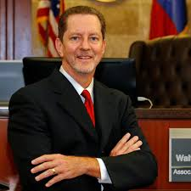
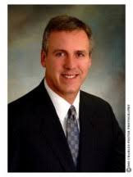
Fort Bend County Court Team
The Team consists of Judges from the 328th and 387th District Court, Cluster Court, CASA, CPS, Behavioral Health Services, ECI, Substance Abuse Providers, Therapists and any person involved with our children and families.
The Court Team meets several times a year facilitated Fort Bend Behavioral Health Services.

Slide 3
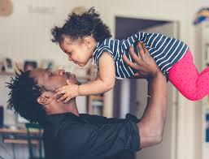
Educate parents
Ensure that their child receives appropriate developmental screenings and services
Increase visits with parents and their child
Connect families to community services
Monthly court hearings to ensure accountability (as determined by Judges)
Reunification/Relative Conservatorship/Adoption

Slide 4
CASA’s Vision in Changing the Face of Visitation
We serve children from Birth to Age 5
Encourage
Child Development/Bonding (Ages Birth – 3 years)
Pre-school and Kindergarten Readiness (Ages 4-5 years)
Behavioral Health Services Involvement

Slide 5
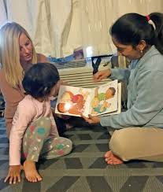
Always
Observe and listen to your parents
Build a rapport
Bring pictures of the child to share with the parents
Review the “Your Baby’s Development” Hand-out
Observe Parenting Skills
Look for the POSITIVE.

Slide 6
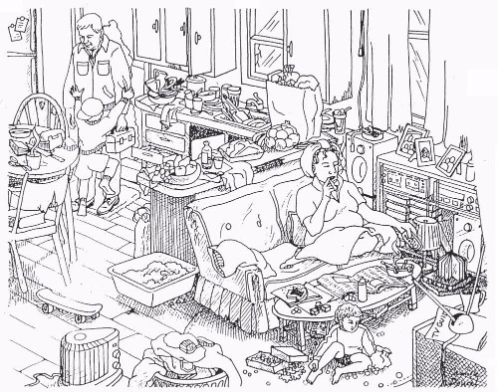
Strengths in Families

Slide 7
Dad Still Face Video

Slide 8
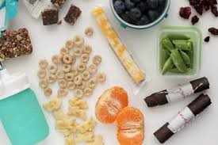
Visitation Bag
Age-appropriate toys and books
Diapers/Wipes/Lotion
Homemade toys
Blanket
Introduce Diaper Bag (Visitation Bag) to Parent(s)

Slide 9
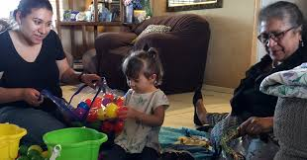
Visitation Timeline
Welcome and Play 15 minutes
Bonding/Sensory 5 minutes
Snack 15 minutes
Clean-up/Diaper Change 5 minutes
Story-time/Cuddling 10 minutes
Goodbye <5 Minutes

Slide 10
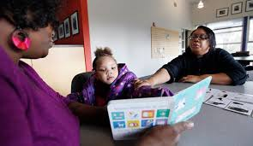
CASA’s Monthly Do To List:
Visit your CASA Child at a minimum once a monthly
Bring a Visitation Bag
Take pictures
Make monthly contact with CPS Caseworker, AAL for the child, and your Advocacy Specialist
Document ALL contacts in Optima
Submit Court Reports 10-14 days in Advance

Slide 11
WHAT’S NEXT?
“Job Well Done” Reunification Gift
Ongoing Continuing Education opportunities

Slide 12
QUESTIONS

