Slide 1
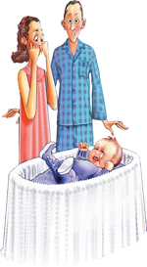
PERIOD OF PURPLE CRYING www.purplecrying.info
National Center on Shaken Baby Syndrome (NCSBS)
www.dontshake.org
Notes:
PERIOD OF PURPLE CRYING IS A PROGRAM JOINTLY DEVELOPED BY NCSBS AND DR. RONALD BARR, A DEVELOPMENTAL PEDIATRICIAN AND WORLD EXPERT ON INFANT CRYING.
IT’S AN EVIDENCE-BASED PROGRAM BASED ON 30 YEARS OF SCIENTIFIC RESEARCH AND THE GOAL OF THE PROGRAM IS TO EDUCATE PARENTS AND CAREGIVERS ABOUT NORMAL INFANT CRYING AND THE DANGER OF SHAKING AN INFANT.
DR. BARR CAME UP WITH THE PHRASE “PERIOD OF PURPLE CRYING” AND HE AND THE NCSBS CONDUCTED TRIALS BETWEEN 2003-2007 AND THE PERIOD OF PURPLE CRYING PROGRAM WAS MADE AVAILABLE FOR GENERAL USE IN 2007.
NCSBS HAS IMPLEMENTED THE PROGRAM IN SEVERAL STATES AND THEY ARE CURRENTLY WORKING WITH 4 MAJOR METROPOLITAN AREAS IN TEXAS TO IMPLEMENT THE PROGRFAM STATEWIDE THROUGH HOSPITALS.

Slide 2
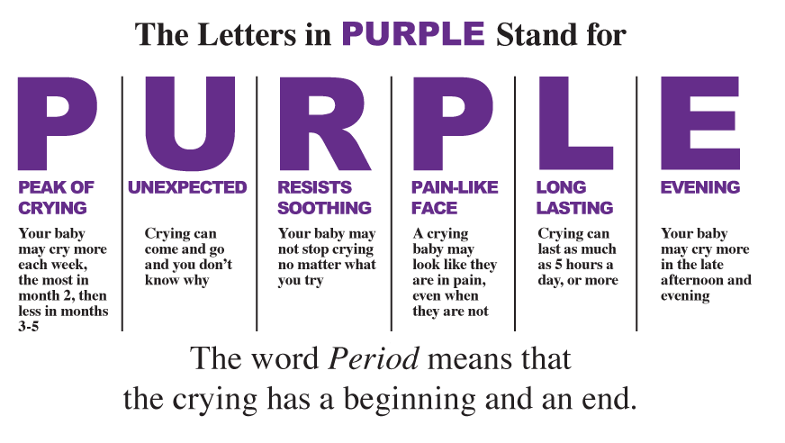
https://www.youtube.com/watch?v=3f97psdLPC4&index=1&list=WL
Notes:
PERIOD OF PURPLE CRYING IS NOT BECAUSE BABIES TURN PURPLE WHEN THEY CRY. DR. BARR EXPLAINS IT IS MEANINGFUL WAY OF UNDERSTANDING THIS PERIOD IN A BABY’S LIFE WHEN CRYING WILL INTENSIFY AND CAN BE VERY FRUSTRATING FOR PARENTS AND CAREGIVERS. IT IS A NORMAL DEVELOPMENTAL PHASE AND WILL COME TO AND END. HE SAYS ALL BABIES AND PARENTS WILL GO THROUGH THIS.
PURPLE IS AN ACRONYM WHERE EACH LETTER DESCRIBES A CHARACTERISTIC IN AN INFANT CRYING.
P: PEAK OF CRYING
CRYING WILL START AT ABOUT 2 WEEKS AFTER BABY IS BORN, WILL PEAK AT ABOUT 2-3 MONTHS AND decreased between 3 and 5 months.
U: UNEXPTECED
BABY WILL START CRYING FOR NO APPARENT REASON. ONE MINUTES THEY ARE HAPPY AND CONTENT, THE NEXT, THEY START CRYING AND PARENTS DON’T KNOW WHY.
R: RESIST SOOTHING
NO MATTER WHAT YOU DO, IT WON’T WORK. WORKED BEFORE BUT NOT AT THIS PARTICULAR TIME.
P: THEY LOOK LIKE THEY ARE IN PAIN
EVEN THOUGH THEY ARE NOT. PARENTS THINK THEY MUST BE IN PAIN SINCE THEY CRY SO MUCH AND THAT THERE IS SOMETHING WRONG WITH THEM, EVEN AFTER DOCTOR TELLS THEM BABY IS FINE, STILL CRY.
L: LONG LASTING
SOME BABIES CAN CRY FOR HOURS, SOME AS LITTLE AS 30 MINUTES, YET THEY ARE STILL NORMAL AND HEALTHY.
E: EVENING
CRYING SEEMS TO INCREASE DURING LATE AFTERNOON, EVENING, AFTER PARENTS COME HOME FROM WORK.
WWW.CLICKFORBABIES.ORG, MORE THUMBNAIL, SPREAD THE WORD +SAMPLE FACEBOOK: YOU TUBE LINK
HERE IS A VIDEO OF DR. BARR EXPLAINING IN MORE DETAILS THIS PERIOD OF PURPLE CRYING.

Slide 3
WHY IS MY BABY CRYING SO MUCH?
Amount of crying increases and peaks between 2-3 months, decreases between 4-5 months.
Crying starts and stops for no apparent reason at all.
Crying is unsoothable, no matter what you do.
Crying infants look like they are in pain.
Crying can go on for long period of times.
Crying increases in late afternoon and evening.
https://www.youtube.com/watch?v=1EIgAXZFhHU&list=WL&index=3
https://www.youtube.com/watch?v=m0stI1ILGUo&list=WL&index=2
https://www.youtube.com/watch?v=uAFoB1i2kMI&list=UUV0vQ0PivWwfVZfYJJth2kw
https://www.youtube.com/watch?v=HdFcR00cyOk&list=UUV0vQ0PivWwfVZfYJJth2kw
Notes:
DR. BARR EXPLAINS 6 CRYING FEATURES (PART OF PURPLE CRYING) THAT PARENTS DON’T EXPECT WITH THEIR NEW BABIES WHICH CAN BE VERY FRUSTRATING, OVERWHELMING AND STRESSFUL FOR THEM. PARENTS KNOW BABIES CRY BUT DON’T REALIZE THIS IS A NORMAL DEVELOPMENTAL PHASE WHICH WILL COME TO AN END.
CRYING STARTS AT 2 WEEKS, INCREASES BETWEEN 2-3 MONTHS AND WILL DECREASE BETWEEN 3-5 MONTHS. THIS PERIOD WILL NOT LAST FOREVER, THAT’S WHY IT’S CALLED PERIOD OF PURPLE CRYING. IMPORTANT FOR PARENTS/CAREGIVERS TO UNDERSTAND THIS.
IT DOES NOT HAVE ANYTHING TO DO WITH WHAT PARENTS ARE DOING. THAT’S WHY IT’S UNEXPECTED. ONE MINUTE BABY WILL BE HAPPY AND CONTENT, NEXT WILL START CRYING FOR NO APPARENT REASON. ONCE PARENTS UNDERSTANDS THIS IS A NORMAL PHASE, IT WILL HELP THEM DEALING WITH THEIR FRUSTRATION.
CRYING IS UNSOOTHABLE: WHAT MAY HAVE WORKED BEFORE (LIKE FEEDING, CHANGING DIAPER, CARRYING BABY) WILL NOT WORK. THIS CAN BE VERY FRUSTRATING AND HARD FOR PARENTS TO UNDERSTAND BECAUSE PARENTS THINK THERE IS SOMETHING WRONG WITH THE BABY OR THAY THEY ARE FAILING. DR. BARR WANTS PARENTS TO UNDERSTAND THAT THIS WILL PHASE WILL HAPPEN AND THAT IT IS OK AND THEIR BABY IS NORMAL.
PAIN: BABIES LOOK LIKE THEY ARE IN PAIN WHEN IN FACT THEY ARE NOT. AGAIN CAN BE VERY FRUSTRATING FOR PARENTS. DR. BARR EXPLAINS IF A BABY CRIES BECAUSE OF SICKNESS OR DISEASE, IT WILL USUALLY BE ON TOP THE “PURPLE” CRYING PERIOD. OF COURSE, CAN BE VERY DIFFICULT FOR PARENTS TO KNOW THIS. IMPORTANT FOR PARENTS TO WORK WITH THEIR DOCTOR TO SEE IF BABY IS SICK.
5TH CRYING FEATURE IS THAT THIS CRYING CAN GO ON AND ON FOR HOURS. THIS IS THE PEAK PERIOD BETWEEN 2-3 MONTHS. SOME BABIES WILL CRY FOR AS LONG AS 5-6 HOURS WHILE OTHERS CAN CRY AS LITTLE AS 30-35 MINUTES.
6TH FEATURE IS THAT THIS CRYING TENDS TO HAPPEN IN LATE AFTERNOON, EARLY EVENING. DR. BARR SAYS THESE CRYING FEATURES CAN OCCUR ANY TIME OF DAY OR NIGHT BUT THAT FOR MOST INFANTS, THIS INCREASE IN CRYING WILL OCCUR IN LATE AFTERNOON OR EVENING.
DR. BARR WANTS PARENTS AND CAREGIVERS TO REMEMBER THAT ALL BABIES CRY, SOME MORE THAN OTHERS, AND THAT IT’S OKAY TO GET FRUSTRATED. IT’S WHAT YOU DO WITH YOUR FRUSTRATION THAT IS IMPORTANT.
SHOW 2 VIDEOS: 1. SHOW CLIP FROM PURPLE DVD SHOWING UNEXPECTED CRYING 1.03
CLIP ABOUT FATHER COMING HOME FROM WORK: UNDER INFORMATION FOR DADS. 2:16
CLIP ABOUT CRYING BOTHERING NEIGHBORS: 2.34. FRUSTRATING FOR NEIGHBORS AS WELL

Slide 4
PRINCIPLES OF SOOTHING
1st principle of soothing: Some soothing behaviors work some of the time, but nothing works all of the time.
2nd principle of soothing: Soothing can work preventively if the soothing activities are applied when the infant is not crying rather than just in response to crying.
Notes:
NOW THAT WE KNOW WHY A BABY CAN BE CRYING SO MUCH, THEN THE NEXT QUESTION IS HOW CAN YOU SOOTHE YOUR BABY?
THERE ARE MANY WAYS TO SOOTHE A BABY (AND WE WILL LOOK AT COMMON SOOTHING METHODS), HOWEVER DR. BARR SAYS THERE ARE 2 IMPORTANT PRINCIPLES OF SOOTHING FOR PARENTS TO REMEMBER: 1. BABIES ARE NOT PREDICTABLE AND ARE NOT LIKE MACHINES WITH AN ON/OFF BUTTON. 2. WHAT DR. BARR IS SAYING IS THAT BY DOING SOOTHING METHODS WHEN BABY IS NOT CRYING, IT WILL MAKE THEM EVEN MORE EFFECTIVE AT KEEPING THE BABY CALM ONCE IT STOPS CRYING.
WWW.PURPLECRYING.INFO
SHOW COMMON 7 FEATURES OF SOOTHING BEHAVIORS ON PURPLE CRYING WEBSITE UNDER SOOTHING SECTION. THESE FEATURES APPLY TO VIRTUALLY ALL SOOTHING BEHAVIORS THAT PARENTS & CAREGIVERS DO.

Slide 5
COMMON FEATURES OF SOOTHING
Position
Repeating
Notes:
NOW THAT WE KNOW WHY A BABY CAN BE CRYING SO MUCH, THEN THE NEXT QUESTION IS HOW CAN YOU SOOTHE YOUR BABY?
THERE ARE MANY WAYS TO SOOTHE A BABY (AND WE WILL LOOK AT COMMON SOOTHING METHODS), HOWEVER DR. BARR SAYS THERE ARE 2 IMPORTANT PRINCIPLES OF SOOTHING FOR PARENTS TO REMEMBER: 1. BABIES ARE NOT PREDICTABLE AND ARE NOT LIKE MACHINES WITH AN ON/OFF BUTTON. 2. WHAT DR. BARR IS SAYING IS THAT BY DOING SOOTHING METHODS WHEN BABY IS NOT CRYING, IT WILL MAKE THEM EVEN MORE EFFECTIVE AT KEEPING THE BABY CALM ONCE IT STOPS CRYING.
WWW.PURPLECRYING.INFO
SHOW COMMON 7 FEATURES OF SOOTHING BEHAVIORS ON PURPLE CRYING WEBSITE UNDER SOOTHING SECTION. THESE FEATURES APPLY TO VIRTUALLY ALL SOOTHING BEHAVIORS THAT PARENTS & CAREGIVERS DO.

Slide 6
COMMON FEATURES OF SOOTHING
Rhythms
White Noise
Notes:
NOW THAT WE KNOW WHY A BABY CAN BE CRYING SO MUCH, THEN THE NEXT QUESTION IS HOW CAN YOU SOOTHE YOUR BABY?
THERE ARE MANY WAYS TO SOOTHE A BABY (AND WE WILL LOOK AT COMMON SOOTHING METHODS), HOWEVER DR. BARR SAYS THERE ARE 2 IMPORTANT PRINCIPLES OF SOOTHING FOR PARENTS TO REMEMBER: 1. BABIES ARE NOT PREDICTABLE AND ARE NOT LIKE MACHINES WITH AN ON/OFF BUTTON. 2. WHAT DR. BARR IS SAYING IS THAT BY DOING SOOTHING METHODS WHEN BABY IS NOT CRYING, IT WILL MAKE THEM EVEN MORE EFFECTIVE AT KEEPING THE BABY CALM ONCE IT STOPS CRYING.
WWW.PURPLECRYING.INFO
SHOW COMMON 7 FEATURES OF SOOTHING BEHAVIORS ON PURPLE CRYING WEBSITE UNDER SOOTHING SECTION. THESE FEATURES APPLY TO VIRTUALLY ALL SOOTHING BEHAVIORS THAT PARENTS & CAREGIVERS DO.

Slide 7
COMMON FEATURES OF SOOTHING
Closeness
Sensations
Notes:
NOW THAT WE KNOW WHY A BABY CAN BE CRYING SO MUCH, THEN THE NEXT QUESTION IS HOW CAN YOU SOOTHE YOUR BABY?
THERE ARE MANY WAYS TO SOOTHE A BABY (AND WE WILL LOOK AT COMMON SOOTHING METHODS), HOWEVER DR. BARR SAYS THERE ARE 2 IMPORTANT PRINCIPLES OF SOOTHING FOR PARENTS TO REMEMBER: 1. BABIES ARE NOT PREDICTABLE AND ARE NOT LIKE MACHINES WITH AN ON/OFF BUTTON. 2. WHAT DR. BARR IS SAYING IS THAT BY DOING SOOTHING METHODS WHEN BABY IS NOT CRYING, IT WILL MAKE THEM EVEN MORE EFFECTIVE AT KEEPING THE BABY CALM ONCE IT STOPS CRYING.
WWW.PURPLECRYING.INFO
SHOW COMMON 7 FEATURES OF SOOTHING BEHAVIORS ON PURPLE CRYING WEBSITE UNDER SOOTHING SECTION. THESE FEATURES APPLY TO VIRTUALLY ALL SOOTHING BEHAVIORS THAT PARENTS & CAREGIVERS DO.

Slide 8
COMMON FEATURES OF SOOTHING
Sight, Sound, Smell
Notes:
NOW THAT WE KNOW WHY A BABY CAN BE CRYING SO MUCH, THEN THE NEXT QUESTION IS HOW CAN YOU SOOTHE YOUR BABY?
THERE ARE MANY WAYS TO SOOTHE A BABY (AND WE WILL LOOK AT COMMON SOOTHING METHODS), HOWEVER DR. BARR SAYS THERE ARE 2 IMPORTANT PRINCIPLES OF SOOTHING FOR PARENTS TO REMEMBER: 1. BABIES ARE NOT PREDICTABLE AND ARE NOT LIKE MACHINES WITH AN ON/OFF BUTTON. 2. WHAT DR. BARR IS SAYING IS THAT BY DOING SOOTHING METHODS WHEN BABY IS NOT CRYING, IT WILL MAKE THEM EVEN MORE EFFECTIVE AT KEEPING THE BABY CALM ONCE IT STOPS CRYING.
WWW.PURPLECRYING.INFO
SHOW COMMON 7 FEATURES OF SOOTHING BEHAVIORS ON PURPLE CRYING WEBSITE UNDER SOOTHING SECTION. THESE FEATURES APPLY TO VIRTUALLY ALL SOOTHING BEHAVIORS THAT PARENTS & CAREGIVERS DO.

Slide 9
WELL TRIED SOOTHING METHOD
CARRYING
Includes many of the common features of soothing:
Change in position
Eye to eye contact
Sensations: touch, sight, smell, sound
Closeness
Rhythm
Notes:
CARRYING IS A METHOD USED IN ALL CULTURES ALL OVER THE WORLD
CAN BE DONE BY SWADDLING A BABY, CARRYING A BABY IN A SLING CLOSE TO THE BODY OR SIMPLY CARRYING THE BABY IN YOUR ARMS. 5. RHYTHM: MOVEMENT OF WALKING AROUND WITH BABY.
2 ACTION STEPS TO DO WHEN BABY CRIES A LOT DURING PEAK PHASE: 1. INCREASE AMOUNT OF SOOTHING: INCREASE CARRYING, WALKING, TALKING, ROCKING: ALL THE SOOTHING METHODS PARENT KNOW AND USE. ALSO IMPORTANT FOR PARENTS TO REMEMBER THAT DOING THESE SOOTHING METHODS WHEN BABY IS NOT CRYING, IT WILL MAKE THEM EVEN MORE EFFECTIVE AT KEEKING BABY CALM ONCE IT STOPS CRYING (2ND PRINCIPLE OF SOOTHING)
2ND ACTION STEP: IF AFTER TRYING ALL OF THIS, YOU GET FRUSTRATED BECAUSE THE CRYING DOES NOT STOP, IT IS OK TO PUT BABY DOWN IN SAFE PLACE FOR 10-15 MIN. AND WALK AWAY AND COME BACK LATER TO CHECK ON BABY WHEN YOU HAD A CHANCE TO CALM DOWN.
DR. BARR WANTS PARENTS TO KNOW AND UNDERSTAND THAT IT IS NOT THE BABY’S FAULT AND NOT THEIR FAULT. NORMAL DEVELOPMENTAL PHASE PART OF THE PERIOD OF PURPLE CRYING.
GO OVER 10 TIPS TO SOOTH A CRYING INFANT: IN SOOTHING SECTION, COMMON SENSE & WELL TRIED SOOTHING METHODS.

Slide 10
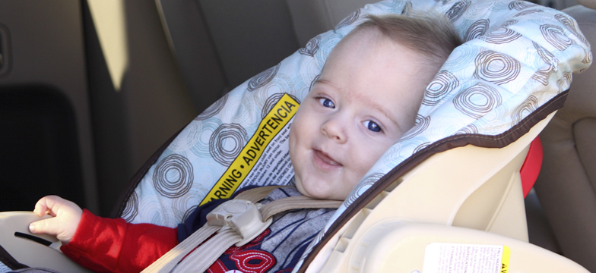
WELL TRIED SOOTHING METHODS
Carry in Sling
Car Ride
Notes:
NOW THAT WE KNOW WHY A BABY CAN BE CRYING SO MUCH, THEN THE NEXT QUESTION IS HOW CAN YOU SOOTHE YOUR BABY?
THERE ARE MANY WAYS TO SOOTHE A BABY (AND WE WILL LOOK AT COMMON SOOTHING METHODS), HOWEVER DR. BARR SAYS THERE ARE 2 IMPORTANT PRINCIPLES OF SOOTHING FOR PARENTS TO REMEMBER: 1. BABIES ARE NOT PREDICTABLE AND ARE NOT LIKE MACHINES WITH AN ON/OFF BUTTON. 2. WHAT DR. BARR IS SAYING IS THAT BY DOING SOOTHING METHODS WHEN BABY IS NOT CRYING, IT WILL MAKE THEM EVEN MORE EFFECTIVE AT KEEPING THE BABY CALM ONCE IT STOPS CRYING.
WWW.PURPLECRYING.INFO
SHOW COMMON 7 FEATURES OF SOOTHING BEHAVIORS ON PURPLE CRYING WEBSITE UNDER SOOTHING SECTION. THESE FEATURES APPLY TO VIRTUALLY ALL SOOTHING BEHAVIORS THAT PARENTS & CAREGIVERS DO.

Slide 11
WELL TRIED SOOTHING METHODS
Gently Rock
Vacuum
Notes:
NOW THAT WE KNOW WHY A BABY CAN BE CRYING SO MUCH, THEN THE NEXT QUESTION IS HOW CAN YOU SOOTHE YOUR BABY?
THERE ARE MANY WAYS TO SOOTHE A BABY (AND WE WILL LOOK AT COMMON SOOTHING METHODS), HOWEVER DR. BARR SAYS THERE ARE 2 IMPORTANT PRINCIPLES OF SOOTHING FOR PARENTS TO REMEMBER: 1. BABIES ARE NOT PREDICTABLE AND ARE NOT LIKE MACHINES WITH AN ON/OFF BUTTON. 2. WHAT DR. BARR IS SAYING IS THAT BY DOING SOOTHING METHODS WHEN BABY IS NOT CRYING, IT WILL MAKE THEM EVEN MORE EFFECTIVE AT KEEPING THE BABY CALM ONCE IT STOPS CRYING.
WWW.PURPLECRYING.INFO
SHOW COMMON 7 FEATURES OF SOOTHING BEHAVIORS ON PURPLE CRYING WEBSITE UNDER SOOTHING SECTION. THESE FEATURES APPLY TO VIRTUALLY ALL SOOTHING BEHAVIORS THAT PARENTS & CAREGIVERS DO.

Slide 12
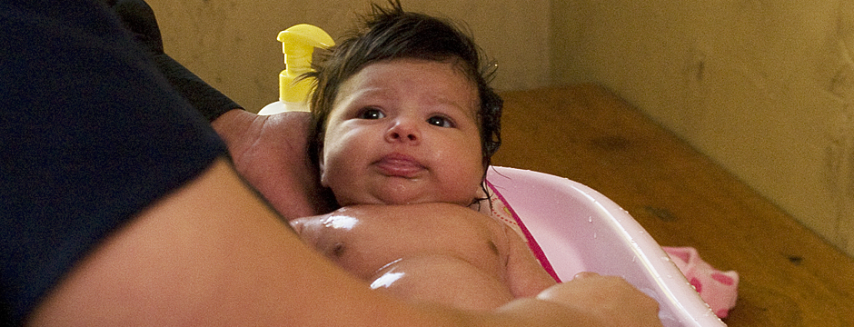
WELL TRIED SOOTHING METHODS
Sing
Bath
Notes:
NOW THAT WE KNOW WHY A BABY CAN BE CRYING SO MUCH, THEN THE NEXT QUESTION IS HOW CAN YOU SOOTHE YOUR BABY?
THERE ARE MANY WAYS TO SOOTHE A BABY (AND WE WILL LOOK AT COMMON SOOTHING METHODS), HOWEVER DR. BARR SAYS THERE ARE 2 IMPORTANT PRINCIPLES OF SOOTHING FOR PARENTS TO REMEMBER: 1. BABIES ARE NOT PREDICTABLE AND ARE NOT LIKE MACHINES WITH AN ON/OFF BUTTON. 2. WHAT DR. BARR IS SAYING IS THAT BY DOING SOOTHING METHODS WHEN BABY IS NOT CRYING, IT WILL MAKE THEM EVEN MORE EFFECTIVE AT KEEPING THE BABY CALM ONCE IT STOPS CRYING.
WWW.PURPLECRYING.INFO
SHOW COMMON 7 FEATURES OF SOOTHING BEHAVIORS ON PURPLE CRYING WEBSITE UNDER SOOTHING SECTION. THESE FEATURES APPLY TO VIRTUALLY ALL SOOTHING BEHAVIORS THAT PARENTS & CAREGIVERS DO.

Slide 13
WELL TRIED SOOTHING METHODS
Breastfeed
Pacifier
Notes:
NOW THAT WE KNOW WHY A BABY CAN BE CRYING SO MUCH, THEN THE NEXT QUESTION IS HOW CAN YOU SOOTHE YOUR BABY?
THERE ARE MANY WAYS TO SOOTHE A BABY (AND WE WILL LOOK AT COMMON SOOTHING METHODS), HOWEVER DR. BARR SAYS THERE ARE 2 IMPORTANT PRINCIPLES OF SOOTHING FOR PARENTS TO REMEMBER: 1. BABIES ARE NOT PREDICTABLE AND ARE NOT LIKE MACHINES WITH AN ON/OFF BUTTON. 2. WHAT DR. BARR IS SAYING IS THAT BY DOING SOOTHING METHODS WHEN BABY IS NOT CRYING, IT WILL MAKE THEM EVEN MORE EFFECTIVE AT KEEPING THE BABY CALM ONCE IT STOPS CRYING.
WWW.PURPLECRYING.INFO
SHOW COMMON 7 FEATURES OF SOOTHING BEHAVIORS ON PURPLE CRYING WEBSITE UNDER SOOTHING SECTION. THESE FEATURES APPLY TO VIRTUALLY ALL SOOTHING BEHAVIORS THAT PARENTS & CAREGIVERS DO.

Slide 14
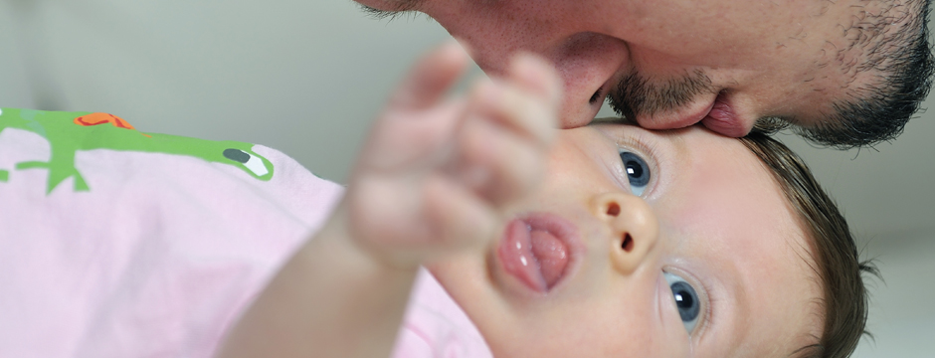
WELL TRIED SOOTHING METHODS
Skin to Skin
Eye Contact
Notes:
NOW THAT WE KNOW WHY A BABY CAN BE CRYING SO MUCH, THEN THE NEXT QUESTION IS HOW CAN YOU SOOTHE YOUR BABY?
THERE ARE MANY WAYS TO SOOTHE A BABY (AND WE WILL LOOK AT COMMON SOOTHING METHODS), HOWEVER DR. BARR SAYS THERE ARE 2 IMPORTANT PRINCIPLES OF SOOTHING FOR PARENTS TO REMEMBER: 1. BABIES ARE NOT PREDICTABLE AND ARE NOT LIKE MACHINES WITH AN ON/OFF BUTTON. 2. WHAT DR. BARR IS SAYING IS THAT BY DOING SOOTHING METHODS WHEN BABY IS NOT CRYING, IT WILL MAKE THEM EVEN MORE EFFECTIVE AT KEEPING THE BABY CALM ONCE IT STOPS CRYING.
WWW.PURPLECRYING.INFO
SHOW COMMON 7 FEATURES OF SOOTHING BEHAVIORS ON PURPLE CRYING WEBSITE UNDER SOOTHING SECTION. THESE FEATURES APPLY TO VIRTUALLY ALL SOOTHING BEHAVIORS THAT PARENTS & CAREGIVERS DO.

Slide 15
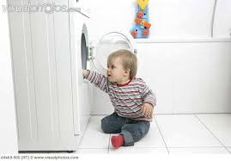
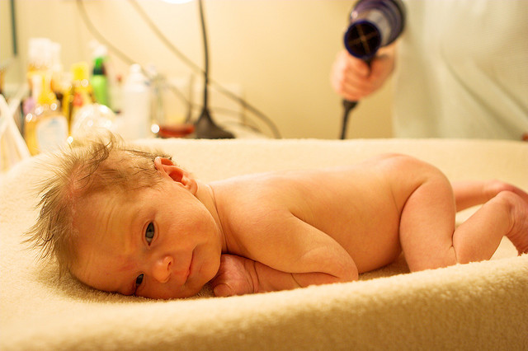
SOOTHING METHODS TO AVOID
Putting a baby on top of a dryer or washer when it is running.
Putting a baby near a hair dryer that is running.
Notes:
VERY DANGEROUS AS THE MOTION OF DRYER/WASHER CAN CAUSE BABY TO FALL OFF ONTO THE FLOOR.
SECOND ONE IS ALSO VERY DANGEROUS AS BABY CAN COME INTO CONTACT WITH THE HOT HAIR DRYER AND GET BURNED.
DR. BARR WANTS PARENTS/CAREGIVERS TO BE AWARE ABOUT DIFFERENT PROGRAMS/INTERVENTIONS ON THE MARKET TO HELP THEM SOOTHE THEIR BABIES WHEN THEY CRY AND CLAIM HOW EFFECTIVE THEY ARE. HE SAYS HE IS RELUCTANT TO RECOMMEND ANY SPECIFIC COMMERCIAL PROGRAM FOR 2 REASONS:
AS YOU CAN SEE, IT IS UNLIKELY THAT ANY OF THESE PROGRAMS CAN OFFER ANY TECHNIQUE THAT YOU AS A PARENT CANNOT ALREADY DO (ALL DIFFERENT SOOTHING METHODS DISCUSSED).
SOME CLAIMS MADE BY THESE PROGRAMS CAN CREATE UNREALISTIC EXPECTATIONS ABOUT HOW TO SOOTHE A CRYING BABY. JUST AS IS TRUE OF ALL SOOTHING METHODS AND ANY TECHNIQUE OR PRODUCT, SOME SOOTHING STRATEGIES WORK SOME OF THE TIME, BUT NOTHING WORKS ALL OF THE TIME: 1ST PRINCIPLE OF SOOTHING.
THE PERIOD OF PURPLE CRYING SAYS TO INCREASE THE SOOTHING TECHNIQUES IF BABIES CRY, BUT IF AN INFANT DOES NOT RESPOND TO YOUR BEST SOOTHING EFFORT, IT IS OK, THERE IS NOTHING WRONG WITH YOU OR THE BABY. REMEMBER, IT’S WHAT YOU DO WITH YOUR FRUSTRATION THAT’S IMPORTANT: DO NOT SHAKE A BABY.

Slide 16
TIPS TO DEAL WITH FRUSTRATION AND ANGER
Listen to music
Take a warm bath
Notes:
WHEN A PARENT STARTS TO FEEL FRUSTRATION AND ANGER AT A CRYING BABY, IT IS TIME TO TAKE A BREAK AND CALM DOWN. 1ST PUT BABY IN A SAFE PLACE AND TRY TO RELAX WITH THESE TIPS.
VOLUNTEER: SERVICE TO OTHER CAN QUICKLY HELP YOU FORGET YOUR OWN PROBLEMS.
CLARIFY YOU PLAN, GOALS AND VALUES AND LIVE BY THEM: WHAT’S IMPORTANT TO YOU.
14. SEEK HELP: IF YOU FEEL YOU’RE OVERWHELMED AND STRESSED, IT’S OK TO ASK FOR HELP, NOTHING WRONG WITH THAT: ASK A RELATIVE, OR CALL CHILD HELP HOTLINE: SHOW 31 SECOND CLIP YOU TUBE

Slide 17
TIPS TO DEAL WITH FRUSTRATION AND ANGER
Watch TV: your favorite TV show
Exercise

Slide 18
TIPS TO DEAL WITH FRUSTRATION AND ANGER
Take a nap
Engage in a craft, hobby that is enjoyable

Slide 19
TIPS TO DEAL WITH FRUSTRATION AND ANGER
Write your feelings in a journal
Talk to someone

Slide 20
TIPS TO DEAL WITH FRUSTRATION AND ANGER
Don’t do too much: don’t sweat the small stuff
Stay organized

Slide 21
TIPS TO DEAL WITH FRUSTRATION AND ANGER
Volunteer
Laugh and laugh often

Slide 22
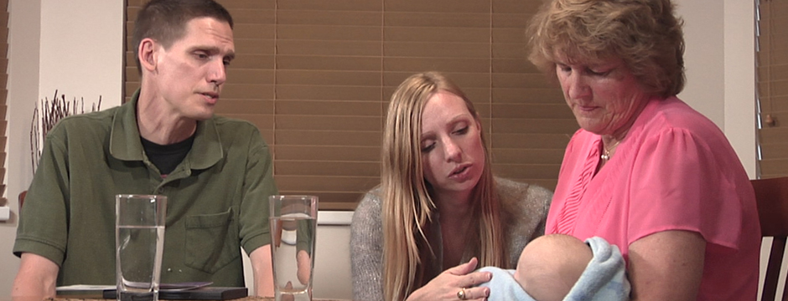
TIPS TO DEAL WITH FRUSTRATION AND ANGER
Clarify values
Seek help
https://www.youtube.com/watch?v=04aMDOzw_M8&index=5&list=WL

Slide 23
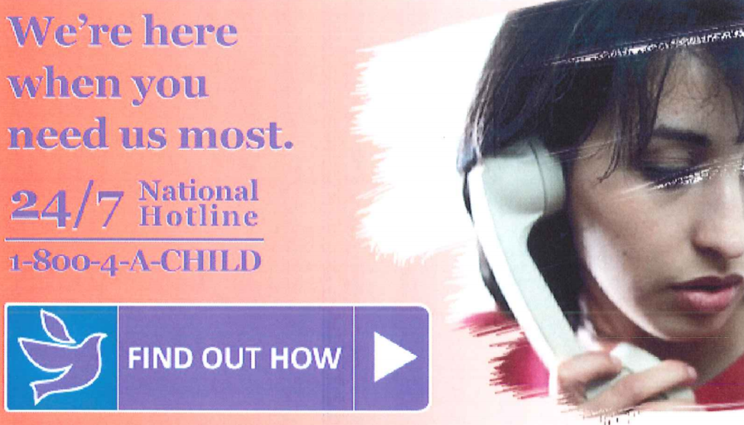
CHILD HELP HOTLINE 1-800-4-A-CHILD (1-800-422-4453)
CHILD HELP IS 24/7 TOLL FREE NUMBER
TALK TO A PROFESSIONAL TRAINED COUNSELOR
GET HELP ON DEALING WITH INFANT CRYING AND OTHER DEVELOPMENT TOPICS
Notes:
WHEN PARENTS/CAREGIVERS GET TO A POINT WHERE THEIR FRUSTRATION AND ANGER COULD POTENTIALLY HURT A BABY, THEN PUT BABY DOWN IN A SAFE PLACE AND CALL THE CHILD HELP HOTLINE.

Slide 24
PERIOD OF PURPLE CRYING
PERIOD OF PURPLE CRYING IS AN IMPORTANT PREVENTION PROGRAM AIMED TO REDUCE THE INCIDENCE OF SHAKEN BABY SYNDROME.
PERIOD OF PURPLE CRYING PROGRAM AIMS TO EDUCATE PARENTS/CAREGIVERS ABOUT THIS NORMAL DEVELOPMENTAL PHASE IN A BABY’S LIFE.
IT PROVIDES STEPS ON HOW TO COPE WITH AN INFANT’S CRYING AND HOW TO DEAL WITH THEIR FRUSTRATION.
IT HELPS THEM UNDERSTAND THE DANGERS OF SHAKING OR ABUSING A BABY.
Notes:
REASON WHY IT’S AN IMPORTANT PREVENTION PROGRAM IS BECAUSE IT GOES BEYOND SIMPLE WARNINGS TO NOT SHAKE A BABY BUT RATHER ADDRESSES THE MAIN CAUSE OF SHAKING WHICH IS FRUSTRATION WITH A BABY’S CRYHING.
ALL INFANTS GO THROUGH THIS STAGE IN THEIR DEVELOPMENT WHEN THEY CRY MORE THAN ANY OTHER TIME IN THEIR LIVES.
AGAIN DR. BARR WANTS PARENTS/CAREGIVERS TO REMEMBER IT IS OKAY TO GET FRUSTRATED AND ANGRY, IT IS WHAT YOU DO WITH IT THAT IS IMPORTANT.

Slide 25
www.clickforbabies.org
NATIONAL CAMPAIGN TO RAISE AWARENESS ABOUT THE PERIOD OF PURPLE CRYING AND TO HELP PREVENT THE SHAKING AND ABUSE OF INFANTS.
PURPLE CAPS ARE KNITTED AND DELIVERED TO BABIES AND FAMILES.
PURPLE CAPS SERVE AS A VISUAL REMINDER FOR PARENTS OF THE PERIOD OF PURPLE CRYING AND THE NORMAL, INCREASED CRYING BABIES WILL GO THROUGH.
IT ALSO REMINDS PARENTS TO GO BACK AND LOOK AT THE MATERIAL THEY WERE GIVEN IN THE HOSPITAL.
Notes:
NCSBS HAS A PUBLIC EDUCATION CAMPAIGN CALLED “CLICK FOR BABIES” AND THEY DO THIS IN PARTNERSHIP WITH HOSPITALS, CLINICS AND CHILD ABUSE PREVENTION GROUPS TO CREATE AWARENESS ABOUT THE PERIOD OF PURPLE CRYING AND TO ADDRESS THE LEADING CAUSE OF INFANT ABUSE: FRUSTRATION WITH INFANT CRYING.
THE 2014 CAMPAIGN STARTED IN MAY AND ENDED OCTOBER 1ST. (PEOPLE START KNITTING.) PURPLE CAPS WILL BE DELIVERED IN NOVEMBER AND DECEMBER TO FAMILIES IN HOSPITALS DURING OFFICIAL ANNOUNCEMENT ABOUT SHAKEN BABY SYNDROME. (CAPS CAN BE KNITTED ALL YEAR ROUND) BUT CAMPAIGN IS IN NOVEMBER & DECEMBER.
WAS TOLD BY NCSBS THEY ONLY HAVE ONE LOCATION IN TEXAS FOR CAPS TO BE DELIVERED: SHEPPARD AIR FORCE BASE IN WICHITA FALLS (OUTSIDE OF DALLAS). WAS TOLD THEY ARE LOOKING TO EXPAND NEXT YEAR.
THE PURPLE CAPS SERVE AS A VISUAL REMINDER FOR PARENTS OF THE PERIOD OF PURPLE CRYING AND THE NORMAL, INCREASED CRYING BABIES WILL GO THROUGH. IT ALSO REMINDS PARENTS TO GO BACK AND LOOK AT THE MATERIAL THEY WERE GIVEN IN THE HOSPITAL.
THEY ARE ALSO OTHER WAYS TO GET INVOLVED BESIDES KNITTING. SHARE INFO ATTACHED TO BE DISTRIBUTED.

