Slide 1
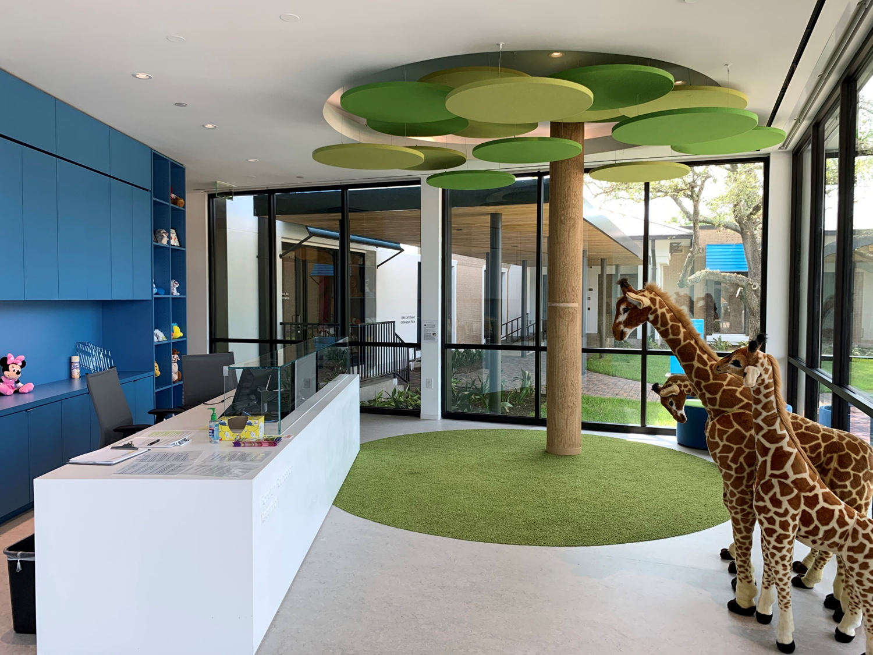
Recognizing and Responding to Child Abuse

Slide 2
Who we are
Notes:
CAC
Lessen the trauma to abused children going through legal systems.
Offers forensic interviews, therapy services, criminal court advocacy, and referrals for medical exams.
Facilitates Coordination between DFPS, Law Enforcement and District Attorney’s Office.
All services are free.
Children treated in the CAC are given school excuses during treatment. Please respect confidentiality of those students.
CASA
CASA advocates for children’s “best interests” in the foster care system by recruiting, training and deploying community advocates called Guardians ad Litem or CASA Volunteers to provide a voice for children in the courts.
Provides specialized support to all foster youth who are removed from Fort Bend County through programs to fit the child’s development needs and considerations for education, medical, emotional and mental health needs.
Works with Biological families, foster or kinship families, county attorneys, and other support services involved with the child or family.
Often collaborates with schools for educational advocacy. CASA volunteers may visit children on campus and may have access to educational records of the student or students they are assigned to as advocates.
Utilizes

Slide 3
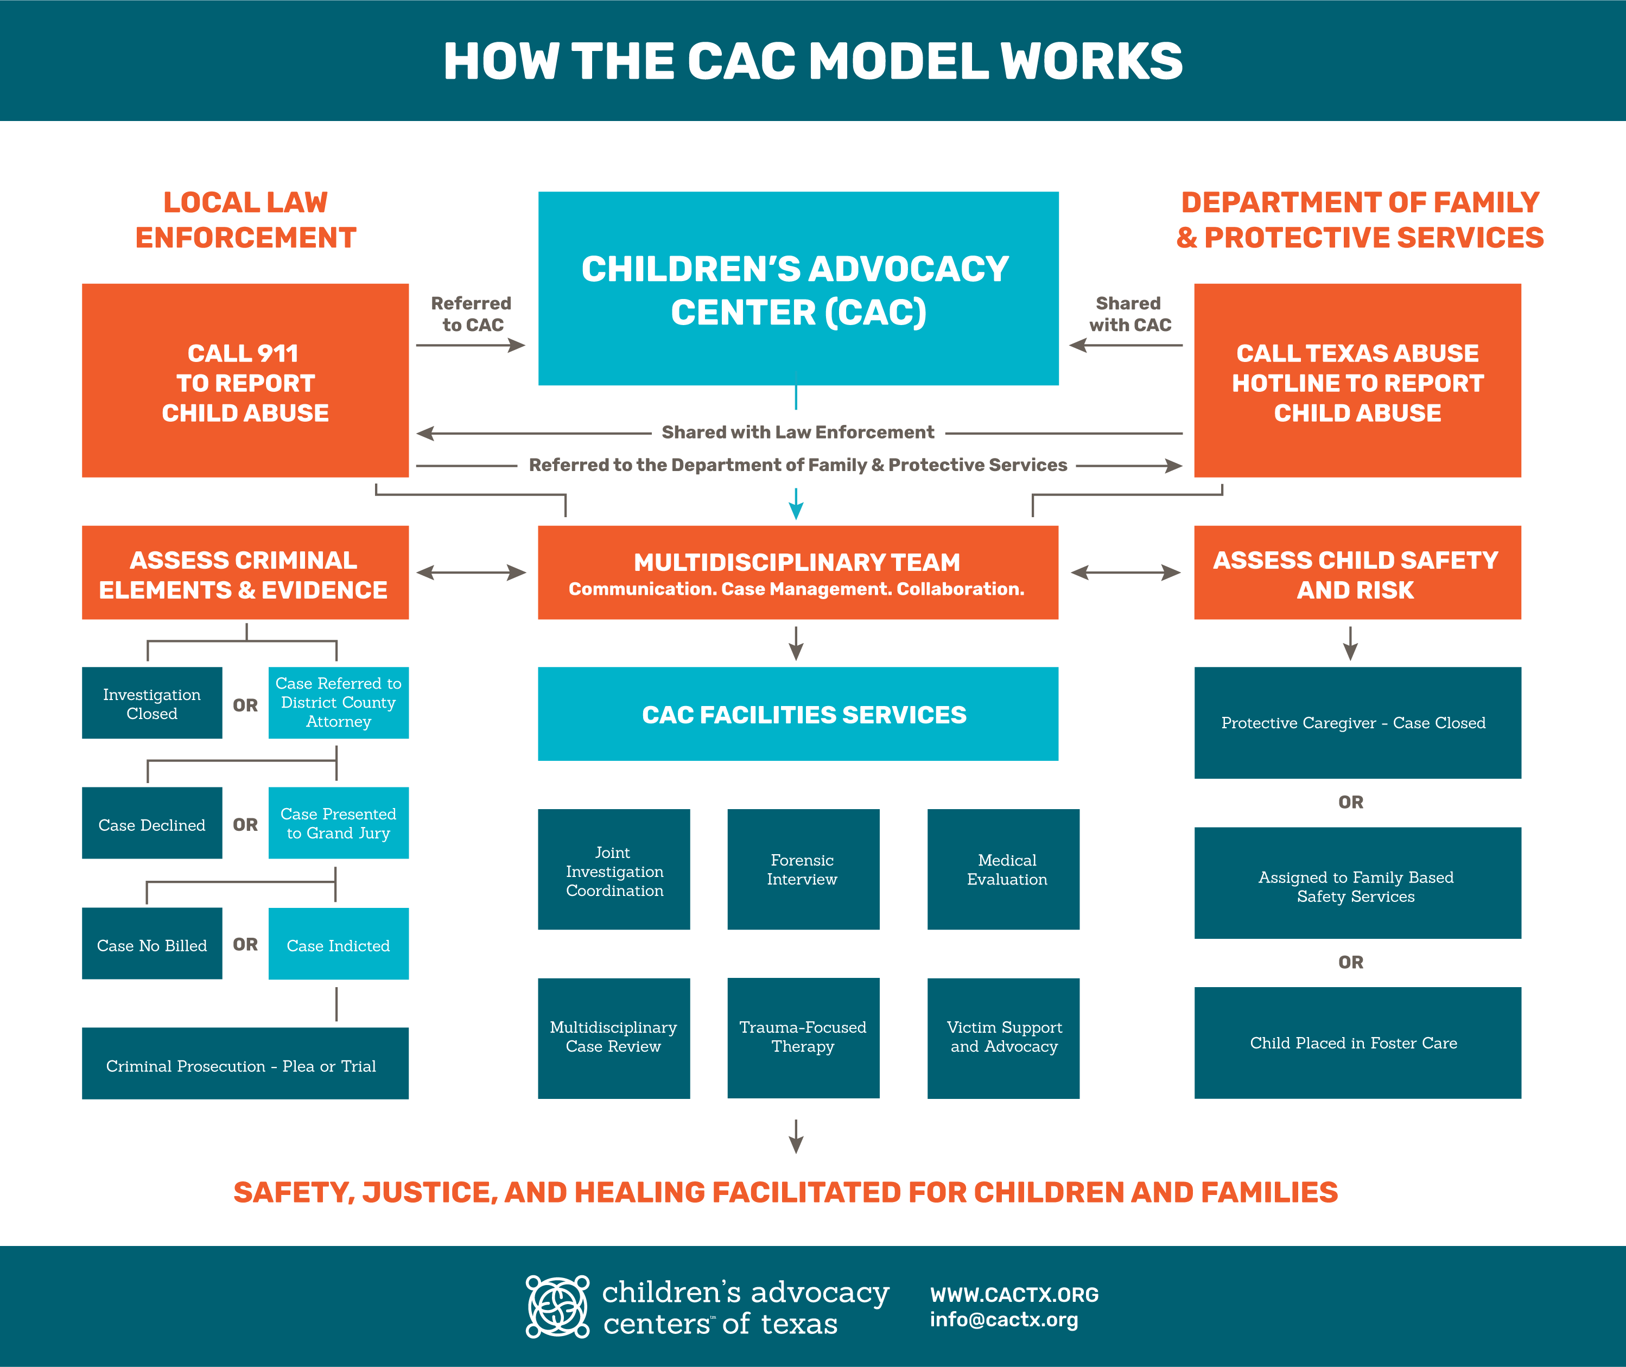

Slide 4
A look at our area
30-50% increase in domestic violence
5,360 reports reviewed by MDT coordinators
3,524 children and families served
Updated 2021
Notes:
30-50% increase in domestic violence reports in our region during COVID-19.
We saw more severe cases of physical abuse.
5,360 reports were reviewed in our CAC for possible interviews resulting in 2458 meeting criteria for an interview. This is up 53% from 2019.
3,524 children and families were served in our CASA and CAC programs in 2020.

Slide 5
Poll questions
To join the poll go to:
slido.com
enter code #406043

Slide 6
Which topic would you like more in depth information on?
ⓘ Start presenting to display the poll results on this slide.

Slide 7
What are some of the signs that children showed that caused you to make a CPS report?
ⓘ Start presenting to display the poll results on this slide.

Slide 8
Child Abuse Facts
Notes:
Neglect is the most common form of abuse according to Child Trends for FY 2019 both in Texas and across the nation. This is reflective in the number of children served in our CASA program where 65% of the children served are primarily a result of neglect.
Many types of abuse overlap with each other which means that when we see one type of abuse, we need also be looking for other types of abuse.
Domestic violence is a risk factor for child abuse. Rates of domestic violence co-occur from 30% to 60%
The Children’s Advocacy Center sees children who have experienced sexual abuse, serious physical abuse, or witness of violent crimes
66% of their cases are for sexual abuse 22% are for physical abuse and 7% are witness to violent crime.

Slide 9
Child Abuse Facts
Notes:
1 in 10 children will experience sexual abuse before their 18th birthday.
40 % of sexually abused children will be revictimized in their lifetime.
98% of children are abused by someone they know

Slide 10
Child Abuse Facts
Notes:
Nearly 70% of all reported sexual assaults (including assaults on adults) occur to children ages 17 and under (Snyder, 2000) (NCVS, 2002)
Youths have higher rates of sexual assault victimization than adults. In 2000, the sexual assault victimization rate for youths 12 to 17 was 2.3 times higher than for adults (U.S. Dept. of Justice, Bureau of Justice Statistics, 2000).

Slide 11
Children with Disabilities
More at risk for abuse
Noticing signs is even more important
Signs may be missed as part of diagnosis
Notes:
More at risk:
Greater dependence on caregivers
More likely to be in one-on-one situations if they have physical needs
Can be more isolated if social situations present challenges for their needs
Signs
Children who are not getting proper care and dependent on others are in a more serious situation than those who can do for themselves
These children may have verbal challenges that make it very difficult to disclose
Signs may be dismissed as part of their diagnosis
Making a report
Be specific and clear about behavioral changes and if you think this is abuse related
Give information about the child’s diagnosis
Include information about who is caring for the child

Slide 12
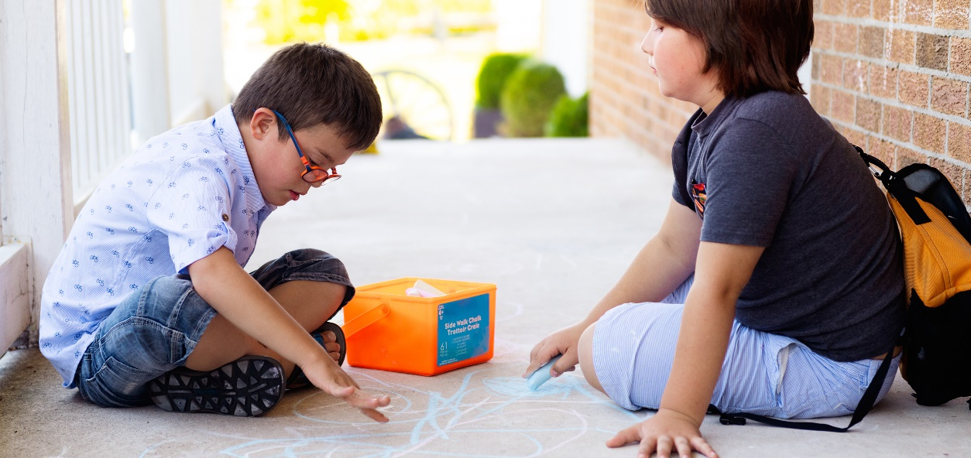
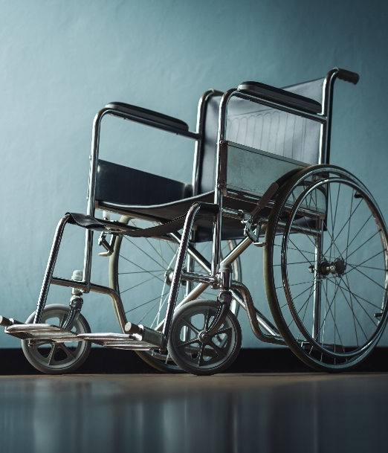
Types of Neglect
Notes:
Physical Neglect:
Failure to provide a child with the necessary food, clothing, and shelter to maintain a healthy life.
Neglectful supervision:
Placing the child in, or failing to remove a child from, a situation that a reasonable person would realize requires judgment or actions beyond the child’s level of maturity, physical condition, or mental abilities.
Results in bodily injury or a substantial risk of immediate harm to the child.
Exposes the child to a substantial risk of harmful sexual conduct.
Exposes the child to sexual abuse committed against another child.
Medical
Failure to seek, obtain, or administer medical treatment that could result in substantial harm.

Slide 13
Signs of Neglect
Notes:
Signs of Neglect:
Obvious malnourishment
Lack of personal cleanliness
Torn or dirty clothing
Stealing or begging for food
Child unattended for long periods of time
Need for glasses, dental care, or other medical attention
Frequent tardiness or absence from school

Slide 14
Physical Abuse
Deliberate actions resulting in injuries to a child or genuine threats of such actions or concerns about physical injuries of an unexplained or suspicious nature.
Notes:
Definition: Deliberate actions resulting in injuries to a child or genuine threats of such actions or concerns about physical injuries of an unexplained or suspicious nature. (DFPS, 2021)
Signs of Physical Abuse:
Frequent injuries such as bruises, cuts, black eyes, or burns without adequate explanations
Frequent complaints of pain without obvious injury
Burns or bruises in unusual patterns that may indicate the use of an instrument or human bite; cigarette burns on any part of the body
Lack of reaction to pain
Aggressive, disruptive, and destructive behavior
Passive, withdrawn, and emotionless behavior
Fear of going home or seeing parents
Injuries that appear after a child has not been seen for several days
Unreasonable clothing that may hide injuries to arms or legs

Slide 15
Physical Abuse cont.
Explanation given doesn’t match
Unexplained injuries
Non-accidental injuries
Fading bruises or other marks
Notes:
Definition: Deliberate actions resulting in injuries to a child or genuine threats of such actions or concerns about physical injuries of an unexplained or suspicious nature. (DFPS, 2021)
Signs of Physical Abuse:
Frequent injuries such as bruises, cuts, black eyes, or burns without adequate explanations
Frequent complaints of pain without obvious injury
Burns or bruises in unusual patterns that may indicate the use of an instrument or human bite; cigarette burns on any part of the body
Lack of reaction to pain
Aggressive, disruptive, and destructive behavior
Passive, withdrawn, and emotionless behavior
Fear of going home or seeing parents
Injuries that appear after a child has not been seen for several days
Unreasonable clothing that may hide injuries to arms or legs

Slide 16
Emotional Abuse
An emotional or mental injury caused by the parent or caregiver that results in an observable effect on the child.
Notes:
Verbal/actions comments by adults that cause emotional distress to child
Comments/actions leading to intense impact on child’s self-esteem
Must be a repeated pattern

Slide 17
Emotional Abuse
Often occurs with other abuse types
Most damaging long-term effects
Often requires mental health assessment
Notes:
Signs of Emotional Abuse:
Over compliance
Low self-esteem
Severe depression, anxiety, or aggression
Difficulty making friends or doing things with other children
Lagging in physical, emotional, and intellectual development
Caregiver who belittles the child, withholds love, and seems unconcerned about the child’s problems

Slide 18
Sexual Abuse
Any sexual act between an adult and a minor, or between two minors, when one exerts power over the other.
Notes:
It may include forcing, coercing, or persuading a child to engage in any type of sexual act.
It also includes non-contact acts such as exhibitionism, exposure to pornography, voyeurism, communicating in a sexual manner, and commercial sexual exploitation.

Slide 19
Sexual Abuse
Unlikely to have physical signs
Changes in behavior
Aggression, rebellion, or other changes
Notes:
Physical signs:
Persistent or recurring pain during urination or bowel movements
Wetting or soiling accidents unrelated to toilet training
Sexually transmitted diseases
Chronic stomach pain
Headaches
Emotional signs:
Anxiety and depression
Sleep disturbances, including nightmares or night terrors
Change in eating habits
Unusual fear of certain people or places; reluctance to be alone with a certain person
Changes in mood that could including anger, aggressiveness towards parents, siblings, friends, pets
Rebellion or withdrawal; runaway behavior
Change in attitude towards school or academic performance; lack of interest in friends, sports, or other activities
Unexplained or frequent health problems like headaches or stomach aches

Slide 20
Sexual Abuse Prevention
Access
Boundaries
Red Flags
Notes:
Sexual abuse most often occurs in private – one on one interactions are high risk areas for abuse.
Consider where adults and students may be alone together, or students alone with other students.
Are there alternatives to one on one situations? (locker rooms, stairwells, office hours for teachers, restroom breaks, private messaging conversations)
Boundaries -
Keep conversations visible to others in person and virtually
Follow school policies regarding interaction with students
If a student violates a boundary, gently but firmly remind them that boundaries are in place.
This is my space and this is your space.
Let’s get other students involved in this conversation or your parents.
Red Flags:
Physical: Tickling, horseplay, hugging, massaging, wrestling, going overboard with affection.
Emotional: Making a child feel important, cared about or understood, spending too much time with them, choosing favorites, giving gifts, acting possessive, sending excessive or inappropriate texts, sharing personal information to make the child feel like they have a special relationship, promising extra recognition or attention.
Behavioral: Keeping secrets with child, offering drugs or alcohol, telling inappropriate jokes, showing inappropriate content (sexual explicit content or pornography)

Slide 21
When a child discloses….
Abuse most often occurs with a known adult
Children sometimes “test the waters”
Most abuse cases are reported by school personnel
Notes:
Abuse most often occurs in the home of the child or with a perpetrator who is close to the family – For all abuse types 77.5% of the perpetrators are parents of the victim according to Child Maltreatment findings (2019) https://www.childwelfare.gov/pubpdfs/canstats.pdf
For sexual abuse the perpetrator is known to the victim in 98% of cases. CACTX, 2021
Children may “test the waters” by telling pieces of story to gauge reactions
A calm and open demeanor is important.
Let the child know what is happening is not their fault and telling is very important.
School personnel are the most common reporters of child abuse. 68.6 % of all reports of alleged abuse are made by professional reporters.
21% of School personnel
11% medical personnel
10% social services staff

Slide 22
Best Practices for Educators
Listen with undivided attention
Only get enough information to make a report
Child should not be asked to talk to multiple people
Notes:
Disclosure-
A child tells you that someone has been hurting them or doing something to them that makes them uncomfortable.
They may not offer a lot of details or may say things that are confusing or contradictory.
You may ask open ended questions to get enough detail to make a CPS report such as who was involved or what happened.
Please do not get additional details or ask the child to speak to additional faculty members.
Sometimes disclosures are unclear so if a child says something that doesn’t make sense or you don’t understand it is ok to ask for more details. Again, being very open ended and limiting questions to only those necessary to make a report

Slide 23
Why is it important for children to tell their story one time?
Notes:
Allow child to tell story ONE TIME to ONE PERSON
Repeated questioning of child leads to:
Traumatized child
Investigations that are jeopardized because child’s story may “change”
Children who are too tired of talking about it to disclose during a forensic interview
Children who become frightened about consequences of disclosure and may recant
Young children start to realize it is a “big thing”
Person child told should be the reporter on the case

Slide 24
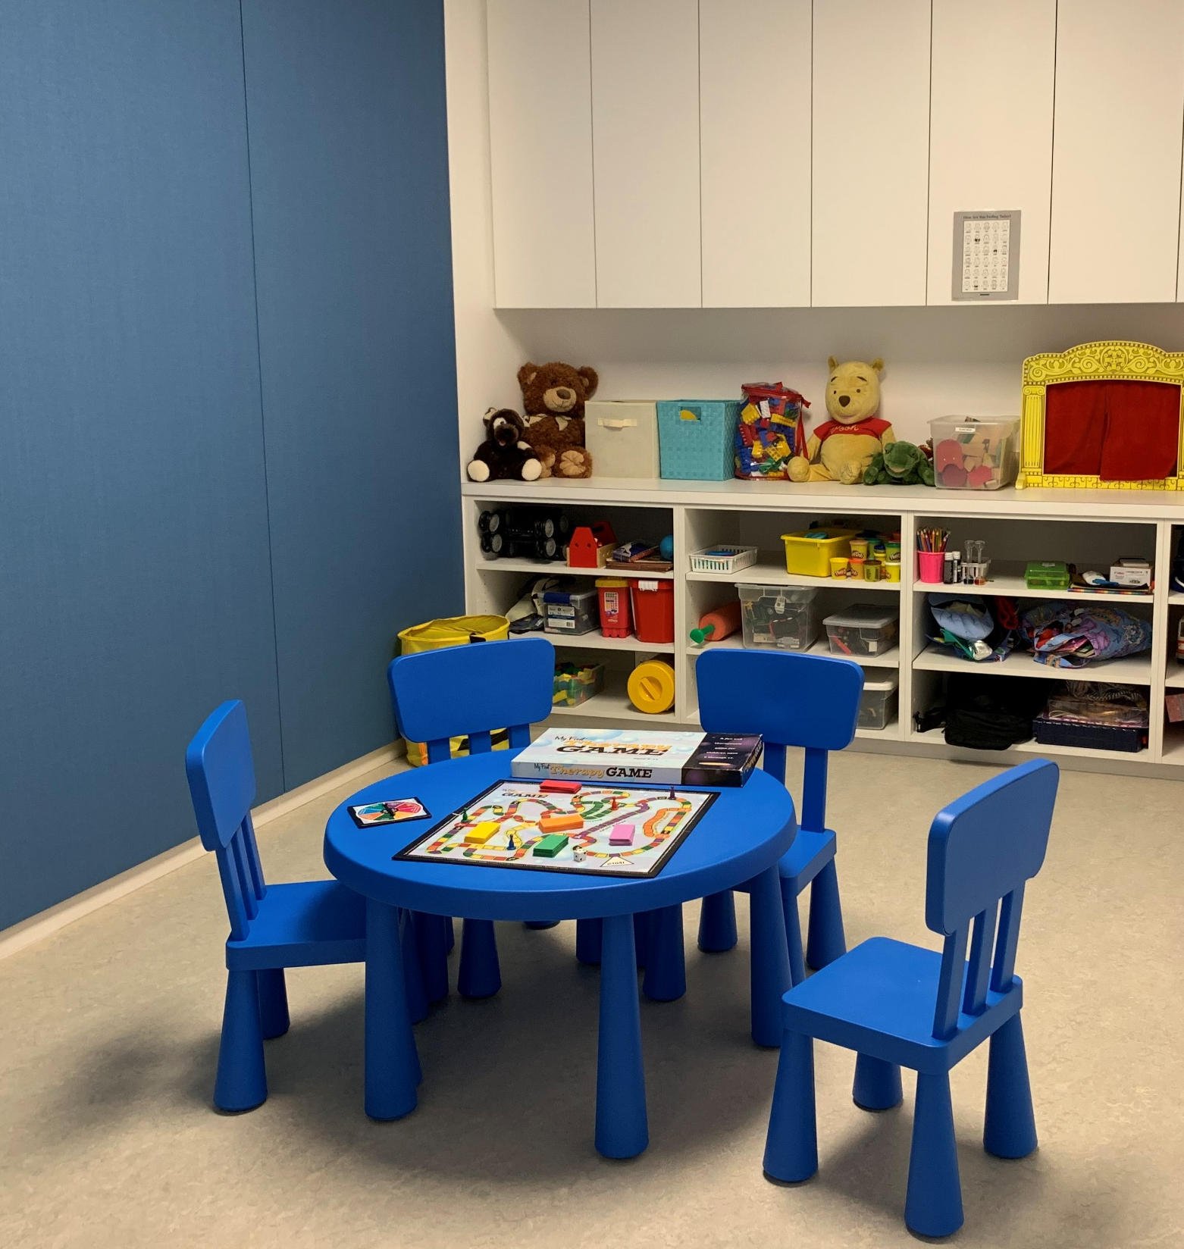
Response to a child who discloses
Notes:
Do not promise child anything
They may not return to school
They may not go home to parents
Parents may be angry with them
Somebody may get into trouble
Reassure them that they did the right thing by telling
Reassure child that it is okay to go with caseworker
Make sure that CPS has private space available for talking with the children
Document any visible injuries following school protocol.

Slide 25
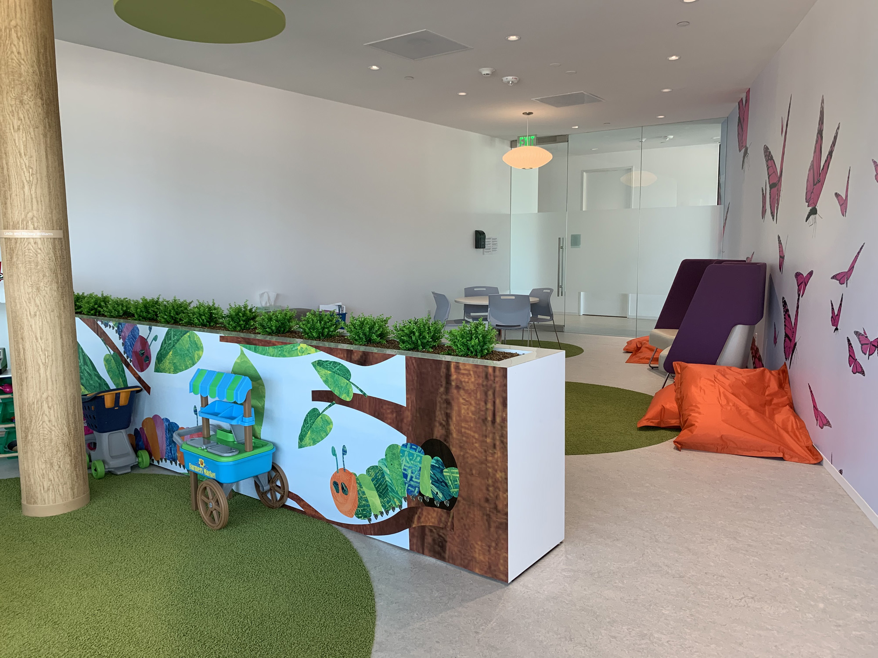
Interacting with parents/caregivers
Notes:
Do not need to investigate by questioning student, friends or parents
NEVER notify parents of suspicions or report of in home abuse
They may shut the child down
They may cause the child to recant
They may run with the child
They may re-abuse the child for telling
Do not provide information to parents if they contact the school
CPS will deal with parents’ questions, concerns, etc.

Slide 26
What is your biggest concern when making a CPS report?
ⓘ Start presenting to display the poll results on this slide.

Slide 27
Missed reports
70% of child sex offenders have between one and nine victims
Sometimes suspected abuse is never reported
Notes:
Only about a third of child sexual abuse incidents/cases are identified, and even fewer are reported.
Researchers estimate that 38% of child victims disclose the fact that they have been sexually abused.5,6 Of these, 40% tell a close friend, rather than an adult or authority.7 These “friend-to-friend” disclosures do not always result in reports. This means that the vast majority of child sexual abuse incidents are never reported.

Slide 28
When should I make a CPS report?
Child discloses abuse
You suspect abuse
Witness abuse
Notes:
For children with disabilities:
Making a report
Be specific and clear about behavioral changes you think are abuse related
Give information about the child’s diagnosis
Include information about who is caring for the child

Slide 29
Reporting Law
Professionals must make a CPS report within 48 hours of their discovery or suspicions of abuse
If you have suspicions of abuse, you are responsible for making a report, not another person within your staff.
Notes:
Legal duty to report
Educators, Counselors, Nurses, Coaches, Administrative staff, Paraprofessionals are all considered professional reporters
Consequences
Class B Misdemeanor
6 months in jail and fine
Reporting to CPS
Priority 1cases
Priority 2 cases
CPS Hotline 1-800-252-5400

Slide 30
When making a report
1-800-252-5400
Notes:
Details needed to report
Child’s name, age, DOB
Type of abuse – what they told you or what you witnessed
Name/relationship of alleged perpetrator
If child is frightened to return home
Good information to have if child offers it but do not question for information
Extent of abuse
Frequency/duration
Non-offending caregiver’s knowledge of abuse
Document conversation with child – outcry witness

Slide 31
Youth-on- youth
sexual abuse
Notes:
REVIEW WHAT THIS IS
Signs in Preschool/Elementary Age
Young children exhibiting sexual acting out behaviors
Actions beyond developmentally appropriate behavior ( preoccupation with genitals, touching other students on their genitals or asking to see private parts repeatedly, forcing another child to engage in sexual behavior)
Children < 10 can have no legal consequences
Signs of Sexual Abuse in Middle/High School students
Pre-teen/teens exhibiting sexual behavior
Sexual activity among peers on campus
Sexually explicit pictures being shared among students

Slide 32
Best Practices for youth-on-youth abuse
Initiating child under 10
Middle School
High School
Notes:
Children < 10
Report to CPS ensure safety of both children involved. Please include any additional behavior, academic, or emotional changes in either child.
Purpose is to determine if children have experienced abuse
Follow school policy regarding notifying family of victim
Pre-teen/teens
Reports should be made to school PD
Report is made to investigate “consent”
No youth under 17 can give consent to sexual activity.
Helps identify potential patterns by aggressors
Identifies vulnerable victims
Follow school policy regarding notifying family of victim

Slide 33
Allegations of
School Personnel
Notes:
Boundary violations
Pattern of complaints about inappropriate physical contact with students
Students sharing comments about staff
“He’s creepy”
“She likes certain boys”
Teacher spending time behind closed doors with students
Unnecessary one on one time with students
Communication with students outside school platforms
Contact with students outside of school

Slide 34
Reports regarding school personnel
Child does not need to be questioned
Notify campus police immediately
Make a CPS report
Notes:
Follow school policy regarding notification of parents

Slide 35
Taking Care of Yourself
Notes:
Children with special needs require more attention and patience
Notice when you become frustrated and create a plan to ask for help.
Take frequent breaks if possible.
Allow another person to help with situations which easily frustrate you.
Utilize resources provided by your district or insurance. Investing in your own mental health will reduce burnout.

Slide 36
Other trainings available
Trauma Informed Care
Building Self-Esteem and Compliance in Young Children
Sexual Abuse 101
Stewards of Children – Darkness to Light
Child Exploitation
Internet Safety
Child Safety Matters
Trust Based Relational Intervention
Contact lcastellanos@cafb.org

Slide 37
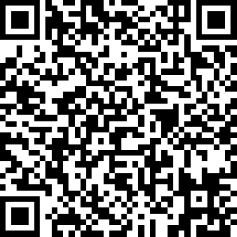
Training Certificate and Feedback Survey
Please scan the QR code:

Slide 38
How you can reach us
Child Advocates of Fort Bend
5103 Avenue N
Rosenberg, TX 77471
281-341-9955
Lindsey Castellanos
Community Outreach Coordinator
281.344.5259
lcastellanos@cafb.org
Metoyer Martin, MSW
CASA Program Director
281.344.5122
mellis@cafb.org

