Slide 1
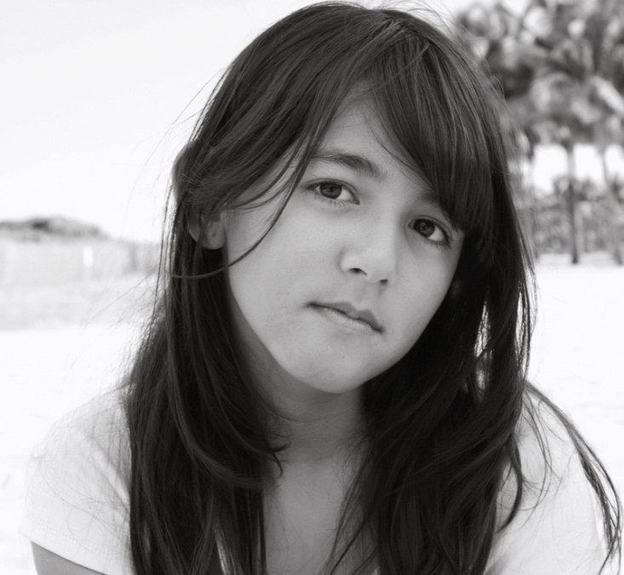
Advocating for Commercially Sexually Exploited Children & Youth
(Your Names Here)
(Replace Logos or Add Yours!)
Notes:
Supplies:
Index Cards
White board or large post-its
markers
Painter’s tape (ideally multiple colors)

Slide 2
Housekeeping
Expectations
Zoom etiquette
Self-care
Notes:
Objective:
· Create a comfortable environment conducive to learning and exploring emotionally difficult content.
*Consider providing light refreshments, coloring pages and colored pencils, fidget items, candy, etc.

Slide 3
Introductions
Introduce yourself!
What program are you representing?
How long have you been affiliated with CASA?
What is your favorite dessert?
Notes:
- Ice breaker activity
o Can be modified/changed to better serve variations in class-size, etc.
o Objective is to create a sense of familiarity among the learners as they prepare to learn about and reflect upon challenging content.

Slide 4
Chapter 1.0
OVERVIEW

Slide 5
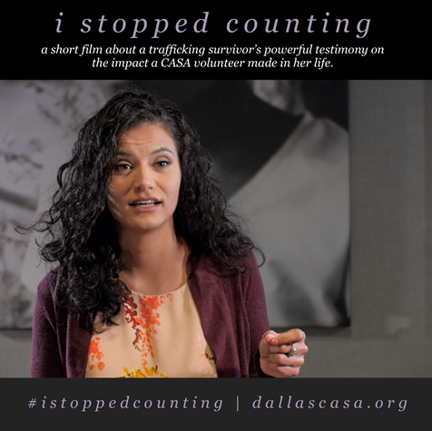
I Stopped Counting

Slide 6
Personal Connection

Slide 7
Origin of CASA Specific C-SEC Training: Collaborative Efforts
Governor’s Office created Child Sex Trafficking Team.
State-wide initiative to create Multi-disciplinary Teams.
Identified Saving Innocence as preferred model for advocacy.
https://www.youtube.com/watch?v=6qf7Iwa88ig&t=9seo
Funding for other specialized programs.
Notes:
To understand how CASA’s CST program began
o Provide some history
- 3 Legislative sessions ago – Gov Office created CST Team​ with the goal of creating a consistent response
- Working in silos​, Collaborative effort, all stakeholders work together
- Found the model Los Angeles, created by Saving Innocence
- Main Focus: create local MDT's
o LE , Medical, advocacy groups, DA's, CAC's, LE, DFPS, Juvenile (grants)
o Care Coordination (DCAC) – 1 ½ years protocol
- How to pass the baton
o Recovery-restoration
- Other funding: drop in centers, emergency shelters, specialized foster homes, Trauma informed trainings, specialized prosecutors, universal screening tools (Allies Against Slavery).

Slide 8
Local Care Coordination Team: Dallas Example
Law Enforcement
DFPS
DCAC
Traffick911
Dallas CASA
Service Providers/Drop-In Centers/Shelters
Promise House
NFNL
Children’s Health
Parkland
Texas Health Resources
Dallas County District Attorney’s Office
Dallas County Juvenile
Department

Slide 9
Basic Continuum of Care
Meet Emergency Needs
Provide Urgent Care
Support Restoration
Build Resiliency

Slide 10
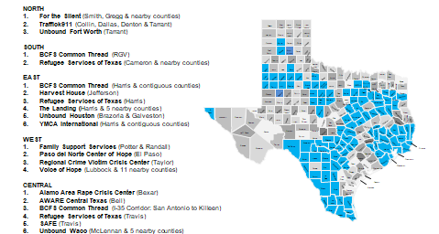
CSEY Advocacy Agencies

Slide 11
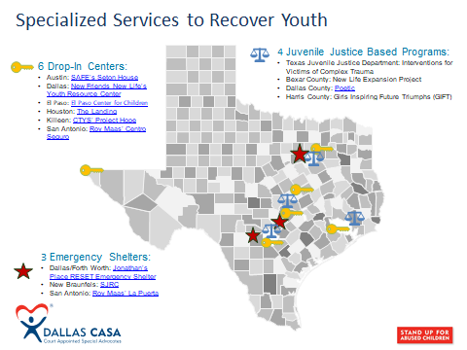
Specialized Services to Recover Youth

Slide 12
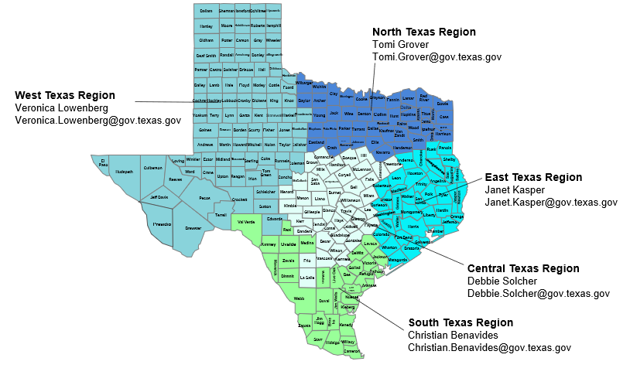
Care Coordination Regional Map and Contact Info*
*Contact info changes regularly

Slide 13
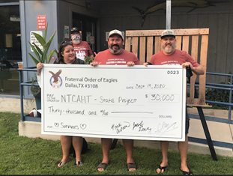
Local Coalition: Dallas Example

Slide 14
Chapter 2.0
DEFINING HUMAN TRAFFICKING
Notes:
Ask group: your definition of human trafficking??? The layperson’s definition? Write notes on whiteboard?

Slide 15
What IS Human Trafficking?
Human trafficking is a form of modern-day slavery in which traffickers use force, fraud, or coercion to control victims for the purpose of engaging in commercial sex acts or labor services against his/her will.
If a sex trafficking victim is under the age of 18 (or age of consent in that region of the country), there is no burden of proof for force, fraud, and coercion. (Source: Polaris Project)
Notes:
R
No mention of “movement” across borders, etc. Myth of “child prostitute”, etc. re: children: https://www.youtube.com/watch?v=PyEaGKr35GQ

Slide 16
Commercial Sexual Exploitation of Children/Youth (CSEC or CSEY)
Commercial Sexual Exploitation of Children (CSEC) is a term that refers to a range of crimes and activities involving the sexual abuse or exploitation of a child under the age of 18 for the financial benefit of any person or in exchange for anything of value, including monetary and non-monetary benefits, that are given or received by any person.
Notes:
M
Dept of Justice def. So what does it actually mean. Ask class for examples of things that can be exchanged: clothing, food, shelter, love, etc. Discuss the myth of “survival sex”

Slide 17
Trafficking vs. Smuggling
Trafficking:
•No movement required
•Focus is compelled labor,
service, or commercial sex
•Victim is PERSON
•Victim can be a citizen, documented
migrant, or undocumented
Smuggling:
•Must involve illegally moving across borders (state, country, etc.)
•Focus is transporting or harboring illegal alien
•Crime is against integrity of border
•Victim is a COUNTRY/STATE
Notes:
M
Sex trafficking gets more attention as it is more “glamorous”. Media study: from 2000-2005, articles containing info on HT from major media sources (NYTimes, WashPost, Times of London, Guardian, Toronto Star, and Globe and Mail) compiled data showed:
Media focused significantly more on sex trafficking than on labor trafficking

Slide 18
Types of Trafficking
Sex trafficking (50% of cases investigated by FBI)
can involve: sex acts, “forced prostitution”, mail-order brides, pornography, illicit massage parlors (IMB)
Forced labor/Labor trafficking (35% of cases investigated)
Agricultural industry, construction, factory, food service, cleaning jobs, and can often bleed into the sex industry.
Domestic servitude (15% of cases investigated)
Live-in nannies or maids, kept in a private home, often involves forced labor and sexual assault
Notes:
M
Sex trafficking gets more attention as it is more “glamorous”. Media study: from 2000-2005, articles containing info on HT from major media sources (NYTimes, WashPost, Times of London, Guardian, Toronto Star, and Globe and Mail) compiled data showed:
Media focused significantly more on sex trafficking than on labor trafficking

Slide 19
Local and National Statistics
2016 study by University of Texas and the Institute on Domestic Violence and Sexual Assault:
Est 300,000 human trafficking victims in Texas
79,000 were minors
Est 60-70% of those youth have experienced the foster care system
Average age of reported trafficking victims in the US is 14
Texas ranks second highest in the nation in number of reported cases of human trafficking.
California is first, Florida is third.
Notes:
R

Slide 20
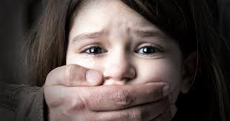
What Society Thinks Sex Trafficking Is…
Notes:
R&M
Do LIVE search for images of trafficking???? Ask for other imagery from the class. Specific problem with the “kidnapped” child; Ashley to do the Google searchingz

Slide 21
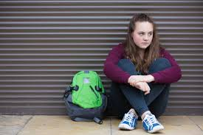
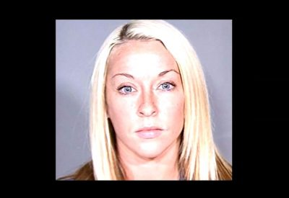
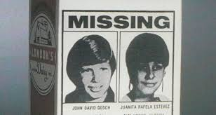
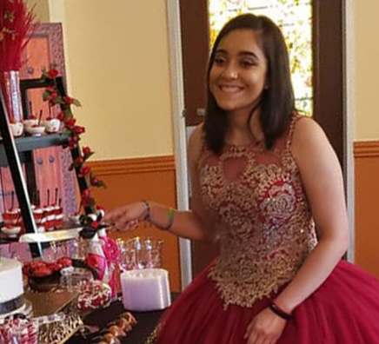
What Sex Trafficking ACTUALLY Is…
Notes:
R&M
Runaways, all young people are at risk, etc.
--15-year-old girl rescued from sex traffickers committed suicide over the weekend. Letty’s father told the station he believed his daughter couldn’t get over being away from the man who took her. She ran away from home twice to be with the man, who had been arrested and then released days later, the family said.
--Rebeka Charleston: top and bottom. Trafficked as teen from Keller, TX. Before and after. Now runs agency Valiant Hearts, public speaking, etc.

Slide 22
Myths- Poll time!

Slide 23
Myths
Most victims are held captive
It is always a violent crime
Only happens “over there”/in illegal industries
Trafficking requires movement across borders
If the person originally consented to prostitution, they can never be a victim of trafficking
They are held against their will
Notes:
POLL???

Slide 24
Julie
Julie entered foster care at age 9 because of sexual abuse by her mother’s boyfriends. In exchange for sex with Julie, boyfriends paid for the mother’s rent and food. After CPS removal, Julie lived in several different foster homes and then Residential Treatment Centers. CASA was appointed from the beginning. At age 13, Julie began running away – always running back to her mother. Her mother would give Julie drugs and alcohol and further victimize her through sexual abuse by her boyfriends. It was hard to keep in touch, but Julie always called her advocate when she had access to a phone. Julie fell behind in school – she is now 16 years old and is classified as a freshman. She was introduced by her mother to a 22-year-old man named Tony – they began dating and it is suspected that he is now her trafficker. Julie has a public and active social media page – she uses an alias and the majority of her friends are male and most of her photos are provocative. After a falling-out with her mother, Julie is now living with Tony. She is pregnant.
Notes:
R

Slide 25
CSEY in Foster Care
What puts a youth in foster care at higher risk for being trafficked?
Notes:
R
Introduce Destiny’s story. Input from class: ask them to make list of Destiny’s risk factors. USE WHITEBOARD IN ZOOM

Slide 26
CSEY and Risk Factors
Runs away from home or placement
Uses drugs or alcohol
Basic needs are not met
In foster care/CPS system
History of sexual abuse
Low self-esteem
Unaddressed trauma
Developmental or learning delays/disabilities
Mental health issues
Identifies as LGBTQ+
Spends a lot of time alone
Undocumented
Notes:
M
Other things to add and consider? Does this list describe a lot of teens in care? Does it describe a lot of teens in general???

Slide 27
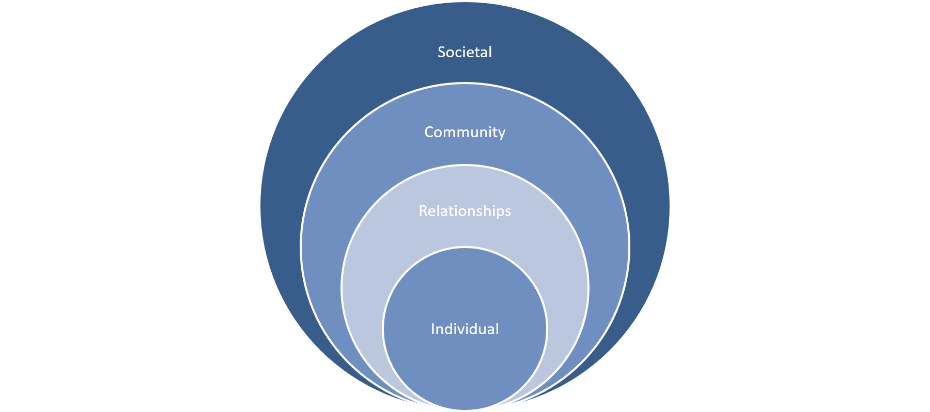
Looking at Sex Trafficking Through the Social-Ecological Model
Notes:
M
The Social-Ecological Model: A complex interplay between individual, relationship, community, and societal factors. It allows us to understand the range of factors that put people at risk for violence, or protect them from experiencing or perpetrating violence. The overlapping rings in the model illustrate how factors at one level influence factors at another level.
This model was developed by the CDC, and is used to address, understand, and prevent a variety of social problems, primarily intimate partner violence. The model can be applied when looking at CSEC youth: what predisposes youth to become vulnerable, what fuels sex trafficking, and what perpetuates further victimization by society’s lack of understanding the dynamics.

Slide 28
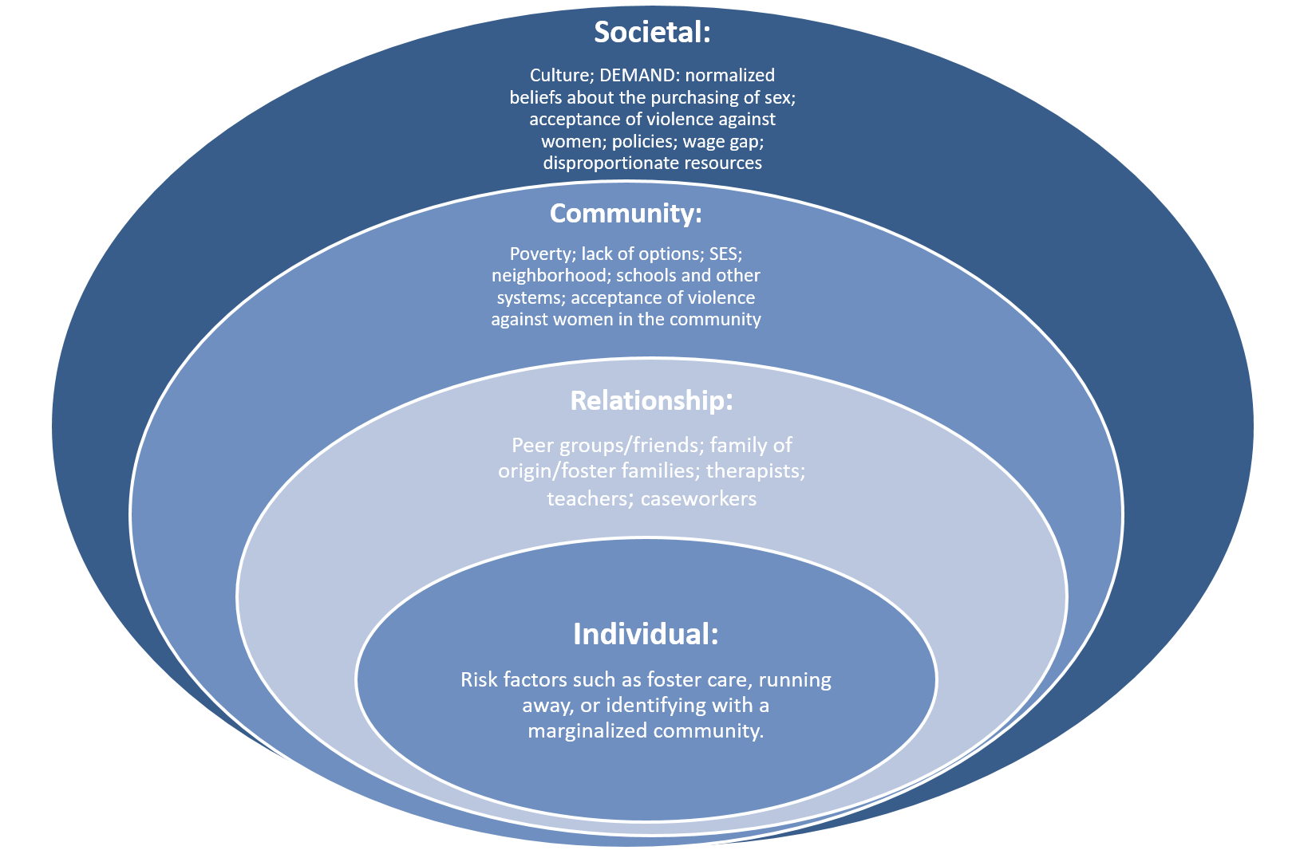
Notes:
R&M
R--I and R
M--C and S

Slide 29
The Social-Ecological Model and Youth in Foster Care
Individual:
Biological and personal history factors that increase the likelihood of becoming a victim or perpetrator of violence. Some of these factors are age, education, income, substance use, or history of abuse. (Risk Factors)
Relationship:
Close relationships that may increase the risk of experiencing violence as a victim or perpetrator. A person’s closest social circle-peers, partners and family members-influences their behavior and contributes to their experience. (family of origin, foster families, CASA advocates, case workers, therapists, etc.)
Community:
Settings, such as schools, workplaces, and neighborhoods, in which social relationships occur and seeks to identify the characteristics of these settings that are associated with becoming victims or perpetrators of violence. (the child welfare system itself, courts, foster care system, etc.)
Societal:
Broad societal factors that help create a climate in which violence is encouraged or inhibited. These factors include social and cultural norms that support violence as an acceptable way to resolve conflicts. Other large societal factors include the health, economic, educational and social policies that help to maintain economic or social inequalities between groups in society. (Social norms and values, Texas Family Codes, CPS policies, Juvenile Law, stigma of being in foster care, stigma of being a “victim”)
Notes:
M
Red: in the case of CSEC…

Slide 30
Activity: Adapted Voices All Around
In your small group/room, complete the worksheet (handout: Voices All Around) on messaging as it relates to the social-ecological model.
Notes:
ALL
Zoom breakout rooms. 4 rooms, Individual, Relationship, Community, Societal. Each facilitator assigned to a room to help guide conversation. Report back to large group. ***NEED ONE PERSON TO STAY IN LARGE GROUP!!!! OR ONLY DO 3 BREAKOUT ROOMS AND ASSIGN EVERYONE BUT 1 GROUP AND FACILITATOR****

Slide 31
Reflection:
What was this activity like for you? Discuss the differences in messaging for Julie and for children who grow up in healthy homes.
What level has the most significant impact on Julie?
Notes:
Can be all of them, can differ from day to day, from view to view…
BREAK?

Slide 32
Give Me a Break!
Notes:
Pass out kit kats

Slide 33
Factors that Keep Human Trafficking Alive
•Poverty
•Global market
•Disproportionate availability of resources worldwide
–Which has lead to global migration, most recently an increase in female migration.
•Widening gap between rich and poor
•DEMAND, especially the demand for young girls.
Notes:
M
Reflect back to the model...

Slide 34
What Fuels the Demand?
•Modern culture that objectifies women and girls
•Minimization and “acceptance” of violence against women
•Normalization of buying sex
•Perpetuating the myths about trafficking which deflect from the actual issues
Notes:
R
***DEMAND ABOLITION STATS: study in 2018, the main driver of sex buying: normalized beliefs about commercial sex trade, it’s a victimless crime, guys being guys. only 6% of men who were polled had been arrested for buying sex, so the criminalality is not a detterrent.

Slide 35
Reflection
What apprehensions/concerns do you have about serving youth who have been trafficked?

Slide 36
Chapter 3.0
VICTIM IDENTIFICATION

Slide 37
Hand Model of the Brain

Slide 38
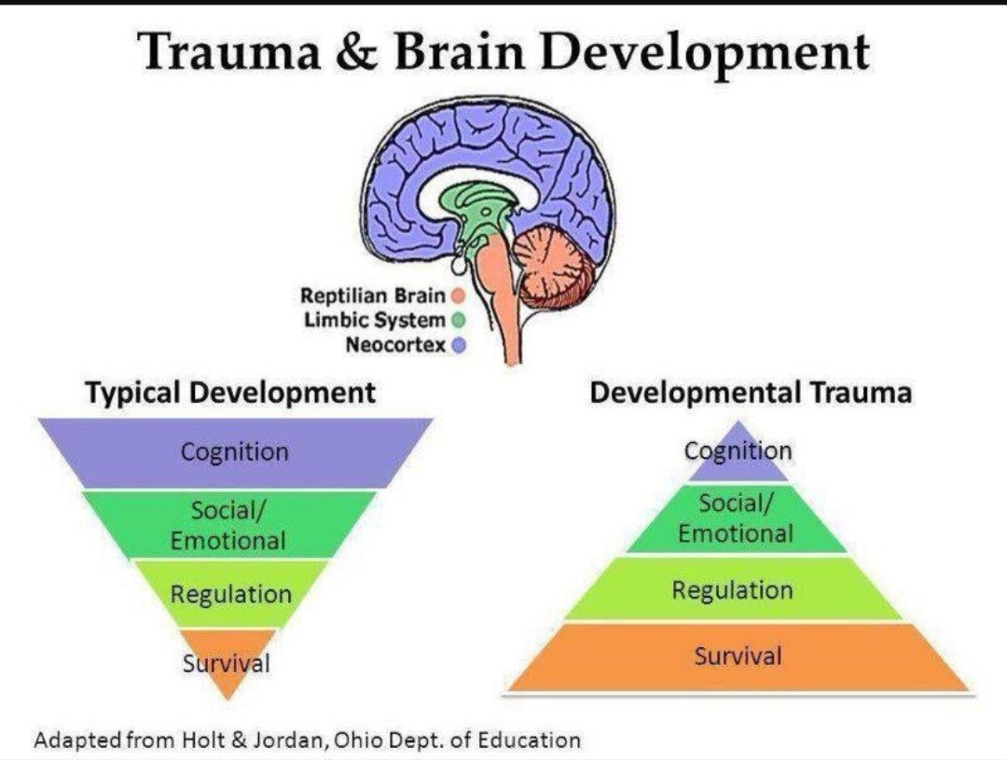
Trauma and Brain Development

Slide 39
Types of Trauma
Acute
Chronic
Complex
Historical
Traumatic Grief
Interpersonal Trauma

Slide 40
Trauma Bonds
The misuse of fear, excitement, sexual feelings, and sexual physiology to entangle another person.
Trauma bonding is a strong emotional attachment between an abused person and their abuser.

Slide 41
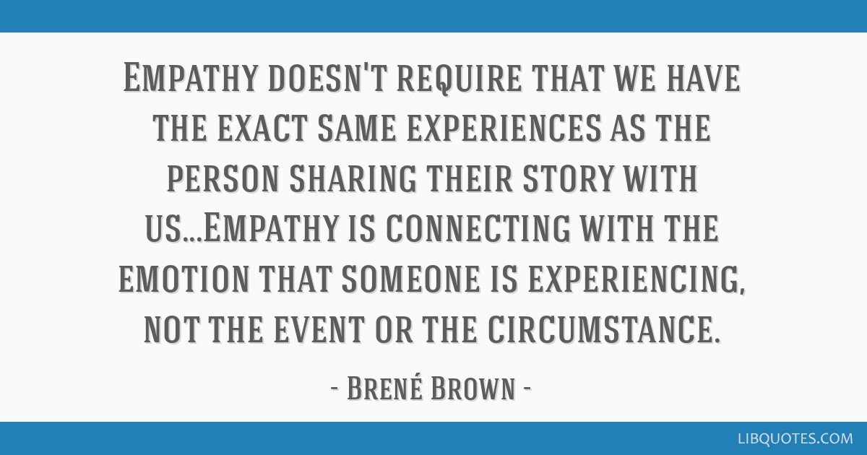
Empathy
The ability to understand and share the feelings of another.

Slide 42
Primary Traumatic Stress vs. Secondary Traumatic Stress
Primary Traumatic Stress
Secondary Traumatic Stress
First-hand exposure to a traumatic event.
Survival responses activated in the brain.
Response to the traumatic event is extreme fear, sadness, shame, anger, etc.
Indirect exposure to a traumatic event.
Result of empathic response within the helper.
Response to secondary traumatic stress can result in compassion fatigue or burnout.

Slide 43
Compassion Fatigue
Sometimes referred to as “vicarious traumatization”
“The emotional residue or strain of exposure to working with those suffering from the consequences of traumatic events” – The American Institute of Stress
Notes:
https://www.youtube.com/watch?v=-3yxouKWVTU

Slide 44
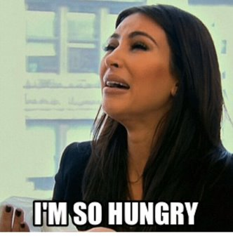
Lunch Time!

Slide 45
Chapter 4.0
TRAFFICKERS, BUYERS, & RECRUITMENT

Slide 46
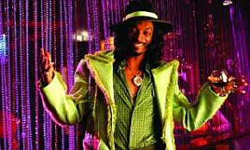
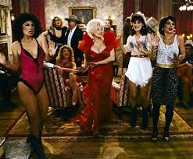
What Society THINKS a Trafficker Looks Like
Notes:
M&R
Ask for other imagery from the class

Slide 47
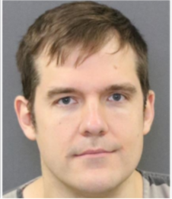
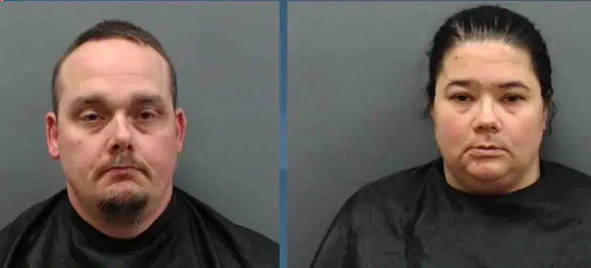
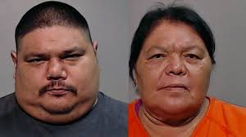
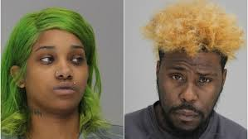
REAL Faces of Traffickers
Notes:
M&R
--“The 17-year-old was eliciting explicit photos from other minors and distributing them to Brian Mohr, a teacher at the HS. There was also evidence he used the photos to coerce the minors into sexual activity”
--27, pleaded guilty last year to charges of sexual assault of a child under 17, human trafficking and compelling prostitution. Prosecutors accused her of a monthlong pimping operation where she raped the teen, forced her to solicit strangers for sex in southwest Houston and made her see buyers at their homes or in a motel room on F.M. 1960.
--Christopher James Regan, 38, and Tanya Marie Regan, 35, made and distributed child pornography, with intent to sell it.
Mr. Regan was sentenced to 90 years and Ms. Regan was sentenced to 50 years in prison.
--Margarita “Rita” Martinez, 61, and her son, Genaro Fuentes, 36, were arrested by TABC agents July 31. A Hidalgo County grand jury indicted Martinez on charges of human trafficking, 15 counts of aggravated sexual assault, 14 counts of sexual assault of a child and one count of manufacturing/delivering a controlled substance.
--Detectives arrested James Duncan, 37, and Katheryne Sneed, 23 on sex trafficking charges. Point out that Katheryne was most definitely a victim before she was 18, and is not his “bottom”, but is also now a criminal.

Slide 48
The Buyers
Most common Buyers, or “Johns” are educated, employed men with enough disposable income to engage in these activities (Urban Institute, 2019)
It is estimated that 15%--20% of American men have purchased sex at least once (Office of Research and Evaluation, National Institute of Justice, 2008)
Examples of customers:
Law enforcement, lawyers, construction workers, truckers, business men, social workers, pastors, city employees (Ohio Attorney General, 2012).
Notes:
M&R
What do you think of when you hear the word, “Buyer” or “John”? Who is the most famous of Buyers???? (Jeffrey Epstein)

Slide 49
Recruitment of a Youth in Foster Care
Traffickers are meeting basic needs that are otherwise not being met
LOVE, housing, food, clothing (sometimes very nice and expensive, other hygiene products, consistency, “family”, transportation
Using social media to find vulnerabilities (e.g. “had a fight with my mom….”, troubles at home, etc., “Not feeling cute today”
Youth are often approached within hours after running away from home/placements
400 teens are sold on the streets of Dallas EACH NIGHT (New Friends, New Life, 2019)
Notes:
M
Have class refer to Destiny and point out her risk factors and what would make her vulnerable…run away, social media, etc.

Slide 50
Signs and Identification
•Unexplained bruises, cuts or marks
•Youth exhibiting fear, depression, anxiety, submission, tension, nervousness
•Excessive calls from boyfriend/girlfriend or fear of displeasing partner
•Unexplained shopping trips or possession of expensive clothing, jewelry, cell phone
•Hypervigilance or paranoid behavior
•Referring to boyfriend as “daddy”, relationships with older men
•Secrecy or defensiveness regarding whereabouts
•Tattoo that could represent branding
•Multiple STDs or pregnancies
Notes:
R

Slide 51
Internet Safety
Notes:
R
Common apps, other places to go for tips for safety: NCMEC.org for their online courses, etc. Look at examples, etc.

Slide 52
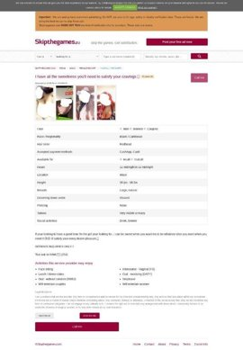
Skipthegames Profile

Slide 53
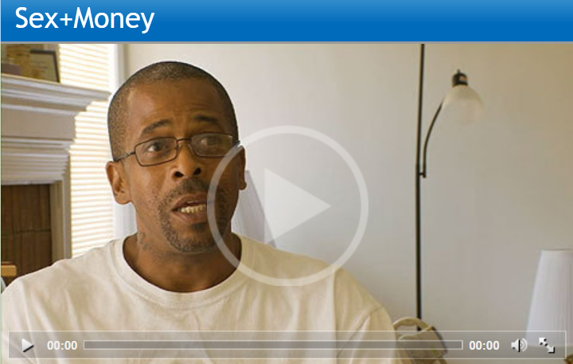
Chatting With a Trafficker
https://www.wingclips.com/movie-clips/sexmoney/pimp-psychology
Notes:
Discussion
Cycle, similar to that of the DV cycle, leave and return 5-7 times…

Slide 54
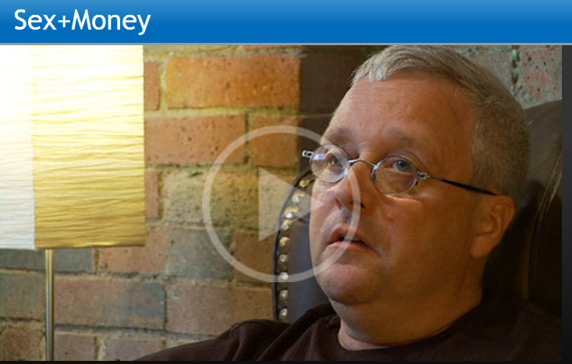
Chatting with a Buyer
https://www.wingclips.com/movie-clips/sexmoney/pastor-testimony
Notes:
Discussion. The language he used—” Street walker”. “Knowing that I would do it again”

Slide 55
Survivor Story: From Victim, to Survivor, to Leader
Notes:
Time? Feels in the room???
https://www.youtube.com/watch?v=odASOknP1kY

Slide 56
Chapter 5.0
SAFETY PLANNING, ENGAGEMENT, & ADVOCACY

Slide 57
Meeting the Youth Where They Are
Don’t try to rescue them!
Notes:
Megan’s Favi story. Introduction to tools. Talk about empowerment vs rescue.

Slide 58
11 Characteristics of an Effective Advocate
Fearlessness
Discerning
Adaptable
Integrity
Leader
Initiative
Principled
Emotional Stability
Approachable
Confident
Team Player
Notes:
R
HANDOUT: Tell story about how SI gave these characteristics to us. Discuss characteristics, and which ones are most important, leveraging these characteristics, etc.

Slide 59
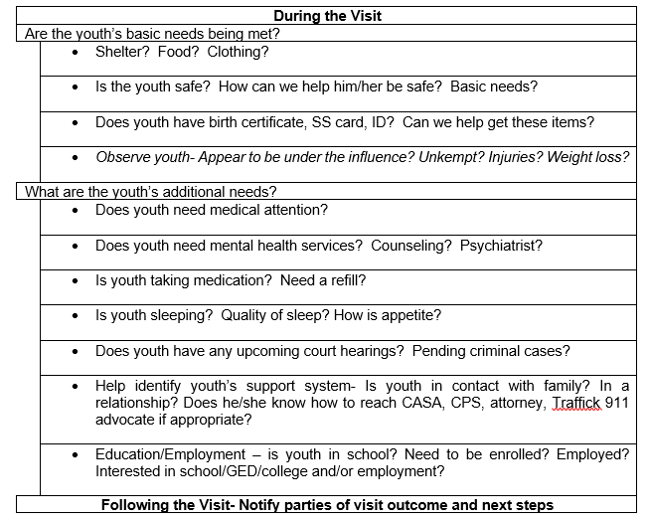
Safety Plan for Face to Face Visits with High Risk Youth: Dallas Example
Notes:
M
Handout! Explain purpose of the safety plan, that you will be completing it WITH your supervisor at various times during a case, depending on the need, and that it is not all-encompassing. Go through the worksheet, ask questions of the audience why it’s necessary to consider these questions, etc.

Slide 60
Developing a Safety Plan
Refer to Julie’s case example. Complete the Safety Plan for your visit based on the following scenarios:
First visit with Julie at her foster placement.
Recently recovered from running away, and she is staying at the CPS office awaiting new placement.
Living with baby’s father/boyfriend in unauthorized placement.
Notes:
***SPECIFY WHAT AGE DESTINY IS FOR #1
Zoom Breakout rooms. Small groups--3 to 4 in each. Work on Safety Plan, 10 mins. Report back to large group.

Slide 61
Reflection
How can you support a youth who may not understand that they are a victim- -that they are experiencing exploitation or being trafficked.

Slide 62
Chapter 6.0
CORE COMPETENCIES & UNDERSTANDING TRAUMA

Slide 63
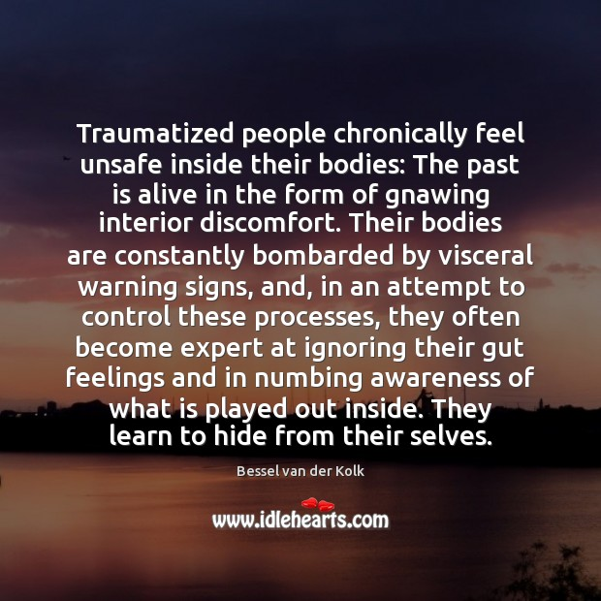

Slide 64
Neuroplasticity
“…Refers to the physiological changes in the brain that happen as the result of our interactions with our environment. From the time the brain begins to develop in utero until the day we die, the connections among the cells in our brains reorganize in response to our changing needs. This dynamic process allows us to learn from and adapt to different experiences” – Celeste Campbell (n.d.).

Slide 65
Core Competencies: Core Knowledge
Basic understanding of the risk factors, indicators, and dynamics of commercial sexual exploitation.
Basic understanding of child-serving systems and how various agencies intersect.
Notes:
Page 49 Companion guide

Slide 66
Core Competencies: Impact and Dynamics of Abuse, Neglect, & Trauma
Basic understanding of child abuse and neglect and its application to victims of commercial sexual exploitation.
Basic understanding of complex trauma, polyvictimization, and toxic stress, how they impact children, and their application to victims of commercial sexual exploitation.
Basic understanding of how trauma impacts providers servicing victims of commercial sexual exploitation.
Notes:
Pg. 39 in Companion Guide

Slide 67
Core Competencies: Informed Application of Skills
Application of the skills for working with children who have experienced trauma to child victims of commercial sexual exploitation.
Notes:
Page 39 in Companion Guide

Slide 68
Trauma-Related Diagnoses
Post-Traumatic Stress Disorder (PTSD)
Anxiety/Depression
Eating Disorders
Suicidal Thoughts
Self-Injury
Substance Abuse
Acute Stress Disorder
Dissociative Disorders
Other common diagnoses:
Oppositional Defiant Disorder (ODD)
Conduct Disorder
Bipolar Disorder
Notes:
PTSD – Life threatening experience with re-experiencing, avoidance, change in cognition/mood, hyper arousal, over 1 month
Acute Stress Disorder – 3 days to 1 month
Reactive Attachment Disorder – Withdrawn from caregivers, social disturbance, early attachment difficulties
Adjustment Disorder – behavioral or emotional reaction to difficult life change
Other Specified Trauma/Stressor Related Disorder – Adjustment disorder more than 6 months
*** Specific diagnoses is less important than understanding symptoms, triggers, etc
*** Diagnostic manual has specific ages, timeframes, symptom check lists, time of onset, etc. so someone may have experienced something really, really traumatic and not meet criteria for PTSD….this doesn’t mean the trauma wasn’t “real” or that the impact is less
*** Other MH diagnoses have similar symptoms, often without connection to the trauma; difficult to assess, may change over time and with further understanding of the child’s history and functioning

Slide 69
Evidence Based Trauma Treatments
Trauma-focused Cognitive Behavioral Therapy (TF-CBT)
Eye Movement Desensitization Reprocessing (EMDR)
Other promising practices
Cognitive Behavioral Therapy (CBT)
Seeking Safety
Trauma-Focused Coping (TFC)
Somatic Experiencing

Slide 70
Adverse Childhood Experiences (ACEs)
Complete the ACE’s test for yourself and then for Julie.
Compare.
How might HER score impact visits and interactions?

Slide 71
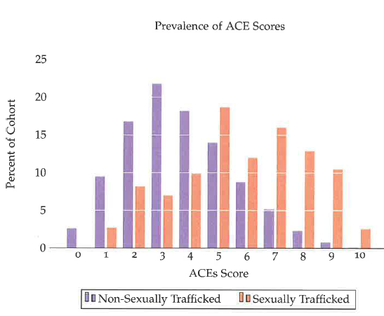
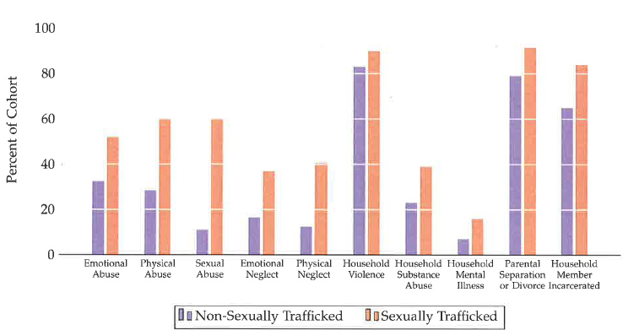
ACE Score in CSEY
Breakdown of Questions
Total Scores

Slide 72
Resiliency
7 C’s of Resilience
Competence
Ability to handle a situation effectively
Confidence
Believing in personal abilities
Connection
Creating a sense of belonging
Character
Having a solid set of morals and values to help determine right from wrong
Contribution
Feeling like a valuable member of society
Coping
Ability to handle stress in a healthy way
Control
Knowledge and ability to affect an outcome

Slide 73
Building Resiliency in Survivors
Safety
Strengths-Based approach
“What happened to you” vs. “What’s wrong with you”
Collaboration
Empowerment, voice, and choice

Slide 74
Self-Care Strategies
Identification and awareness are critical.
Self-Care!
Find someone to talk to (CASA Supervisor or professional mental health provider).
Rediscover things that are fun/important to you outside of your CASA work.
Utilize self-compassion techniques.
Use positive ways to cope with stress.
Exercise, meditation, journaling, expressive arts, etc.
Take a break.

Slide 75
Stages of Change
Pre-Contemplation: Denial, no need to change, actively rejects the idea of change
Contemplation: Recognize the impact that the behavior has on life
Preparation: Looking at alternatives, making plans for change
Action: Actively made commitment to change
Maintenance: maintaining change
Relapse: a slip back
Notes:
M
HANDOUT. Background on Stages of Change, developed to address and understand substance abuse. Rachel Lloyd of GEMS was first to utilize the model when working with CSEC.

Slide 76
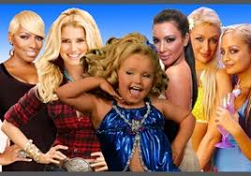
Stages of Change: Quitting Reality TV

Slide 77
The Stages
Pre-contemplation: Watching 2 hours a night of reality TV…because it’s fine. I don’t want to be judged.
Contemplation: Unaware of current events in the world because of not watching the news, or paying attention to current affairs. Missed friend’s birthday party because I chose to stay home and watch The Bachelor.
Preparation: Implemented watching 10 mins a day of actual news…unfollowed Real Housewives on Insta
Action: Cancelled all DVR recordings, goes to Zumba class on Mondays in place of watching The Bachelor
Maintenance: Subscribes to daily news podcast, cancelled cable all together
Relapse: Started dating someone who loves reality TV…
Notes:
R

Slide 78
Name That Stage of Change- Poll
After she has run away the first time, she calls you but won’t tell you where she is….
She has agreed to meet with school counselor at Dallas CAN
Has run away again from her relative’s home, you see on her Facebook page that she posted a pic of her new tattoo which is Tony’s name…
Notes:
R
POLL You can go back and forth through the stages of change. Just as they say in substance abuse recovery, relapse is part of recovery, so a relapse does not equate to a hopeless, terminal situation.
Guide: 1. Contemplation 2. prep 3. relapse Discussion questions: What strengths can you find in each scenario? How would you support her in these scenarios.

Slide 79
Stages of Change: CSEY
Pre-Contemplation: “He’s my boyfriend”, “He takes care of me”, “These people are my family”. Denies being exploited.
Contemplation: “I want to leave, but he’ll find me. There’s no point.” Youth may call you but won’t tell you where they are. Often an external event has confronted the youth, such as an arrest, getting pregnant, rape, new girls, etc.
Preparation: “I want to leave, but I need to save money first”, “I still love him, but I don’t love THIS.” Thinking about alternative ways to earn money; may engage in limited counseling or groups.
Action: “I can see myself going back to school”, “I feel different ‘out here’ “, Working towards school/GED goals, has a job, etc., less running away from placements.
Maintenance: “I can’t believe I wasted so many years of my life. It’s like I never had a childhood.” “This new life is good, but it’s a little boring. No drama.” Is stable in placement, making new connections, developing new skills, and is more open to addressing trauma.
Relapse: “It was too hard—I don’t fit in”, “I was making minimum wage, but can earn more on the streets”, “he loves me and misses me, and I miss him”. Runs away from placement, has made contact with old friends or the trafficker, may have a new social media page with lots of followers.
Notes:
M

Slide 80
Chapter 7.0
IMPACT OF CSE & EMPOWERMENT
Notes:
Tying the trauma stuffs together, referring back to tools

Slide 81
Maslow’s Hierarchy of Needs
Notes:
R
Meeting the child where they are, focusing on needs as they present, through observation and what child is reporting. Focus on her goals, not the goals you might have for her.

Slide 82
Assessing and Meeting Needs
Intangible Needs
Tangible Needs
•Housing/placement
•Basic necessities: food, clothing, toiletries
•Education
•Job/job training
•Legal advocacy/representation
•Medical care
•Counseling/Mental Health treatment
•Safety Plan/ “Relapse” Plan
•General case management
•SAFETY
•Nonjudgmental environment
•Respect
•Engagement in positive community
•*Healthy adult relationships and role models
•Understanding of the recovery process/Stage of Change
•Opportunities to learn new skills/Life Skills
•Self-Empowerment
•Love

Slide 83
Activity: Three’s Company/ Three's Consulting Company

Slide 84
Involving the Child or Youth in the Process
Three’s Company:
Choose a personal problem you don’t mind talking about with 2 other people.
2 Consultants, 1 Client
Client: you have 2 minutes to tell the consultants about your problem.
Consultants: YOU MAY NOT ASK ANY QUESTIONS!!!
After 2 minutes: Consultants have 2 minutes to ask clarifying questions of your client.
After 2 minutes, Client: turn away from the consultants (turn off camera, take a small break, etc). Consultants: have 2 minutes to discuss your client’s problem and solve it! DO NOT ASK ANY MORE QUESTIONS.
Notes:
M
Zoom breakout rooms: 3 to each room. Send messages to the rooms for timers, instructions, etc. --Refer to T video…how important it is to involve the child…
Discuss in large group. Hint: cannot get the full problem in 2 minutes, need more time to share, need more time to ask questions, cannot solve the problem without the client involved, etc.

Slide 85
Reflection
How do we build trust and set realistic expectations to support youth in this population?

Slide 86
What to Expect From Your Supervisor
Support
Connection to Resources
Invitations to Trainings
Continued/ongoing safety planning
You will continue with your current supervisor

Slide 87
Thank You!
Saving Innocence
Texas CASA
National CASA/GAL Association
EarthX
The Office of Governor Greg Abbott
Texas Council on Family Violence
4WMedia
T. Ortiz
Leah Albright-Byrd
Good Pitch
Lekha Singh
Tiffany Kiernan
Quan Tran

Slide 88
We're Done!
Notes:
https://www.youtube.com/watch?v=7wB0tbCeeao

