Slide 1
Local Board of Director (LBOD) FY24 Training

Slide 2
The Roles and Services provided by National CASA, Texas CASA and your program.

Slide 3
The role of National CASA/GAL Association is to strategically establish, promote and support the formation, recruitment, training, development and activities of highly effective member programs.

Slide 4
Establish the core model for CASA/GAL advocacy
Promote, manage, conduct and encourage evidence-based research, scholarship, education, training and the distribution of information in, between and among volunteer CASA and GAL programs
Lead a child advocacy movement through public education and awareness regarding children and youth who have experienced abuse or neglect

Slide 5
Develop and disseminate materials to promote the CASA/GAL program and increase the public’s awareness resulting in increased volunteers, donors and other program supporters
Build and protect the National CASA brand
Establish CASA/GAL standards and ensure achievement through a quality assurance process
Develop and provide a national standardized curriculum that trains volunteer advocates and staff to deliver positive outcomes for children

Slide 6
The Role of Texas CASA

Slide 7
Provide support to local programs in areas of advocacy, governance, communications, administration, finance/risk and volunteer recruitment and retention
This Photo by Unknown Author is licensed under CC BY-SA

Slide 8
Oversight for Quality Assurance and Standards Compliance

Slide 9
Pass-thru Funding
VOCA and
HHSC funds
Guide to Grants
This Photo by Unknown Author is licensed under CC BY-SA

Slide 10
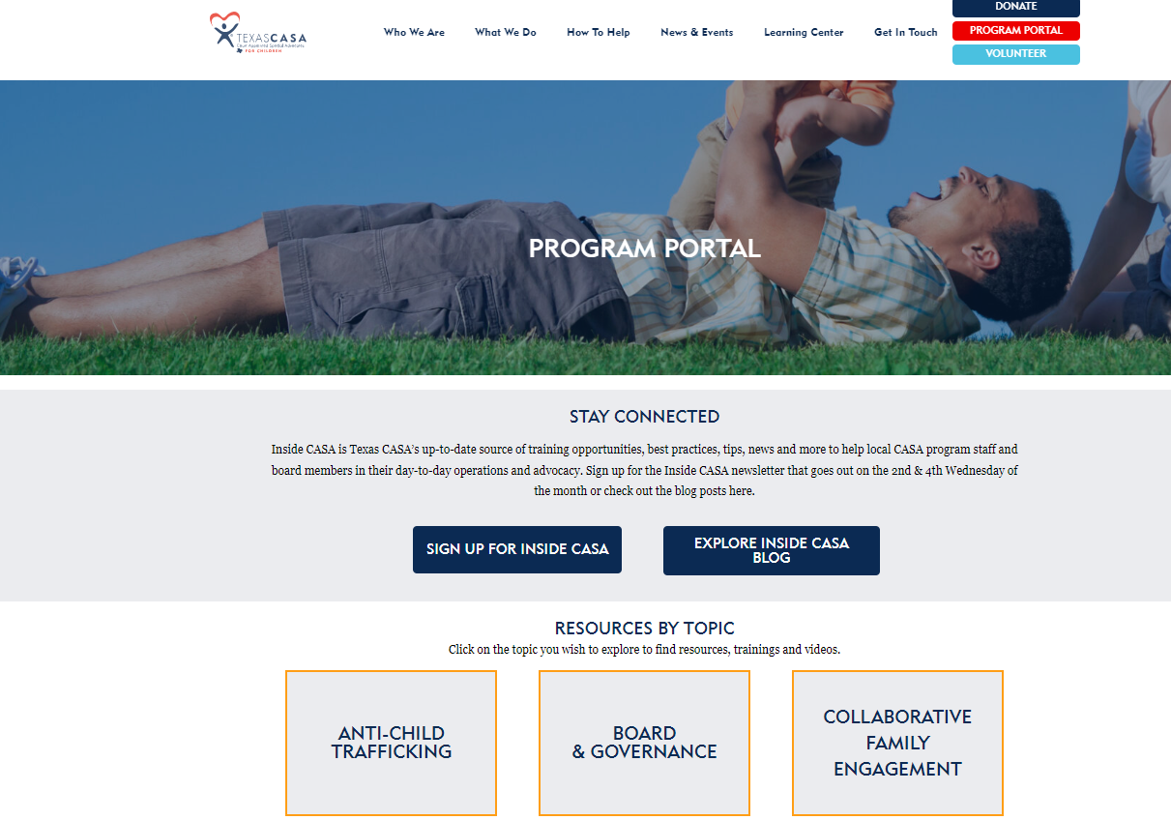
Texas CASA Program Portal
https://texascasa.org/program-portal/board-governance/

Slide 11
Your Local Program
Has a mission statement that is:
Written
Consistent with the National CASA/GAL Core Model
Adopted by the board
Inclusive of Volunteer Advocacy
Approved by Texas CASA

Slide 12
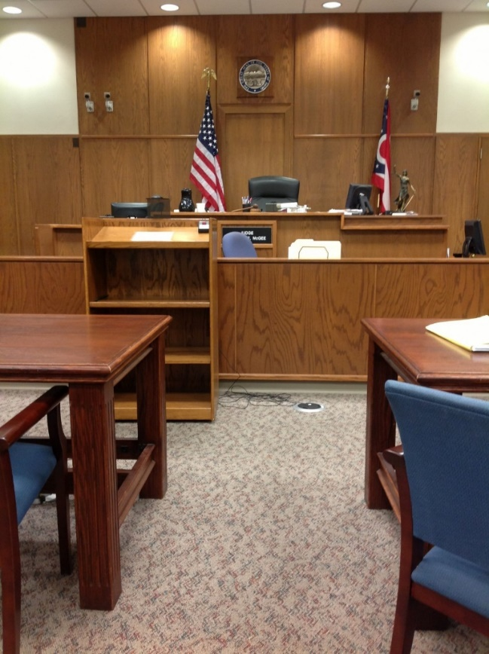
CASA’s role in the Child
Welfare System
GAL Role
Best Interest
https://texascasa.org/understanding-the-roles-in-a-cps-case/

Slide 13
Roles and Responsibilities for CASA Boards

Slide 14
Ensure Effective Organizational Planning
Planning occurs at various levels depending on many circumstances such as the nonprofit’s size and organizational complexity, but most boards focus on creating a comprehensive plan that accounts for each of the following topics:
Recruitment and Retention Planning
Fund Development Planning
Diversity planning
Strategic Planning

Slide 15
CASA Board standards
Minimum of nine Board members
Terms and term limits
Simple majority quorum
Minimum of four meetings a year
Review all required policies every 3 years (Emp, Vol, Conflict of Interest, Weapons, Confidentiality, Code of Conduct etc.)
Committees must include Finance and Executive
Executive Committee must at minimum Pres, VP, Sec, and Treas
This Photo by Unknown Author is licensed under CC BY

Slide 16
CASA Board Recruitment and Onboarding
Written Application
Conducts an in-person interview
Obtain completed reference check on three or more unrelated to applicant.
Age 21 or older
Consent and release to conduct all background checks
Signed and dated confidentiality and conflict of interest.
This Photo by Unknown Author is licensed under CC BY

Slide 17
CASA Board Education-Annual and Orientation
Guiding Principles
Cultural Diversity
Applicable laws and regulations
Core Model
Texas, National and local CASA/GAL services and roles
Applicable goals, objectives, structure and methods of operation
Financial oversight
Court and Child welfare
Program Governance
LBOD attendance by one member at least
This Photo by Unknown Author is licensed under CC BY

Slide 18
CASA Board Renew
Board Recruitment Strategies include:
Election and Screening Processes
Utilize written plan or Board Matrix to identify gaps and overlap.
Community reflected in members

Slide 19
CASA Board Meetings
Board meetings approved or signed by the board secretary or designee and includes attendance and absences, agendas, dates of meetings, topics covered, and decisions or resolutions if applicable.
Standing Committee minutes, includes attendance and absences, agendas, dates of meetings, topics covered, and decisions or resolutions if applicable.
Quorum required for vote.
This Photo by Unknown Author is licensed under CC BY-SA

Slide 20
Provide Sufficient Resources

Slide 21
Make Sure the Organization Fulfills Legal Obligations
Tax-exempt organizations must adhere to several rules in order to maintain their status.
It’s up to board members to be aware of applicable federal, state, and local laws and ensure the nonprofit meets those requirements.
Annual Financial Audit

Slide 22
Provide Proper Financial Oversight
An important part of effective nonprofit management is ensuring revenue is properly managed. Because organizations are granted tax-exempt status by law to fulfill a public need, the board’s obligations extend beyond the organization’s stakeholders.
Funding anticipated during the CASA/GAL program year that is based on
CASA/GAL program goals and objectives.
Fixed and incremental costs of operating the CASA/GAL program and
identification of potentially changing costs.
Review, approval and documentation of any budget deviations.
No more than 50% dependence on funding through HHSC.

Slide 23
Provide Proper Financial Oversight
Independent audits, financial reviews or compilations are required annually.
A financial audit, review or compilation is completed within nine (9) months following the close of the fiscal year, and the audit is submitted to Texas CASA by the designated deadline. The audit must contain a separate schedule of all funds provided under HHSC and VOCA contracts and a Statement of Functional Expenses.
A designated committee of the governing board, such as a finance or audit review committee, or a designated member of the governing board, reviews the audit findings and meets with the independent auditor as necessary.

Slide 24
Audits (continued)
The auditor’s report is reviewed and formally approved or accepted by the governing board and is made available for public inspection.
When a management letter has accompanied the audit, the governing board promptly reviews and ensures that the recommendations are implemented.
The CASA/GAL program sends to Texas CASA any audit findings or questioned costs from any private or government audit/monitoring report within 60 days of receipt of findings.
CASA/GAL programs receiving grant funding through National CASA/GAL Association may be subject to additional financial oversight.

Slide 25
Select and Evaluate the Executive Director

Slide 26
Improve the Organization’s Public Standing
As part of their core duties, board members should publicly advocate for the organization to help maintain a positive standing within the community. For the most passionate board members, this responsibility comes naturally. When networking, they should aim to ignite that same enthusiasm for the cause in others, including their friends, families, and professional connections.

Slide 27
Measuring Success
In order to assess how well your board of directors is fulfilling their nonprofit board responsibilities, it’s important to regularly look at how you’re doing. A standardized assessment can give you the data you need to keep making improvements!
Self-assessment
Peer-to-peer assessment
Assessment by executive director
Assessment by an external consultant

Slide 28
Avoid Overreach
Find the balance within the board to avoid overreach and provide oversight.

Slide 29
Review Your Strategic Plan’s
Goals
Objectives
Persons Responsible
Timelines
Track and Review Annually
Record in the minutes when reviewed

Slide 30
STANDARD 2 GUIDING PRINCIPLES
A. Integrates the following guiding principles into all aspects of CASA/GAL program practices, policies and procedures:
1. Recognize the importance of family preservation and/or reunification:
a. It is in a child’s best interests to remain with their family of origin when safely
possible.
b. The CASA/GAL program acknowledges that children experience trauma when
separated from their family of origin.
c. If a child is removed from their family of origin, it is in the child’s best interests
to be reunified with their family of origin as soon as safely possible.
d. If a child is removed from their family of origin, the child should be placed with a
relative whenever safely possible and in the child’s best interests.
e. Strengthening families, through recommendations for services, supports,
visitation and communications, is in the child’s best interests to achieve stability
and/or reunification.

Slide 31
f. The CASA/GAL program requires and demonstrates respect for the parents and
all parties associated with the case.
g. The CASA/GAL program ensures that information regarding the family’s
strengths is incorporated into reports to the court.
h. The CASA/GAL program ensures that information regarding the child’s wishes
is incorporated into reports to the court.
i. When a court determines a child cannot be safely reunified with their family
of origin consistent with legal mandates, another permanent placement is in a
child’s best interests.

Slide 32
Recognize the importance of diversity, equity and inclusion:
a. All children regardless of age, race, ethnicity, national origin (ancestry), color, religion (creed), gender, gender expression, sexual orientation, disability or physical challenge, or socioeconomic status should be safe, have a permanent home and an opportunity to thrive.
b. The CASA/GAL program acknowledges the existence of implicit bias and takes steps to minimize and/or eliminate implicit bias.
c. The CASA/GAL program demonstrates an understanding of disproportionality impacting children who are in the child protection system due to allegations of abuse or neglect.

Slide 33
FY23 Local Board of Directors (LBOD) training series
https://texascasa.org/resources/fy23-lbod-training/

Slide 34
CULTURAL DIVERSITY EDUCATION SHORT CLIPS

Slide 35
STAY CONNECTED

Slide 36
QUESTIONS?

Slide 37
THANK YOU

